Slide 1
2. Celebrification of media
Graeme Turner (2015) The Reinvention of Media. The impact on celebrity news in transforming media.
“Celebrity News would have been an oxymoron – once”
Notes:
Want to turn now to a second term, celebrification - a term coined by Graeme Turner.
Celebrification is an extension from tabloidization, centred more fully on the celebrity.
Ordinary people becoming celebrities – Adele – even the nature of the Flipping Heck story that might become relevant – its tone, its lacl of criticality. How else could this story have been framed?
Spot the hard news in our main quality newspaper.
Turner argues that celebrity is not just a topic of interested it is more as a process has penetrated all of our lives – many of us now self-style ourselves as celebrities, on social media, as youtube stars - and television is full of ordinary people presenting themselves and being accepted as celebrities. His essay describesd what he believes is the penetration of culture by discourses around celebrity.
Soft news – wedding preparations and a competition to Hawaii, another property story, some celebrity (Adele and our richest man, both celebrities - looks like a celebrity marriage) .
Turner is looking at celebrity in the context of what he calls the reinvention of media - (quite a dramatic claim) argues that celebrification is changing, even reinventing the media itself and fuindamentally, its processes and nature. Always a minor part of all newspapers, celebrity coverage, he argues has become its major engine.
In fact he says CN would have been an oxymoron – why do you think he says that?
Initially the terms – celebrity news - seemed an oxymoron, devaluing the currency of more conventionally serious news: now lost this sense of dissonance as so-called ‘news’ magazines can be purely celebrity, with some human-interest stories thrown in (Kiwi battler – stories of challenging diseases, difficult children, frightening holidays and so forth)

Slide 2
Celebrification - STATE OF PLAY
Celebrification has spread from the ‘red top’ tabloids to the quality press
Rise associated with commercialization; entertainment now provides information as media ownership has become concentrated
Celebrity has always been popular, but what has changed is the preparedness of the media to transform itself
World of celebrity and the everyday seems more porous than ever (Big Brother, The Bachelor, PewDiePie)
Social media has adopted the hybridized (public and private) process of self-fashioning individuals
Everyone can imagine or style themselves as a ‘celebrity’
Construction of politicians as celebrities, conducting policy through Twitter.
Notes:
Turner makes a unique contribution - most discussion of celebrity’s pervasiveness has focused on power, ubiquity and superficiality, rather than looking at the character and the scale of industrial changes that have occurred in newsgathering and journalism. These changes have followed the expansion of the production of celebrity content for the mainstream media.
So let’s walk through his argument. (column i)
Pervasiveness spread from “redtop” tabloids into front pages of sites and papers with high­er quality aspirations, permeating and displacing more serious modes of news.
The increase in celebrity content has occurred in concert with economic downtown and commercialization, the rise of entertainment as a major way of getting information, and the increasing concentration of media ownership. So return to media ownership, why would concentration lead to more celebrity news?
Celebrity stories have always popular, and were one of the ‘most-read’ categories in 1963, what has changed is the extent to which media has skewed their content to satisfying these preferences.
Broader changes in culture – the World of celebrity and the everyday seems more porous than ever. Porous – interchangeable …Ordinary people appear to achieve visibility and attention associated with celebrity: reality shows starting with Big Brother, now The Bachelor etc., or lifestyle and makeover formats. And we have the rise of Youtube celebrities, PewDiePie.
This is also to do with our personal Social media practices – as social media has adopted the hybridized (public and private) process of self-fashioning seen in celebrity culture. More and more of us are constructing personae and marketing ourselves: this has also developed in the political sphere with the construction of politicians as celebrity—to the point where Donald Trump is conducting foreign policy through social media, Twitter.

Slide 3
Celebrification -changing news processes
Regular News | Celebrity News
Seeking out sources | Managed by celebrity machine
Produced for informational purposes | Produced for commercial purposes
Research, shape ‘finding story’ | Provides story ‘ready to run’
Newsgatherer, fact checker | Filtering agent, witness, ‘captured’
Notes:
Turner argues that many of the practices to gather celebrity news are significantly different than what termed regular news. Let’s look at a comparison here.
Regular journalism: going to a source to seek out hidden or at least, unknown information, exploring the world and its stories
Celebrity: Overwhelmingly managed by those who are generating it by the celebrities’ own machine – the celebrity or publicists come to the journalist.
Regular journalism: produced for informational purposes (4th estate) to inform us as citizens
Celebrity: Produced for commercial, rather than informational, purposes – to sell tickets, albums, the celebrity endorsements
Regular journalism: the journalist has to independently research, shape and find the story in her or his material, then checks facts
Celebrity: Promotional industry does as much as it can to make sure ‘ready to run’ – journalist has to do little. Tailored video, high quality stills – journalist as more as a filtering agent rather than news-gatherer (no independent investigation, fact-checking or backgrounding)
Journalist thus are merely witnesses, the event (and the promotion, concert, event) becomes the news – journos cooperate as they are then kept in the loop and given access hence, rather like in the political sphere they are what is known as being ‘captured by their sources’. Refresh on memory on what this means?
An idea of interdependence and cooperation (journalists and celebrity). It does happen also with business and political commentary but most routinized and industrially embedded with celebrity.

Slide 4
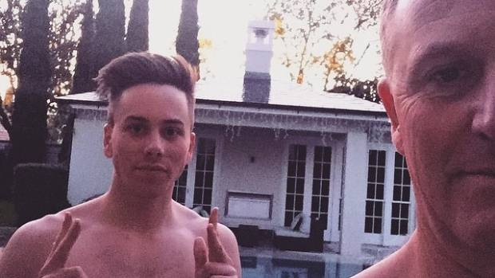
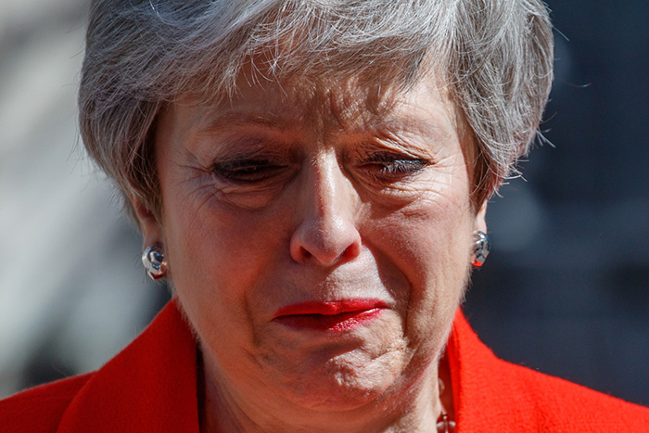
Celebrification - the rise of the image
http://www.tmz.cm/
Notes:
Image – sometimes called Photojournalism – its historical origins lie at the time when newspapers began to publish images of individuals in late 19C, this shifted public interest away from assessment of the subject’s achievement or actions to that or his or her image.
Turner also suggests celebrification has changed how images are used. Rather than illustrating the story, the image becomes the story. The image used to be gathered by a staff news photographer, someone who accompanied a journalist to illustrate a news item (as in 1)
Then in comes the paparazzi - independent photographers who take pictures of celebrities typically while subjects go about their usual life routines. Paparazzi tend to make a living by selling their photographs to media outlets, most often the tabloids.
But now even they are being chased out –challenged by several trend - the amateur photographer/stalker who using the superb technologies now available either take, and sell, pics themselves - or alert P to the movements of celebrities The second trend and Margaret referred to this re sports celebrities is cutting out the middleperson altogether and representing themselves directly to their audience through websites blogs social media instagram, communicating directly with fans, bypassing the promotions industry and the news media altogether - although what is said on these celebrity sites and through social media does itself rapidly become news.
This might be all well and good, but when we have the celebrification of politics, most perfectly through the President of the US, reputedly the most powerful man in the world, and a former celebrity, suggesting that his constituency - effectively the world's people - bypass the media and go straight to his Twitter feedfor the truth, we have a sense of how the self-fashioning of celebrification might mean that the most powerful are never held to account by a media that by definition is meant to hold truth to power.
So some examples here - May more standard shot (although the editors will often chose an image that seems in tune with the reportage), and a more candid shot (candid- capturing someone unrehearsed) of M crying. We saw the increasing use of ‘candid’ shots from mid-1980s (Margaret Thatcher snapped leaving Downing St for the last time). Then there is the ‘red carpet photography’, staged and structured by the celebrities and their teams of promotors. Now even the promotors and celebrity press photographers are being left out as stars increasing produce their own images - which of course are then readily picked up by all media, for nothing.
.

Slide 5
Celebrification - paparazzi
Notes:
One of the most notorious paparazzi instances – Princess Di, still generates the most conspiracy theories.
Princess Diana, formerly married to Prince Charles and the mother of course of Wills (now married to Kate) and Harry (now married to Meaghan) was stalked her with her new boyfriend Dodi Al-Fayed, himself something of a celebrity son of an Egyptian billionaire who owned Harrods.
Famously and notoriously, it was the paparazzi that drove Diana to her death - a case where her driver, slightly drunk took up challenge a raced from paparazzi. Although the population was disapproving of the P, of course the gross and deadly photos of Diana and Dodi - which I won't show here - fetched a fortune.
http://www.dailymail.co.uk/news/article-485294/Published-time-Coroner-releases-amazing-pictures-Diana-car-took-death.html
http://www.dailymail.co.uk/news/article-490362/Dianas-car-took-like-jet-Paparazzi-bike-rider-tells-princesss-day.html
There is the grubby authenticity look of P shots, grainy, blurry, long lens – often a series of shots, rather than a single one, apparently penetrating to the ordinariness of the celebrities’ life. The theme is often that C are just like us ..complex relationships, less than perfect bodies, under all the glamour, ordinary lives.
As Turner points about, these types have photos have moved from being staples of tabloid news, becoming routine elements of mainstream news production again impacting on the typical processes of newsmaking.

Slide 6
Celebrification – gossip as news
Notes:
Gossip as news
Further distinguishing factor Turner makes celebrification has introduced an ‘attenuated relationship’ with the facts – rumour and speculation seems adequate for celebrity news. This indeed could have opened up the road the ‘fake news’ – and all the subsequent debates – as fake it indeed seemed to be.
So let’s unpack again - celebrity news does not need to be true. Does anyone here think any of these reports might be true?
The celebrification of news means that truth and verification has become less important in news generally - and this includes news that can be critically more important that speculating on the lives of celebrities.
Why is this politically important? This subverts the general standard ethical model of truth and verification that is associated with journalism. If gossip or rumour is accepted as news – fewer people will call journalists into account for getting it wrong in what could be considered more important issues.
Whereas stories about Brad or Tom and revenge and love may not impact on us every day, when the most powerful politicians in the world start telling lies, or providing alternative facts, this can have profound implications.

Slide 7
Celebrification - Conclusions
Celebrity news provides entertainment while serving celebrities, their PR, record labels, movie studies, and the media conglomerates.
It is transforming understandings of the need – or not – for truth.
It is changing practices of newsgathering.
‘Celebrity news’ is displacing the populations’ interest in other forms of news
This in turn reduces the scrutiny and accountability of those in power.
Trump as reality star: political coverage becomes a reality show (16.30)
The widespread celebrification of media is structural as well as discursive.
http://www.aljazeera.com/programmes/faultlines/2017/04/trump-show-170410080214061.html
Notes:
Conclusions
CN provides entertainment for its consumer while serving the commercial interests of those with an industrial stake in publicising celebrity, from the celebrity themselves, to the PR machines and record labels, movie studies, and the newspaper conglomerates themselves
It is transforming understandings of the need – or not – for truth.
Adopted a number of practises of news while establishing some of its own, colonizing parts and sometimes all of the sites and platforms once occupied by other versions of the news – celebrification of all news, and the displacement of more conventional news thus weakening public appetite and knowledge.
This in turn reduces the scrutiny and accountability of those in power.
Nowhere more evident now than in the US – with its president a former reality TV star, who now is running aspects of his position like a reality show, and it appears the media is very happy to follow his lead. Politician styles himself as a celebrity, from a celebrity background (16.30) - clear example that the structure of the news was transformed into a reality format (The Apprentice) at the beckoning of a powerful president-cum reality star.
Whereas a fourth estate approach would have analysed whether the candidates were appropriate, how they would impact on all American lives in issues critical to them – death penalty, abortion law, financial regulation, roe vs.wade, policies towards migration – instead, it was coverage of a race.
Profound implications for the US, and indeed for the rest of the world.
Celebrification has significantly changed elements of the industrial structure of news and newsrooms. This is not only because celebrity news is ubiquitous, everywhere, but the rise of celebrity news has changed what the media does and how it goes about it. Therefore, the widespread celebrification of media is structural as well as discursive.
As media move more towards the role of providing entertainment than information and as serious attention to the more old fashioned new formats such as political current affairs declines, then celebrity news may indeed turn out to have played a significant role in displacing the populations interest in other forms of news.
Takes us onto mili-tainment.

