Slide 1
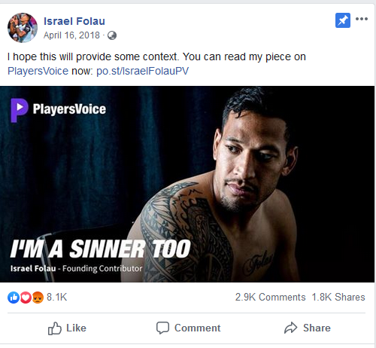
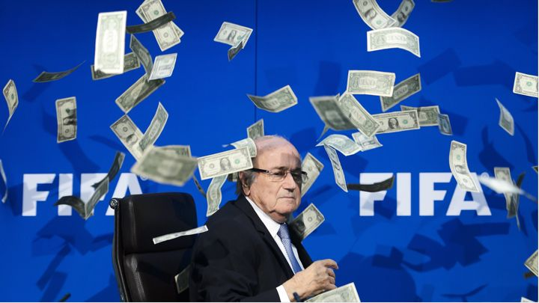
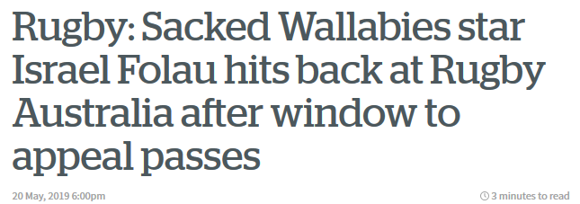
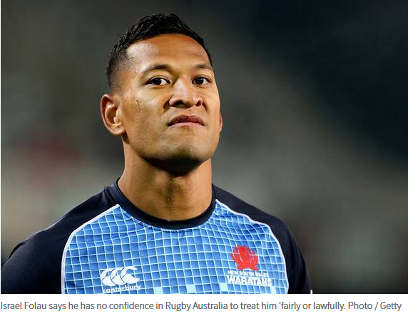
Sports Journalism
‘The longest goodbye: Five players from one rugby team all found to have dementia’

Slide 2
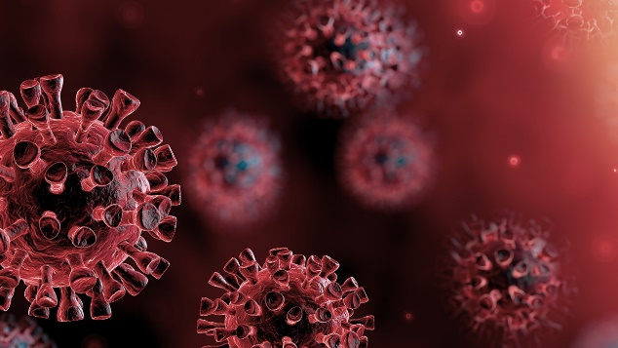
The Impact of COVID-19 on Sports Media
“The novel coronavirus has affected sports like nothing in history. Usually when there is a significant world event, sports serve as a distraction and a way to unify people. In this pandemic, sports is a central part of the story, part of the problem. The virus easily spreads in large crowds...”
To a great extent, the expansion of sports television over the last few decades has relied on live sporting events — not just to generate live event coverage itself, but also to generate content that can be discussed in the many studio shows that also fill these outlets' programming schedules. Without those live sporting events, these many sports television outlets have had to look to alternative programming to fill their schedules.
Sports is going to play a central role in our recovery and getting back to normalcy. When live sporting events return, people will feel safer and better about things. Many events …once people feel safe going to a baseball or basketball game, they will feel safe resuming their normal lives.
A sports journalist is still a journalist, and many have been showcasing their reporting and storytelling skills in news, business and community reporting.
They have told and shared so many good stories.
https://www.shu.edu/communication-arts/news/the-impact-of-covid-19-on-sports-media.cfm

Slide 3
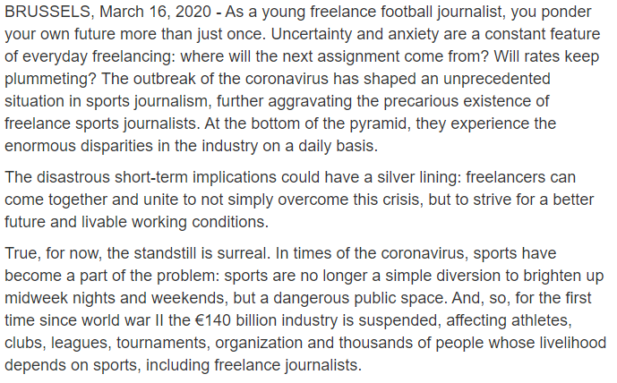
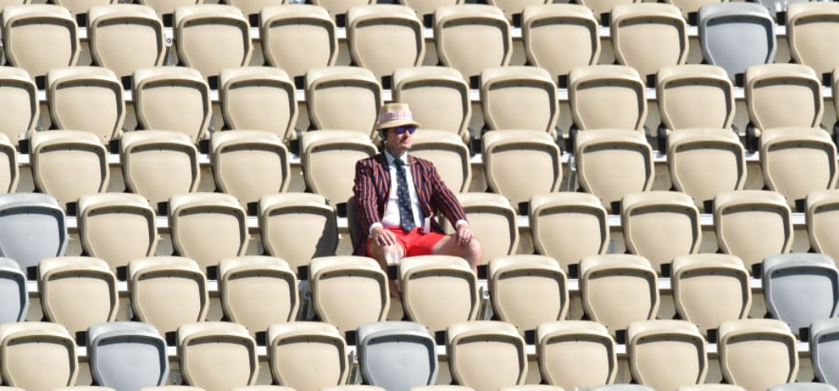
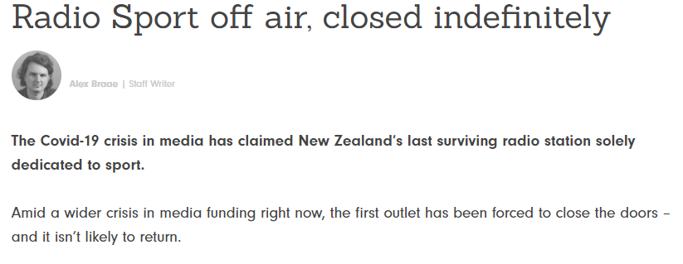
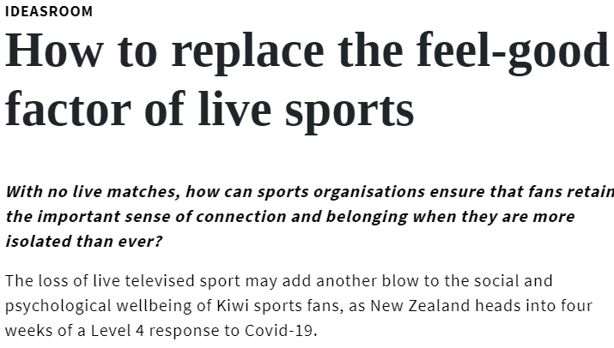
https://thespinoff.co.nz/media/15-04-2020/journalism-in-crisis-nz-media-bosses-at-the-covid-19-committee/
https://www.aipsmedia.com/index.html?page=artdetail&art=27471&CoronavirusSports-JournalismSports-Journalists
https://theconversation.com/cancelled-matches-and-growing-turmoil-the-impact-of-covid-19-on-the-sports-industry-133472
https://www.stuff.co.nz/business/120995004/media-company-nzme-will-cut-its-workforce-by-15
https://www.newsroom.co.nz/ideasroom/2020/03/26/1100138/auckland-op-ed-on-loss-of-sport
https://thespinoff.co.nz/media/30-03-2020/radio-sport-off-air-closed-indefinitely/

Slide 4
Sports Journalism
The ‘Toy Department’ of the news media?
(David Rowe 2007)
Journalists – central intermediaries between sports and society
BUT
Traditionally not considered as one of the serious functions of the fourth estate.
Sport damned as ‘soft news’ with its increasing association with popular culture and entertainment
However the professional sport/media nexus intercepts hard news stories of high level commerce, business practice, medical & social importance
Ongoing distain for tabloid and magazine sports journalism
(although has been in existence since 18th Century)

Slide 5
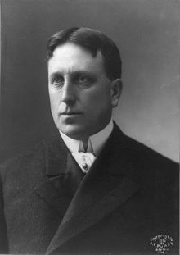
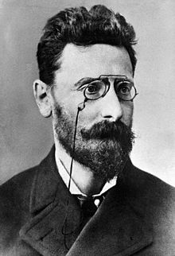
Growth of early sports journalism
Sports content appeared in very early forms of newspapers in the 1700s (eg.Tatler, Spectator and gentlemen's magazines)
Sport was a central focus of the aristocracy and closely associated with gambling
Rapid increase in organised sport as a social movement in 19th century linked to urbanisation and industrialisation/increased leisure
Impetus late 1800s, early 1900s with competition between Joseph Pulitzer (New York World) and William Randolph Hurst (NY Journal)
1908 Olympics – sport as an international vehicle for display of economic power and national identity

Slide 6
The sports press –’the world’s best advertising agency’
“Sports editors of daily newspapers all over the world allow the sports industry to set the agenda and the priorities for coverage of sports events…the sports page in daily newspapers are dominated by the particular types of sport, sports stars and international events which create the biggest turnovers on parameters such as advertising, sponsorship, number of television viewers and spectators in the stadium.
Conversely, the sports press has great difficulties reporting anything that takes place outside the angle of television cameras and after the stadium spotlight have been turned off.” (Schultz-Jorgensen, 2005)

Slide 7
‘Fourth Estate or Fan Club?’ David Rowe 2007
To whom are journalists primarily responsible – their employers or the public
Should journalists be representative of, or distinguishable from, their audience?
How dependent should journalists be on their sources?
Should journalists always be committed to critical coverage of their ‘round’ – even if it means key sources will no longer speak to them?
Is it acceptable from some journalists in popular fields, such as the sports round, to leave ‘hard’ investigative and critical journalism to others on the more ‘serious’ journalistic rounds like politics, law and business?

Slide 8
Right of access struggle sport/media
Journalistic principle at stake:
Freedom of the press
ie: the right for free and unbiased reporting versus sporting bodies control over ‘their’ commercial product
Increasingly sports bodies, and even individual athletes are going directly to public through social media – cutting out the traditional media
Eg. ManU running ownTV & radio station, website and mobile phone service
= ManU controlling both the medium
and the message

Slide 9
Possible effect of increasing control by sports bodies over media content
Adverse effect and the breadth and quality of news coverage of sports
Vetting of free expression so journalists whose reporting may displease the sporting body will be excluded
Lack of photographic coverage of sports because of rights disputes (already happening)
Additional problem:
The growth of media is making it increasingly hard to accommodate them in the press benches and to provide media with access to players for comment.
eg media have access to each member of the All Blacks for one week only when they are in camp, otherwise access is denied.

Slide 10
Dilemma of sports journalism
Authority created by the pulling power of its own popularity – little impetus to change its practices
Insularity from relying on a closed circle of sources
Frequently replicates ‘what works’ and ignores the problems, issues and topics which are closely associated with the world in which it operates.
Increasingly moving closer to entertainment and celebrity journalism which sustains and promotes the sports star system and corporate interests.
Saturation coverage of a small number of sports and marginalise others irrespective of their player base and community interest.
Need to write for the audience who either demands or criticise partisan or objective reporting – getting the balance difficult.
Gender and race imbalance still a strong characteristic of sport and sports journalism
Often worthy of contempt when continues to operate within self imposed limitations
At its best when capable of seeing beneath the surface of events to reveal insights within the media/sport/society nexus

Slide 11
Sports Journalists: From vital link between sport and fans to optional ‘middle-man’
Sports journalists “central cog in the machine of the sports nexus” (Nicholson et al, 2015)
Growth of social media and alternative contents distribution platforms, alters or removes need for sports organisations to engage with fans through sports journalists.
Sports organisations use communication strategies to restrict access to the sport and its athletes.
Sports journalists like others are increasingly being asked to produce more content with less resources.
Sport management professionals job is to decide if a potential news story is useful or harmful publicity and will act accordingly to allow or block access to the source of the story.

Slide 12
Role of social media
Sports Journalism- a rapidly “ leaking craft” - David Rowe 2007
Relationship between sport journalists and audience rapidly changing
Impacts on how sports information is circulated
Social media material increasingly sourced to create stories
Number of followers can determine commercial worth for sponsorships.
Sports journalist no longer the sole ‘gatekeeper’ for sports news and distribution
Athletes producing and distributing own sports news
Members of public creators of sport content
Therefore what is now the function of a sports journalist?
If someone writes about sport are they a journalist?
Is there still a major role for mainstream media institutions delivering sport content?

Slide 13
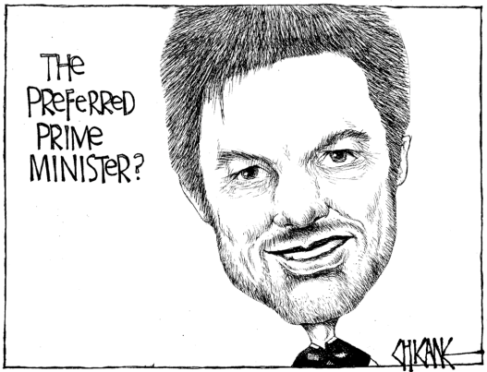
What does sport tell us?
Revealing about aspects of our society
Insight into character & human nature (good and bad)
Human creativity, aspiration, endurance, frailty
Vehicle for feelings and emotions to be channelled
Offers individual and/or collective identity
Constructs notions of national identity
Now central to multinational commerce
BUT all through a very ‘uncertain form’
(which paradoxically is a major part of its appeal)

Slide 14
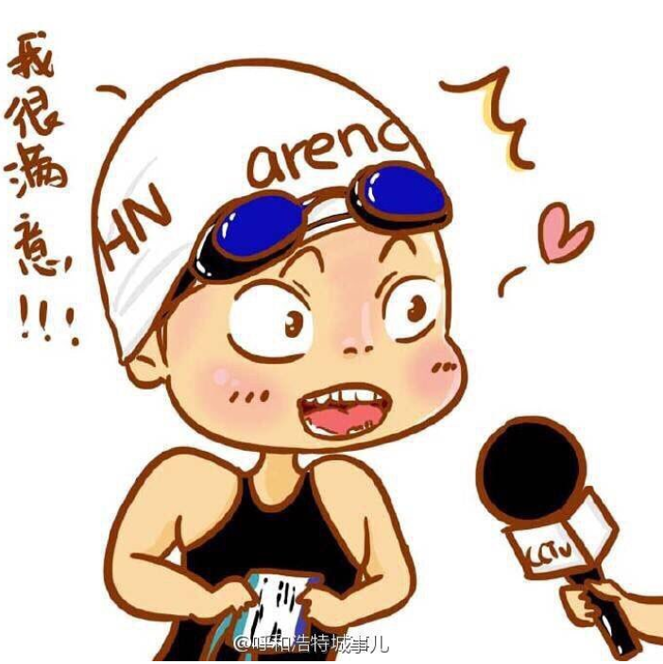
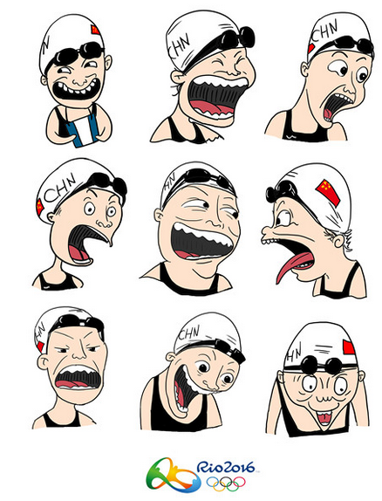
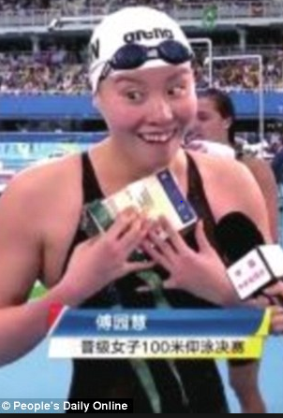
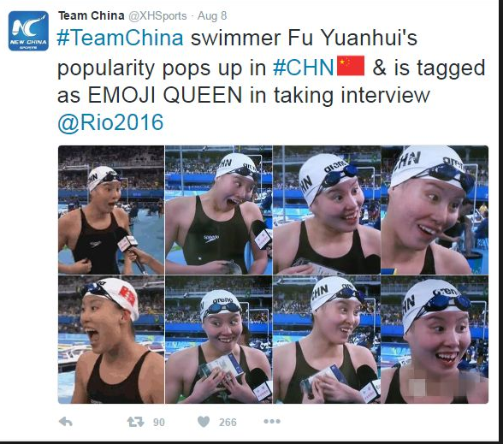
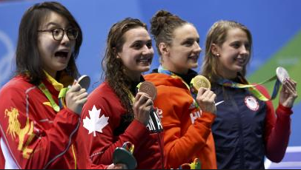
Fu Yuanhui Bronze medal Rio Olympics 2016
https://www.youtube.com/watch?v=Jn0nPGfH1HI

Slide 15
Sports Media Journalism
Sports Narratives
Frequently often used & well known to audiences
Eg. Rivalry regular characteristic of sports narratives - local/national, global, regional, between individuals, countries
Emphasis on people rather than institutions
Made meaningful by actions of people
Sport ideal vehicle for personification, because athletes and players are generally well known to audience.

Slide 16
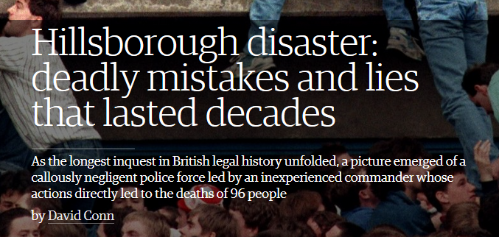
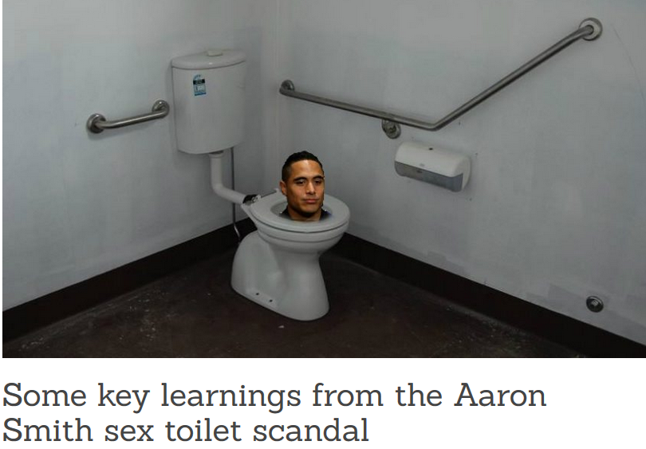
Sports Media Journalism
Sports Narratives – Rowe (1992)
1) Hard news
2) Soft news
3) Orthodox rhetoric
(editorial/celebrity
journalism)
4) Reflexive analysis
(feature articles)

Slide 17
OPINION PIECE
CHARACTERISTICS OF OPINION PIECE
Written by named author/journalist
Usually senior journalist or former high profile player
Offers strong polemic or controversial point of view
Aimed to provoke discussion/reaction
Seeks increase of circulation/readership/active response
often provocatively reflective, written after completion of event or well publicised sporting incident
Eg: Israel Folau ongoing situation played out in mediated space.

Slide 18
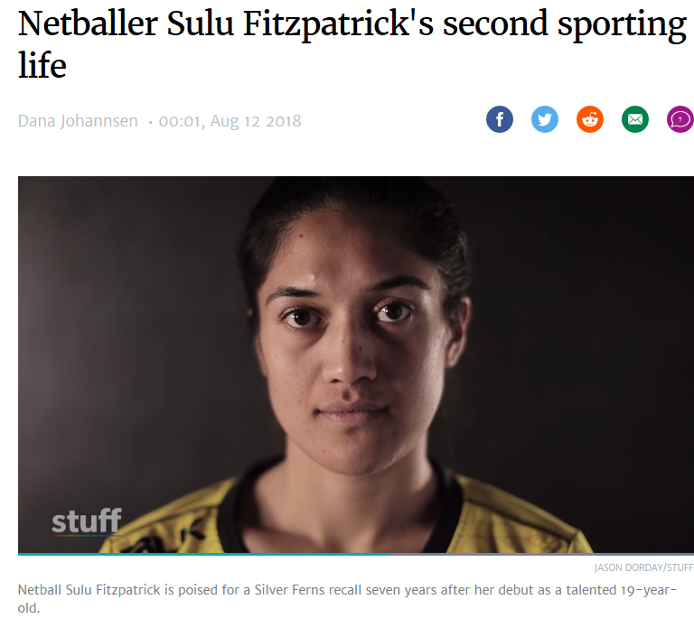
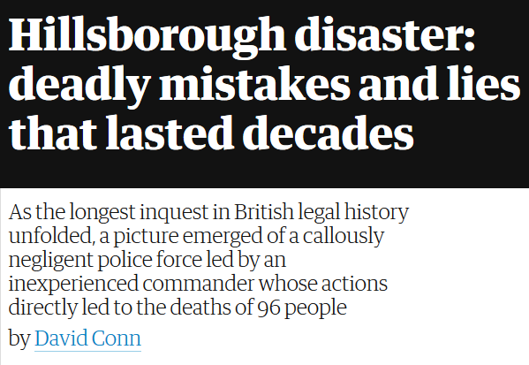
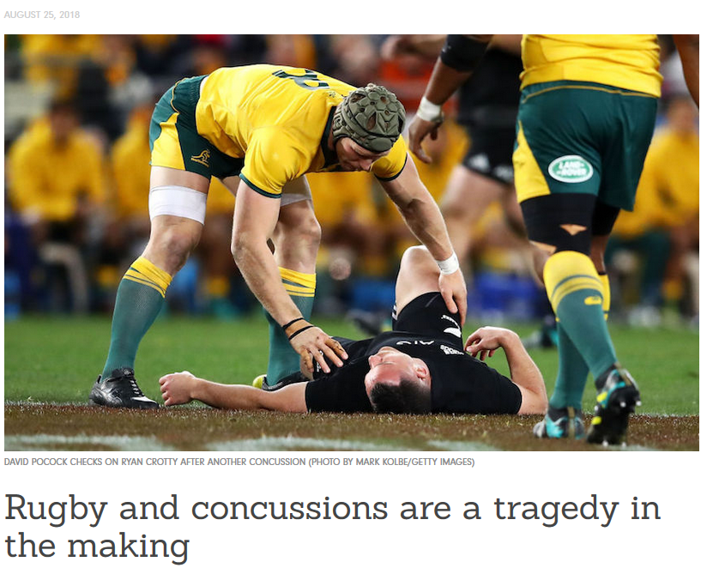
FEATURE WRITING
TYPES OF FEATURES
Background or situational
Investigative features
Follow-up Features
Colour Pieces
Interviews or profiles
Trends or lifestyle features
Seasonal features
Others

Slide 19
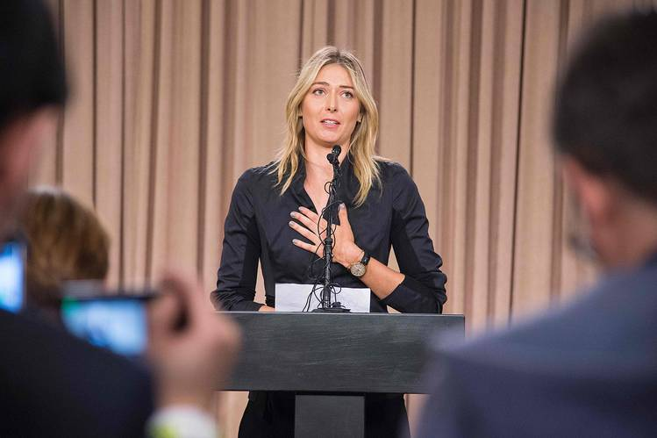
Genres or Recurring Story Types Judicial/legal/contractual matters (hard news)
Player suspensions (on field infringement)
Sporting body judiciary hearing
Court hearings
Rule changes
Player contracts
Breaches of behaviour code
Apologies
Press conference for all media frequently the main vehicle for conveying this information.

Slide 20
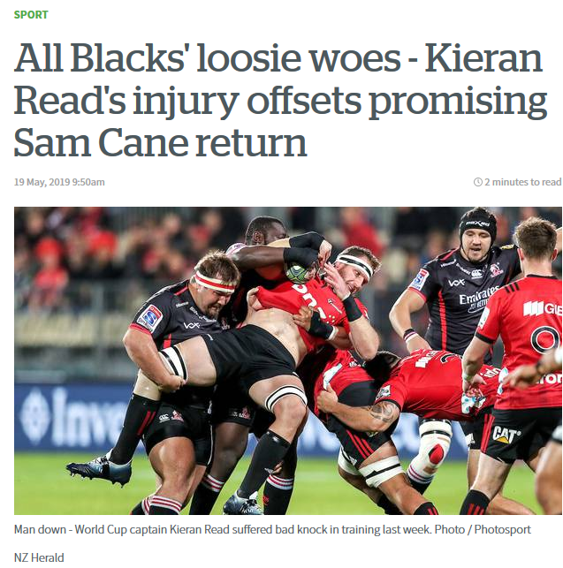
INJURY/FITNESS
Core concern for the ‘business’ of sport and for the individual athlete

Slide 21
SPORT/MEDIA BUSINESS NEWS
Broadcasting rights/fees
Deals between international sporting bodies and broadcasters – access/contracts
Anti-siphoning
Deregulation/regulation
IT convergence
Telco mergers, takeovers, disputes
Broadcasting/New technology partnerships

Slide 22
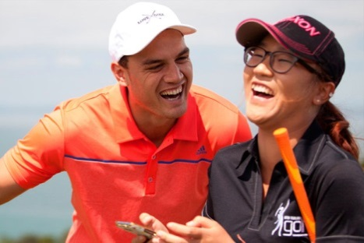
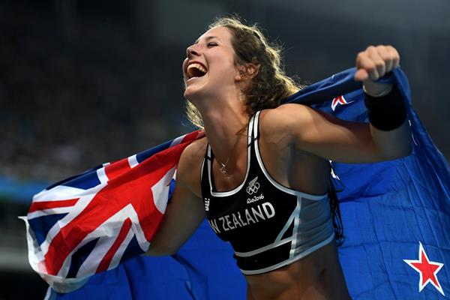
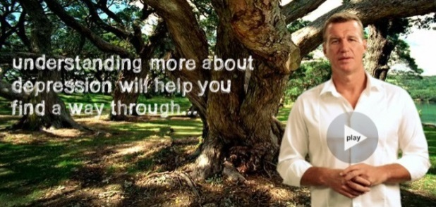
Human Interest & sports ‘celebrities’
Star players: Roger Federer, Lydia Ko, Beauden Barrett, Ronaldo, Messi,
Fallen Role Models: Tiger Woods, Maria Sharapova, Lance Armstrong
Controversial Athletes: Mike Tyson, Quade Cooper, Conor McGregor
Global sports celebrities: David Beckham, LeBron James, Ronaldo,
Young/emerging talent: Eliza McCartney, Grace Nweke
Non-talent tryhards – Eric the Eel, Eddie the Eagle
Personal stories/private lives: John Kirwan – (Depression)
Norm Hewitt (All Black) Alcoholism/bullying/violence
Notes:
Brett Stewart – star player for Manly Sea Eagles, after party for season launch is now charged with sexual assault of 17 year old woman

Slide 23
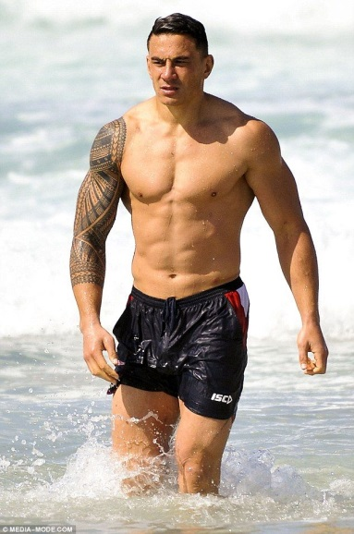
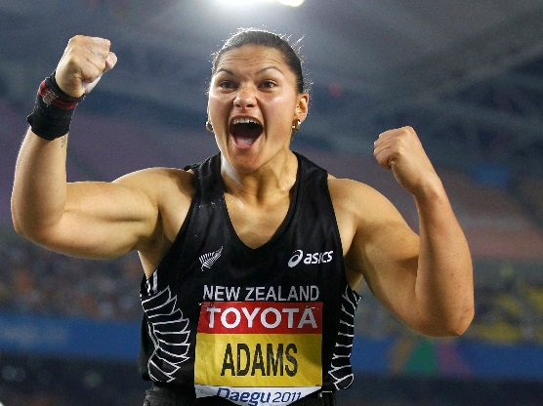
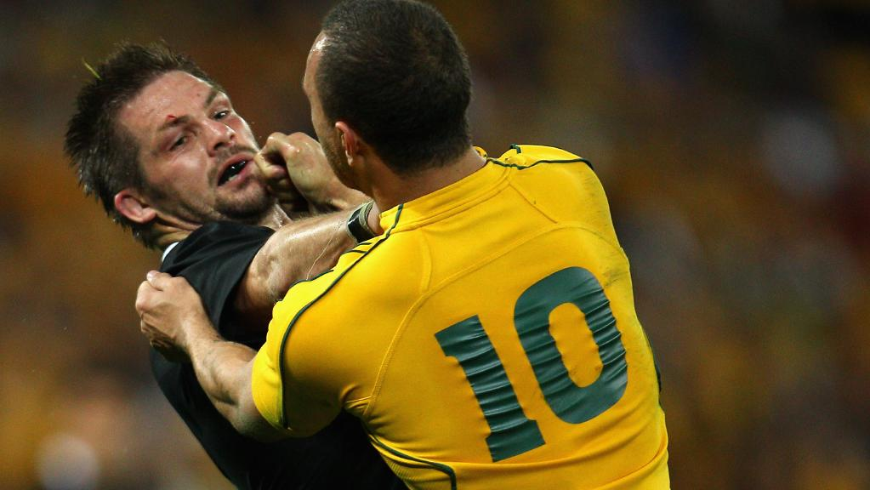
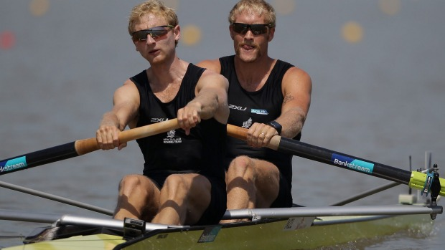
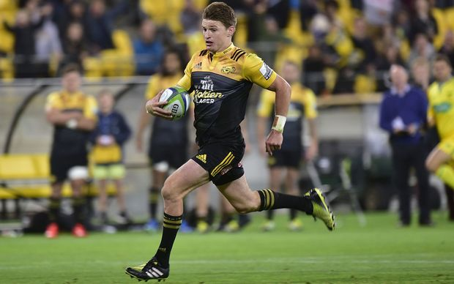
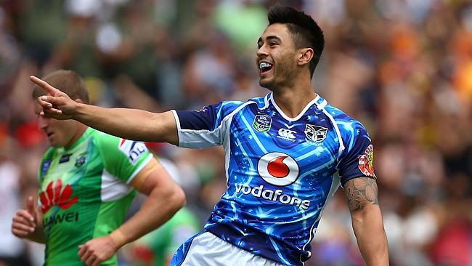
Function of Sportsmen/women for sports journalism
Performers who provide entertainment
2) Personalities who attract and keep
audiences
Bearers of sporting narratives
(Whannel, 2002)

Slide 24
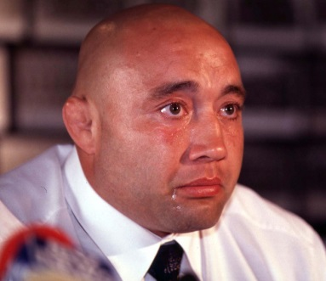
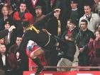
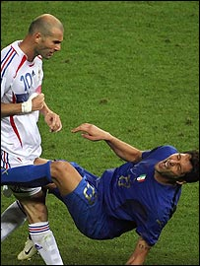
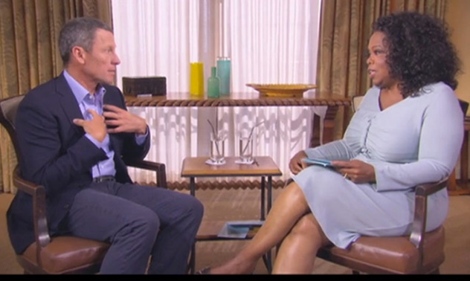
Media Sports narratives which construct or tarnish the image of a star
Emergence of a striking talent
Extraordinary athletic skills
Public recognition/celebration
Displays of arrogance
Public doubts
Erratic behaviour
Personal scandal
Waning power
Failure
Hero redeemed by extraordinary
performance
Forgiveness
“Zidane is one of us all
His stupidity is ours and his talent belongs to the world.”

Slide 25
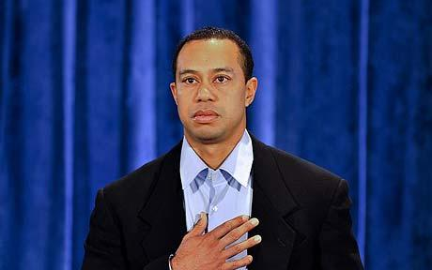
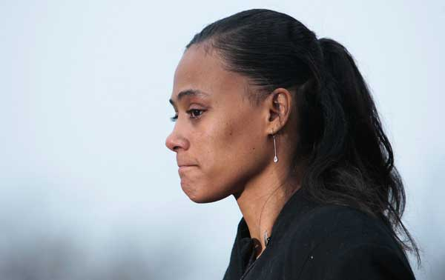
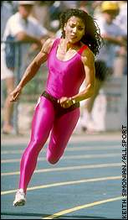
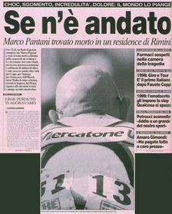
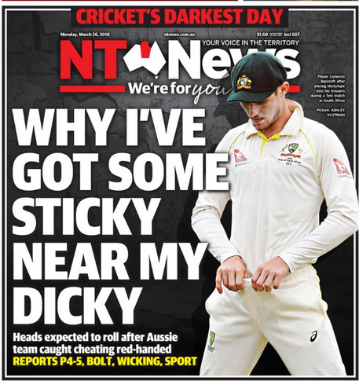
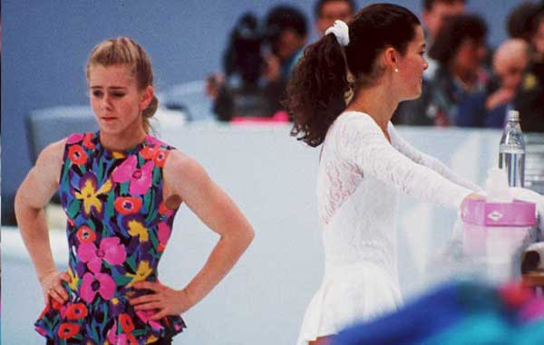
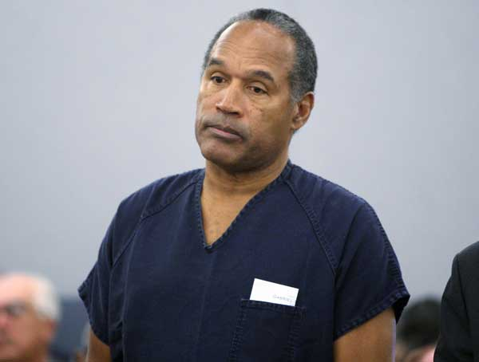
Sports Crises & Scandals
Moral transgression magnified in sport – tension between romantic ideals and commercialised, corruptible reality
Sport stars have high public profile & intense media interest
Sport star scandals are presented to public in story form, which are often running stories and gather interest as they go on
Sport scandal is a complementary product to sports news
Sports scandals have the capacity to break through the protection of professionalised sports organisations and become the property of the print, television and tabloid press
Drug scandals are the most frequent in certain sports eg cycling, weightlifting, endurance events
Notes:
Tiger Woods, Marion Jones, FloJo (Florence Griffith Joyner), Maro Pantani, Tonya Harding & Nancy Kerrigan, Cameron Bancroft Australian cricketer, OJ Simpson.

Slide 26
Impact of mediated scandal
Amateur or professional sport governed by regulations
Professional sport, large and complex, so potential threat to this complex organisation increases exponentially.
The larger the organisation the more potential for things to go wrong
The potential for moral lapses by an individual increases as the organisation develops and employees have greater commercial and cultural influence
Therefore the potential impact increases

Slide 27
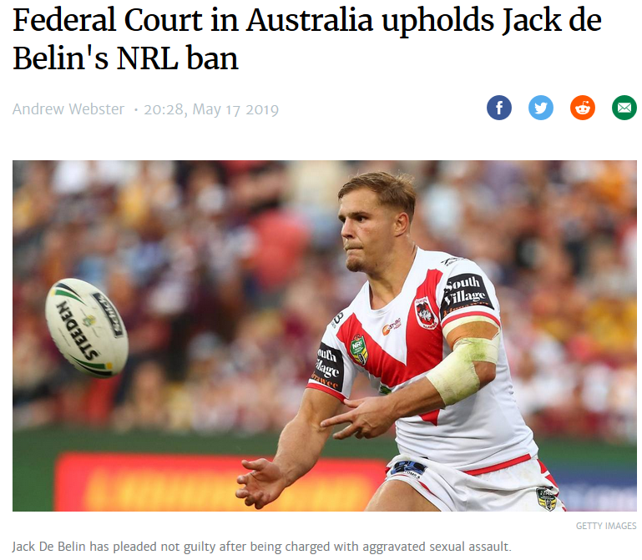
de Belin facing charges of aggravated sexual assault against a 19 year old woman, December 2018
NRL’s new ‘no fault, stand down’ policy means they can stand down players who are facing a serious charge in the criminal court. They cannot play until they are cleared of the charge in a court of law.
The NRL see this policy as necessary to protect the brand and the reputation of the game and their business relationships with sponsors.
It could be 18 mths- 2 yrs before he has a verdict.
de Belin took his employer, the NRL, to the Federal Court claiming unfair restraint of trade as a professional athlete as he is prevented from working (unlike others who face criminal charges and waiting their day in court).
The Federal court ruled upheld the NRL ruling that they have the right to protect their game.

Slide 28
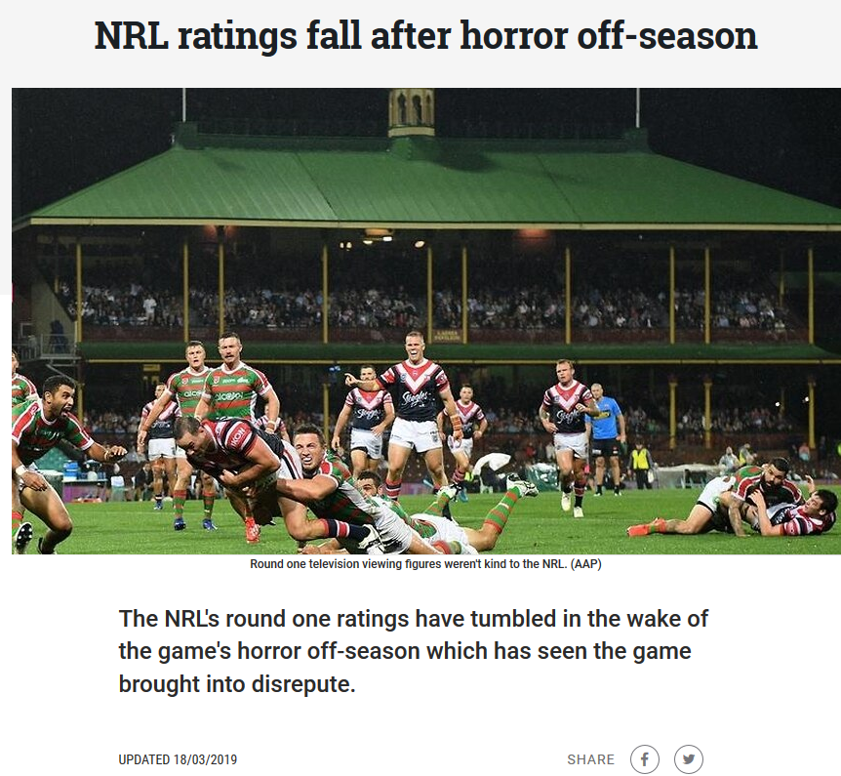
Australian Federal Court ruling de Belin v NRL
“The court found the respondents had established a clear and present danger to their legitimate interests given, among other things, the seriousness of the charge against Mr de Belin and the unprecedented extent of negative headlines which it attracted,” ruled Justice Melissa Perry.
“The reputation of the NRL competition was tarnished by the allegations and tarnished against Mr de Belin and other players during the off-season described in media reports as the ‘summer from hell’.
“The Court accepted that nothing short of a rule
precluding Mr de Belin and others charged in the
future with serious offences of a similar nature from
taking the field was likely to address the clear and
present danger established by the evidence.”
Matt Cleary, ‘The Guardian’, 17 May 2019

Slide 29
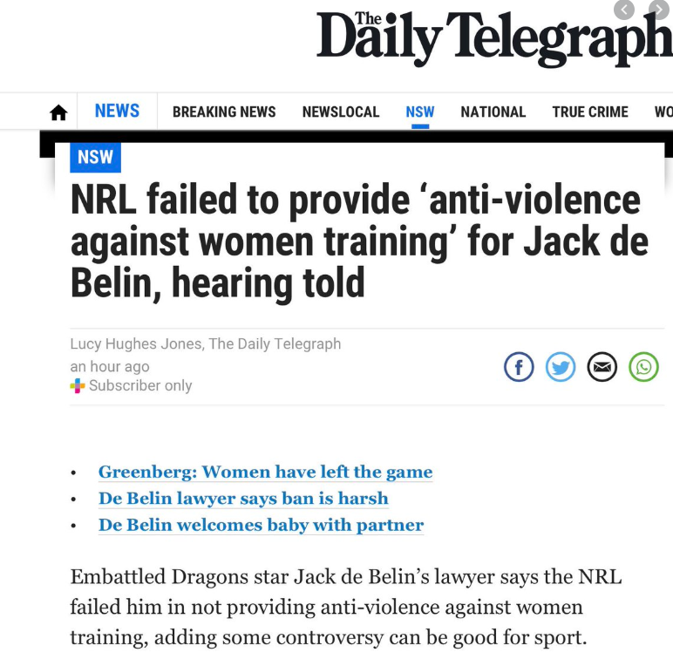
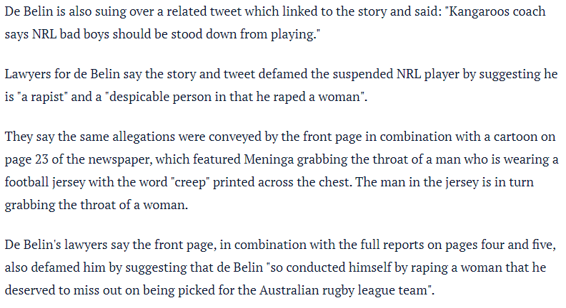
https://www.smh.com.au/national/jack-de-belin-sues-telegraph-for-defamation-over-rapist-allegations-20200220-p542tc.html

