Slide 1
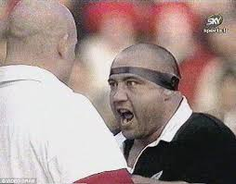
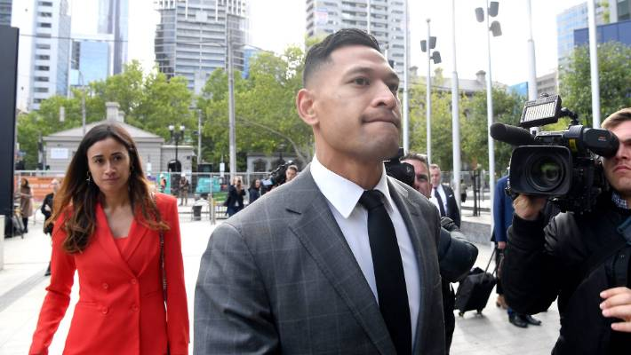
Sports Journalism Pt 2: Mediation of high profile athletes who fall from grace
The redemption of All Black Norm Hewitt
Israel Folau v Rugby Australia

Slide 2
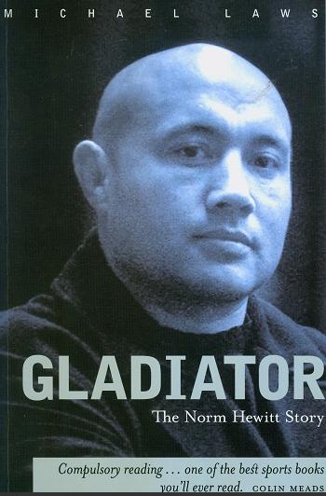
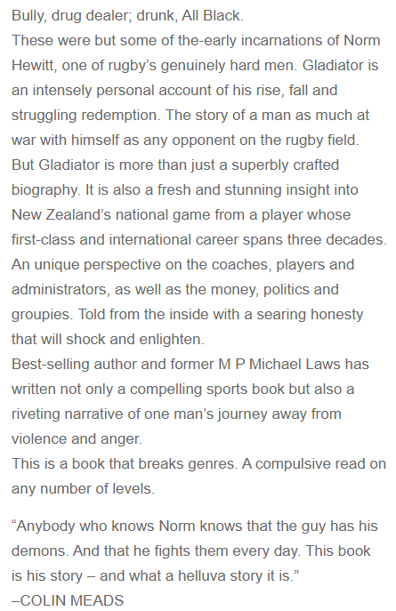

Slide 3
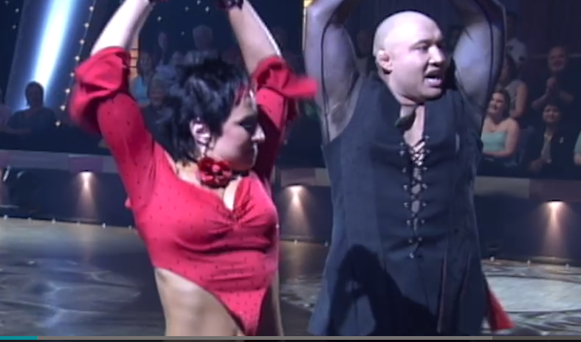
‘Dancing with the Stars’ 2005
https://www.nzonscreen.com/title/dancing-with-the-stars-norm-hewitt-2005

Slide 4
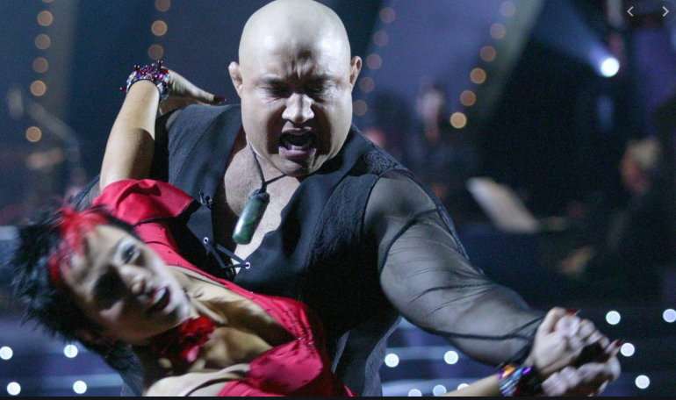
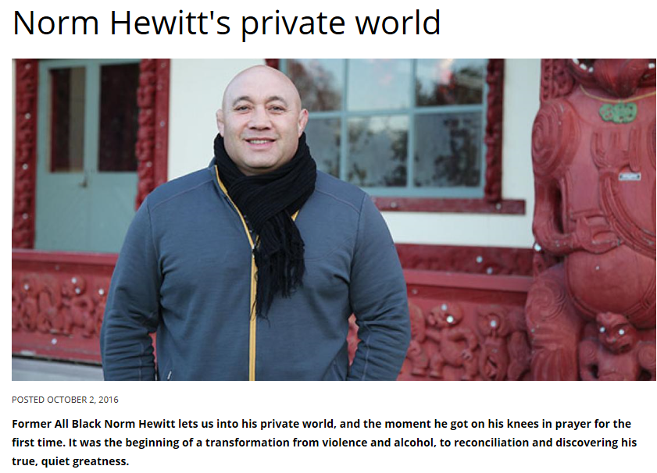
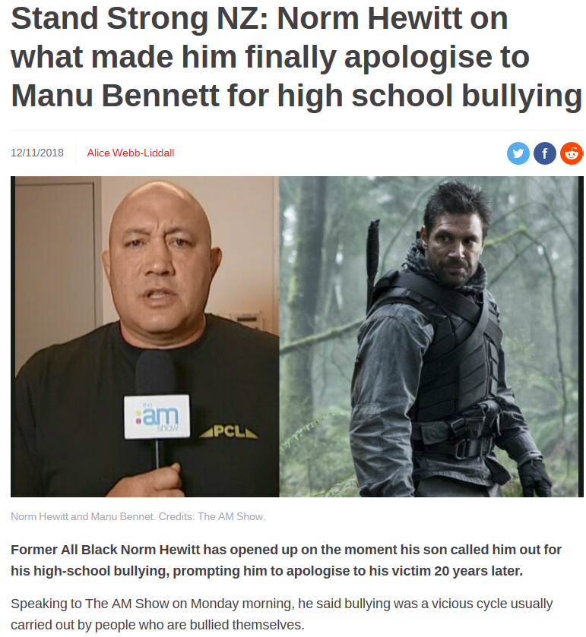
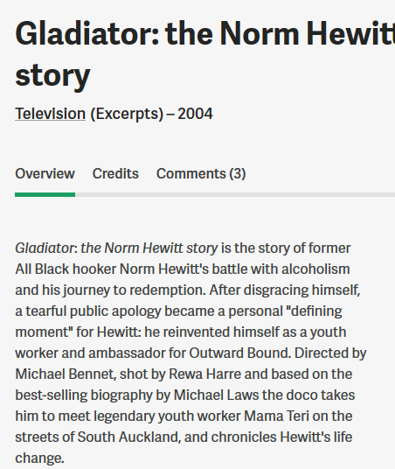
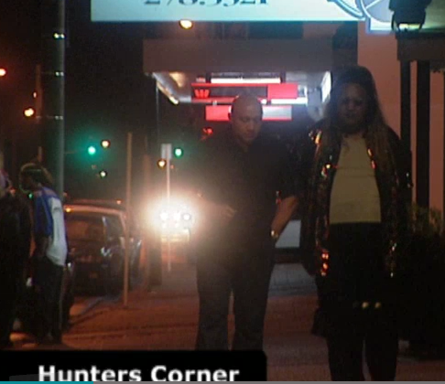
The mediated redemption of Norm Hewitt
https://www.salvationarmy.org.nz/our-community/faith-in-life/soul-food/Norm-Hewitt-private-world
https://www.newshub.co.nz/home/new-zealand/2018/11/stand-strong-nz-norm-hewitt-on-what-made-him-finally-apologise-to-manu-bennett-for-high-school-bullying.html
https://www.nzonscreen.com/title/gladiator-2004

Slide 5
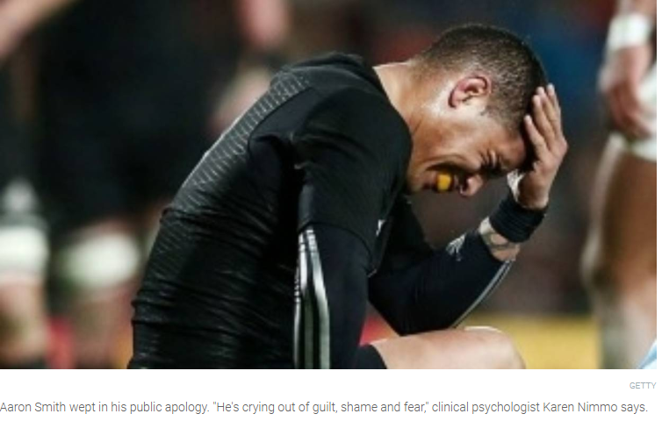
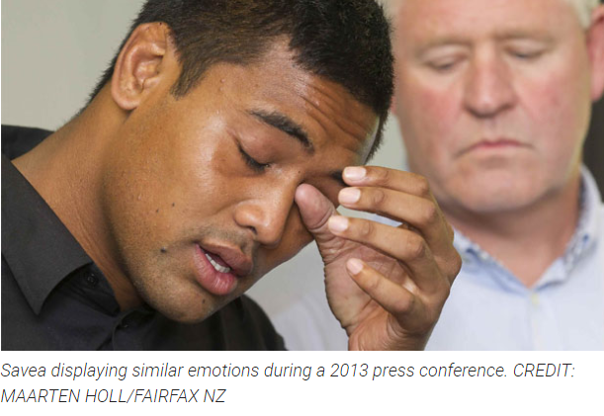
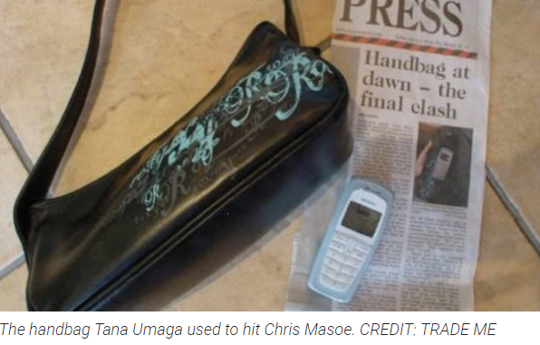
https://www.stuff.co.nz/sport/rugby/85066599/tears-off-the-field--when-sports-stars-get-emotional

Slide 6
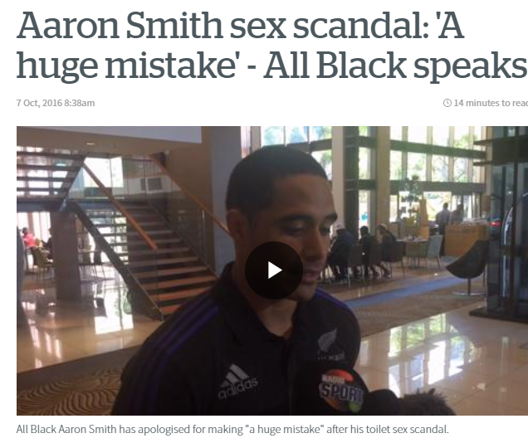
Aaron Smith’s tryst in an airport (disabled) toilet
https://www.nzherald.co.nz/sport/news/article.cfm?c_id=4&objectid=11723446
https://www.stuff.co.nz/sport/rugby/all-blacks/85124210/underfire-all-blacks-halfback-aaron-smith-closes-his-social-media-accounts
https://www.newshub.co.nz/home/sport/2019/11/rugby-how-aaron-smith-rebuilt-his-all-blacks-career-from-toilet-sex-disgrace.html

Slide 7
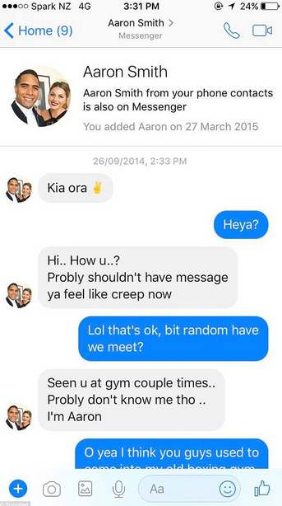
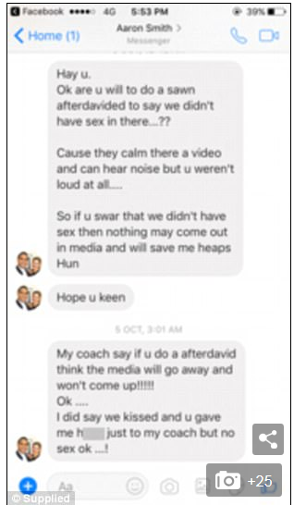
https://www.newshub.co.nz/home/new-zealand/2017/08/aaron-smith-may-have-misled-all-blacks-bosses-in-sex-scandal.html

Slide 8
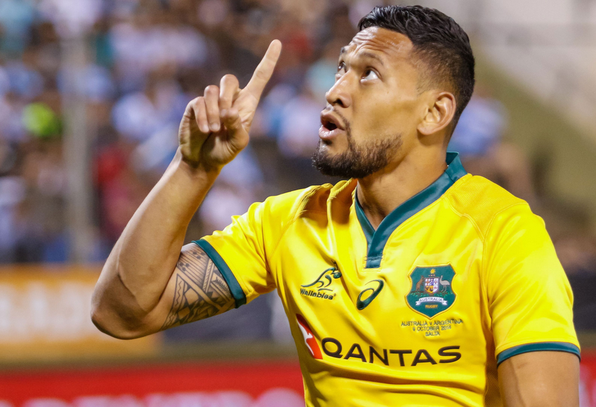
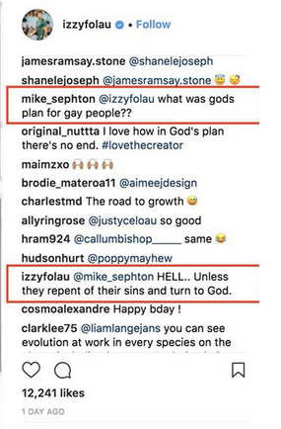
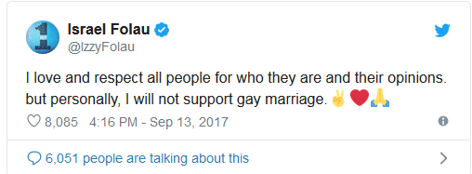
Israel Folau Instagram & Twitter posts 2 April 2018

Slide 9
Rugby Australia ‘Inclusion Policy’
A section of the RA Inclusion Policy seeks to protect gay and lesbian people who choose to play rugby.
Bullet point 1.4:
“Rugby AU recognises that both intentional and unintentional homophobic behaviour exist within society in Australia, and that this can have adverse and potentially significant consequences for some individuals and our game.”
..“rugby has and must continue to be a sport where players, officials, volunteers, supporters and administrators have the right and freedom to participate regardless of gender, sexual orientation, race or religion and without fear of exclusion. There is no place for homophobia or any form of discrimination in our game and our actions and words both on and off the field must reflect this”.

Slide 10
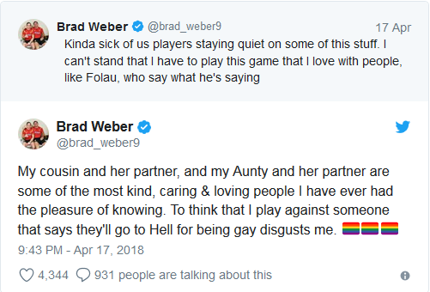
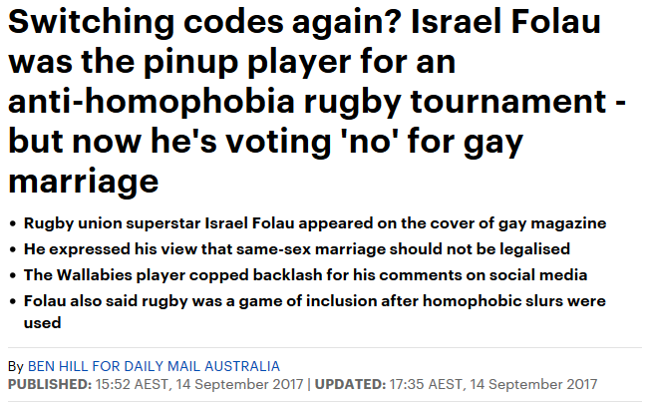
Notes:
Brad Webber plays for the Chiefs

Slide 11
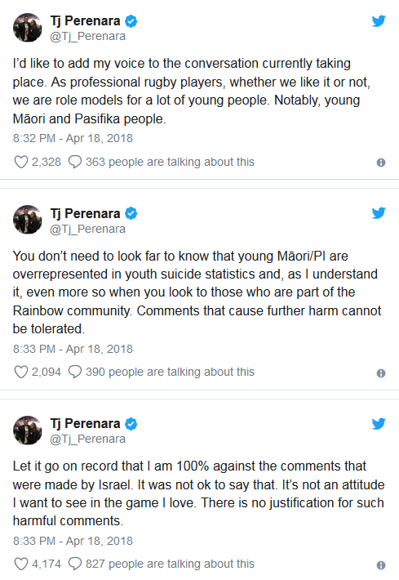
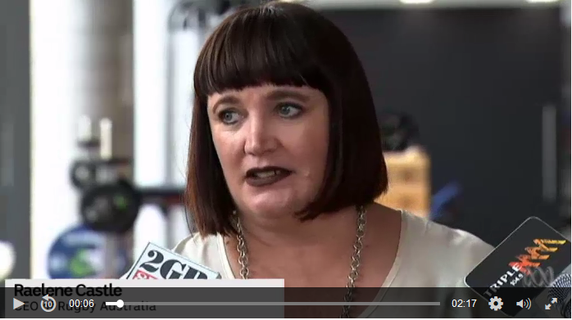
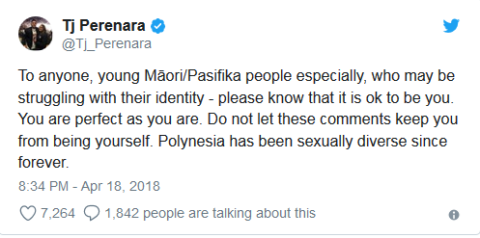
Nigel Owens ( quoted in Stuff 9.4.2018)
“Comments like Israel Folau's about gay people, and all other types of bullying by all kinds of people, is what can put people like that young boy in that moment where it's enough to tip them over the edge, because there is a minority who give the impression you cannot be who you truly are."
"Yes, you are entitled to your opinion but one should understand what that opinion can do to young and vulnerable people's lives, in particular ones in a bad place dealing with their sexuality.“
http://www.abc.net.au/news/2018-04-10/israel-folau-is-a-strong-role-model-says-rugby-australia/9636768

Slide 12
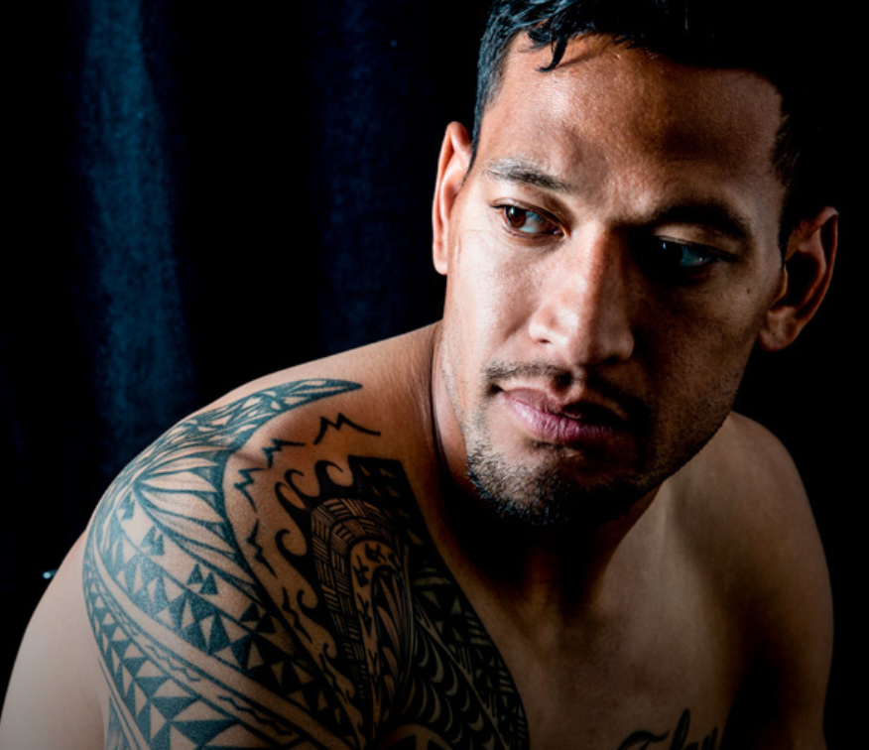
16 April 2018
“After we’d all talked, I told Raelene if she felt the situation had become untenable – that I was hurting Rugby Australia, its sponsors and the Australian rugby community to such a degree that things couldn’t be worked through – I would walk away from my contract, immediately.
I feel I need to explain this part in more detail because at no stage over the past two weeks have I wanted that to happen.
There have been things written about me angling to get a release from my Rugby Australia deal to pursue an NRL contract. That simply isn’t true. There have been rugby offers from the UK, Europe and Japan that are way above anything I could earn in Australia.
This is not about money or bargaining power or contracts. It’s about what I believe in and never compromising that, because my faith is far more important to me than my career and always will be.
After the meeting I went home, turned on the TV and was really disappointed with some of the things that were said in the press conference.
I felt Raelene misrepresented my position and my comments, and did so to appease other people, which is an issue I need to discuss with her and others at Rugby Australia.
That aside, I hope Raelene and Andrew appreciate my position, even if it differs with theirs.
I love rugby union. It has allowed me to travel all over the world and meet some fascinating people along the way.
It is one of the best things about the game in my opinion.
I do not want to bring hurt to the game and want as many people playing it as possible, so when I spoke to Raelene about walking away, it was to help the game, not harm it, in the event we couldn’t come to an understanding.
I used to believe I was defined by my actions on the footy field, but I see now that’s not true.
Read more at https://www.playersvoice.com.au/israel-folau-im-a-sinner-too/#QHQu75SJzMgQRY5U.99
https://www.playersvoice.com.au/israel-folau-im-a-sinner-too/#OWAipdqfc8XHwO0C.97

Slide 13
NZ Bill of Rights Act 1990
13. Freedom of thought, conscience, and religion
Everyone has the right to freedom of thought, conscience, religion, and belief, including the right to adopt and to hold opinions without interference.
14. Freedom of expression
Everyone has the right to freedom of expression, including the freedom to seek, receive, and impart information and opinions of any kind in any form.
The right to freedom of speech is not explicitly protected by common law in New Zealand but is encompassed in a wide range of doctrines aimed at protecting free speech:
Law School Lecturer Rosemary Tobin: This is not an absolute right but framed within a context of “reasonable limitations”.
(Common sense judged from the perspective of the ‘man on the Clapham omnibus’
Ie. an ordinary and reasonable person as defined within British common law)

Slide 14
Human Rights Act 1993
61 Racial disharmony
(1)
It shall be unlawful for any person—
(a)
to publish or distribute written matter which is threatening, abusive, or insulting, or to broadcast by means of radio or television or other electronic communication words which are threatening, abusive, or insulting; or
(b)
to use in any public place as defined in section 2(1) of the Summary Offences Act 1981, or within the hearing of persons in any such public place, or at any meeting to which the public are invited or have access, words which are threatening, abusive, or insulting; or
(c)
to use in any place words which are threatening, abusive, or insulting if the person using the words knew or ought to have known that the words were reasonably likely to be published in a newspaper, magazine, or periodical or broadcast by means of radio or television,—
being matter or words likely to excite hostility against or bring into contempt any group of persons in or who may be coming to New Zealand on the ground of the colour, race, or ethnic or national origins of that group of persons.

Slide 15
Gavin Ellis
People can still express themselves in ways that advance views within the bounds of society's acceptance.
There's no such thing as free speech, and it's a good thing too. (Stanley Fish)
[Fish argued] speech cannot be free because it is never free of consequences and responsibilities.
That may be bad news for Wallabies player Israel Folau who responded to a fan's Instagram message asking about God's plan for gay people with "Hell ... unless they repent their sins and turn to God".
Folau is a role model and his statement could add fuel to homophobia and have profound effects on teenagers still searching for their sexual identity.
[Folau] could have publicly voiced those opinions in a manner that did not cross the line between acceptable and unacceptable speech.
Folau's religious belief in truth "revealed" by God is not the same thing as secular knowledge.
https://www.nzherald.co.nz/nz/news/article.cfm?c_id=1&objectid=12041867

Slide 16
Moana Jackson E-Tangata
In the last few weeks, prejudice seems to have crept out of the dark corners of society again.
Two recent and well-publicised instances have shown the many forms that intolerance and bigotry can take — as well as illustrating the ways in which, even the framing of the debate, can be constrained by history and untested assumptions.
In the first instance, another Pākehā man has voiced the usual tired and racist rants against Māori, with little variation on the old colonising view of our basic inferiority.
In the second case, the noted rugby player Israel Folau reached into the same colonising-sourced rhetoric, and condemned gay people to some mysterious place called “hell”.
…
The condemnation of LGBT people was ..quickly denounced by many people, and, perhaps surprisingly to some, by two All Black halfbacks. TJ Perenara’s rebuke, in particular, has been rightly praised — and his comment, that “Polynesia has been sexually diverse since forever”, was a timely reminder of a cultural and historical truth that is still too often denied in a Once-Were-Missionary type redefining of ancient Pacific realities.

Slide 17
Israel Folau has opened the door, so here's our chance.
Get religion out of sport, in areas where the people who run sport do have a right to exert control.
I'm talking about banning all those hand signals by players to the heavens, along with the religious insignia on armbands and "thanks to God" references during post-match interviews.
I don't really care if Folau's homophobic raving occurs away from official rugby duties. Free speech is free speech and the Folau family is on a roll.
His wife, Silver Ferns netball star Maria Folau, is standing with God and by her man and his views. They are no doubt mightily relieved to be enjoying such a healthy and inspirational non-same sex marriage.
For my money, it's not hate speech from Folau. It's just silly, pathetic, foolish and embarrassing speech. Telling homosexuals to "repent their sins and turn to God" speaks for itself intelligence wise. I feel sorry for the bloke, that his world is so limited. What a sad way to live.
But if a gay person wants to come out and claim that heterosexuals should all burn in hell, I'd have a good old laugh at that as well. These aren't dangerous people. They are silly people…

Slide 18
The Press Conference 4 April 2018
http://www.abc.net.au/news/2018-04-10/israel-folau-is-a-strong-role-model-says-rugby-australia/9636768

Slide 19
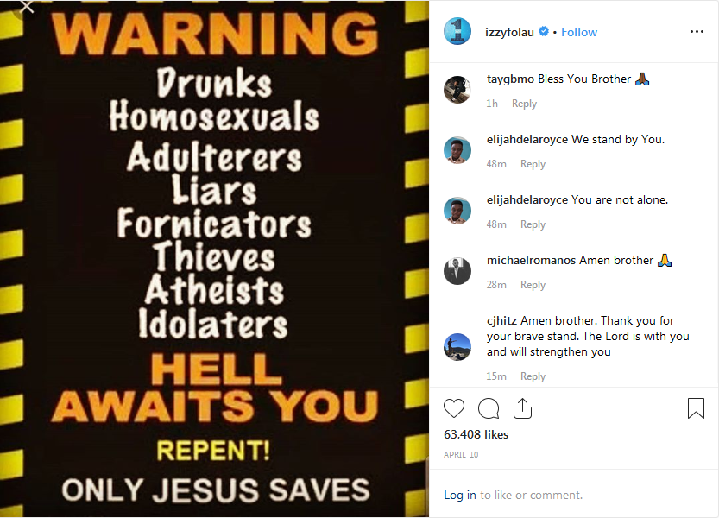
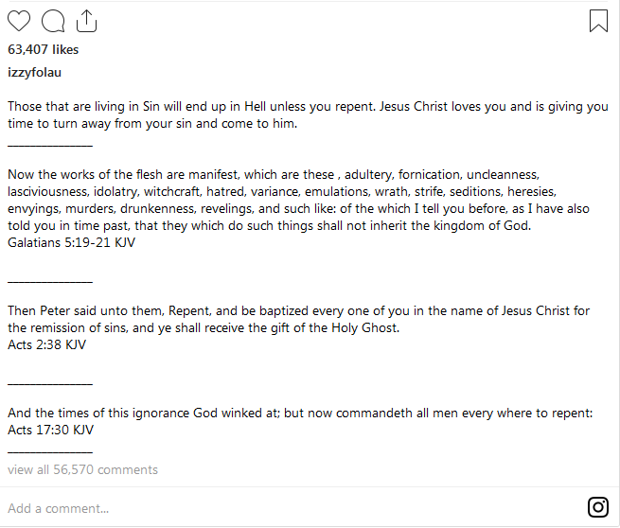
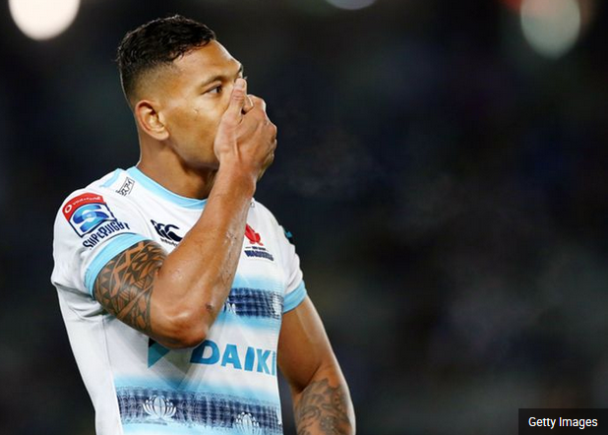
Israel Folau Instagram post 10 April 2019 313,000 Instagram followers

Slide 20
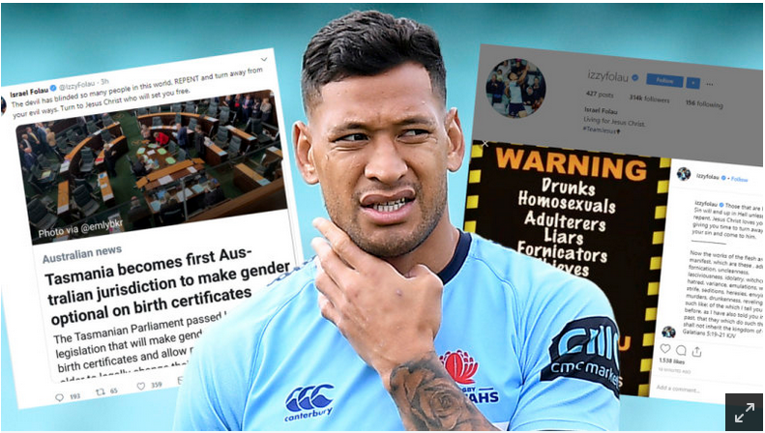
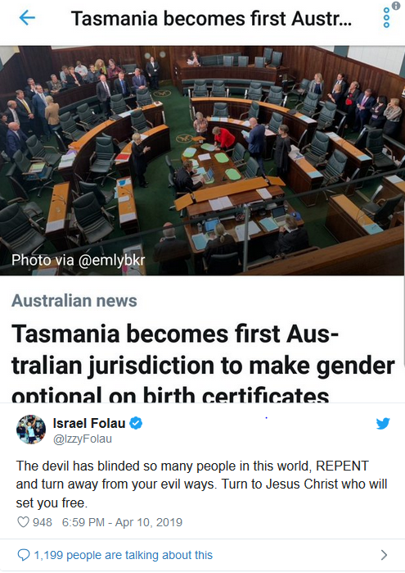
MEDIA STATEMENT Rugby Australia, 10 April 2019
Rugby Australia is aware of a post made by Israel Folau on his Instagram account this afternoon.
The content within the post is unacceptable. It does not represent the values of the sport and is disrespectful to members of the Rugby community.
The Rugby Australia Integrity Unit has been engaged on the matter tonight.

Slide 21
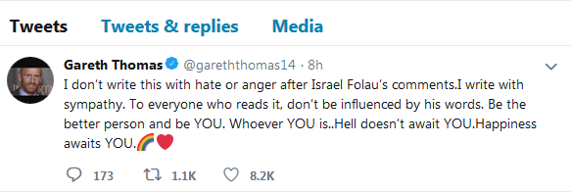
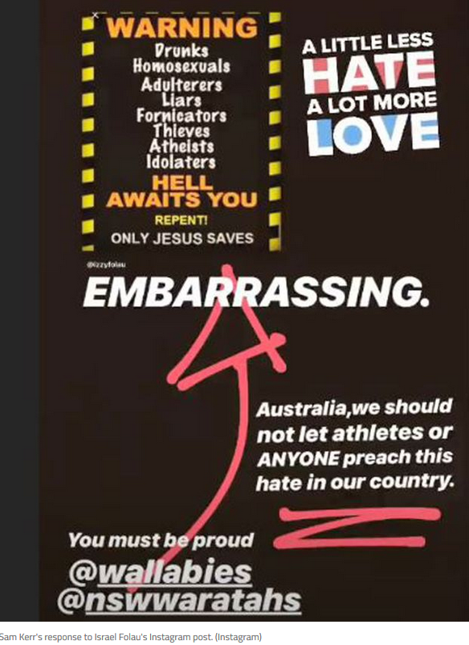
Until Israel Folau repents, Rugby Australia has no choice but to let him go
In the wake of his latest homophobic outburst – gays, among other sinners, are heading to hell once more – Israel Folau has to go, and will go.
Quick. Clean. Gone. At least until such times as he repents.

Slide 22
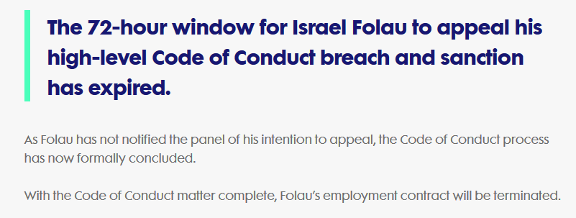

Slide 23
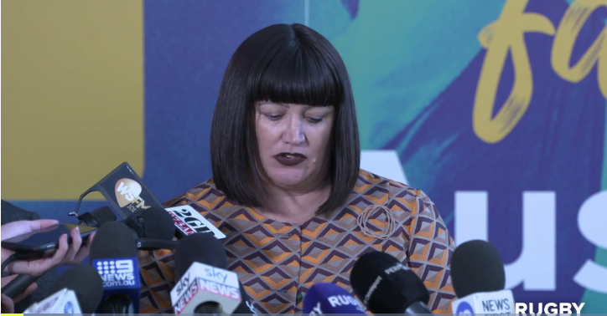
Raylene Castle CEO Rugby Australia Israel Folau contract termination 17 May 2019
https://www.rugby.com.au/videos/2019/05/17/castle-hore-folau-press-conference

Slide 24
The rugby players' union (RUPA) is to set up a committee to review how players can express their faith and beliefs after the Israel Folau sacking saga.
RUPA said on Monday the decision to tear up Folau's Rugby Australia contract was "a sad outcome for Israel, his family, friends, teammates, opponents and all associated with rugby in Australia and around the world."
It also said Rugby Australia had not yet provided any clear parameters to the players specifying how it expects them to express their faith and beliefs in a way it considers acceptable.
"To address this, RUPA will immediately establish and undertake an Expression of Faith & Beliefs Review alongside its' players, incorporating advice from those with and without strong religious beliefs," RUPA said in a statement.

Slide 25
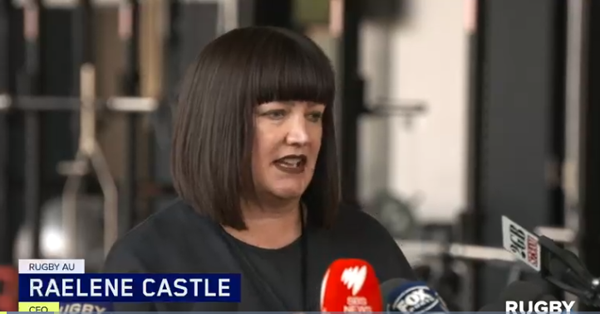
Rugby AU CEO Raelene Castle fronted the media to speak about the Israel Folau settlement 5 December 2019
https://www.rugby.com.au/videos/2019/12/04/castle-press-conference

Slide 26
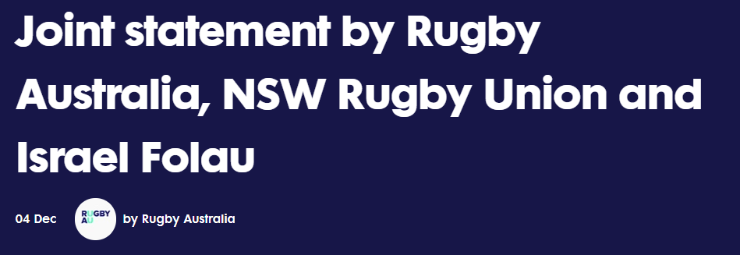
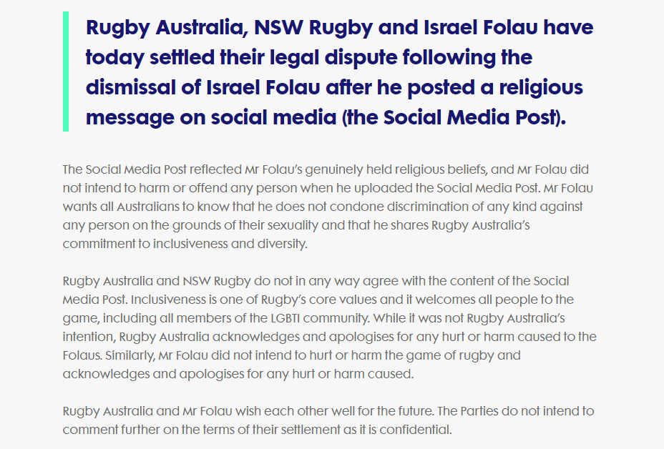
The press release as a legal statement
(agreed as part of the final settlement between RA and Folau’s legal teams)
https://australia.rugby/news/2019/12/04/if-joint-statement-dec

Slide 27
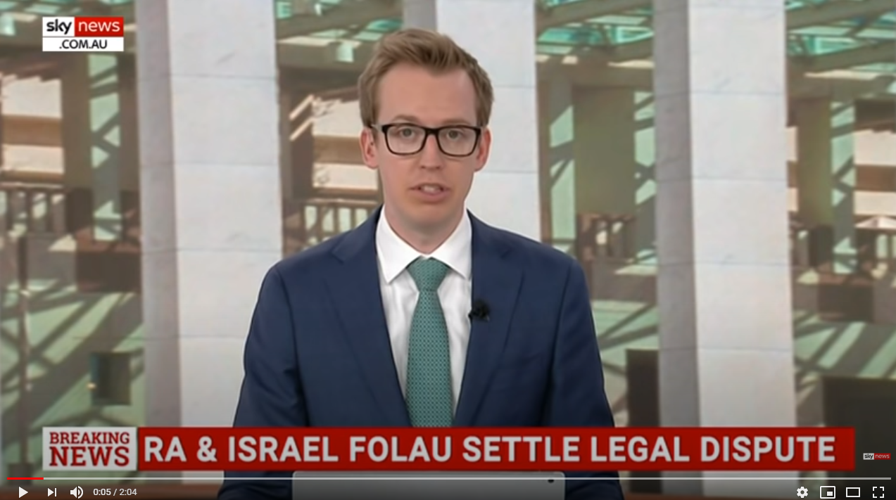
https://www.youtube.com/watch?v=uyL9rPMkAn4
https://www.youtube.com/watch?v=7RPbOWqlA74

Slide 28
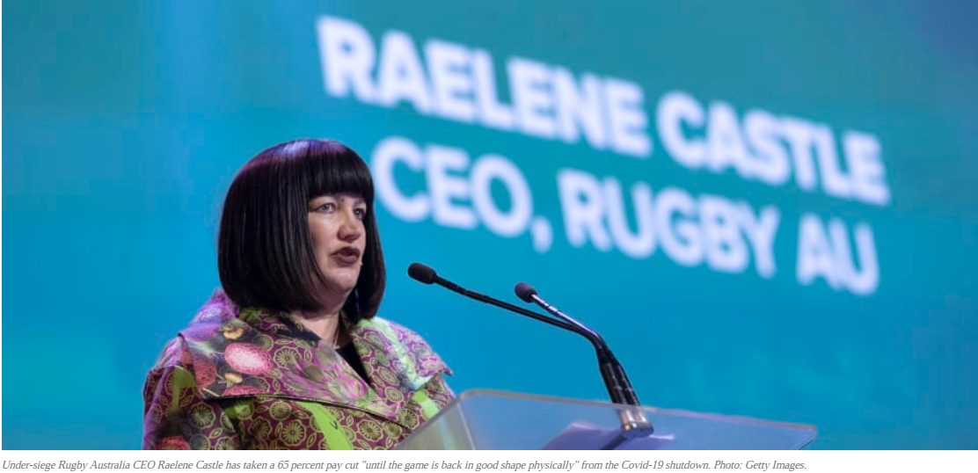
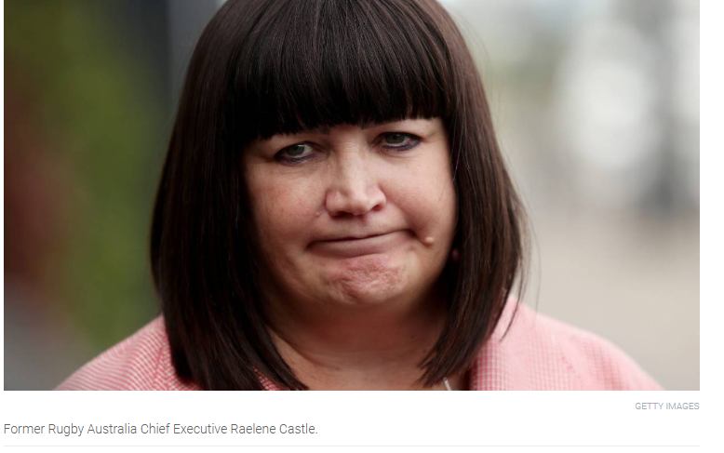
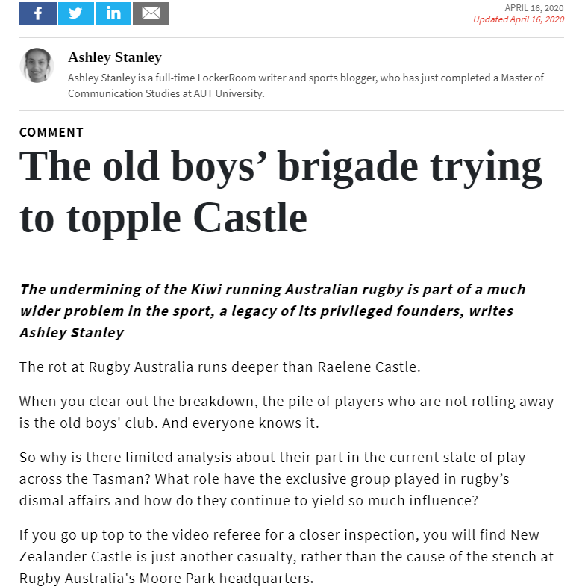
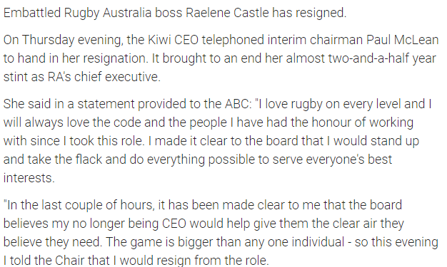
https://www.newsroom.co.nz/lockerroom/2020/04/16/1129991/the-old-boys-brigade-trying-to-topple-castle
https://www.stuff.co.nz/sport/rugby/international/121236083/raelene-castle-resigns-as-rugby-australia-ceo

