Slide 1
MEDIA 743 Chinese Film Genres
Introduction

Slide 2
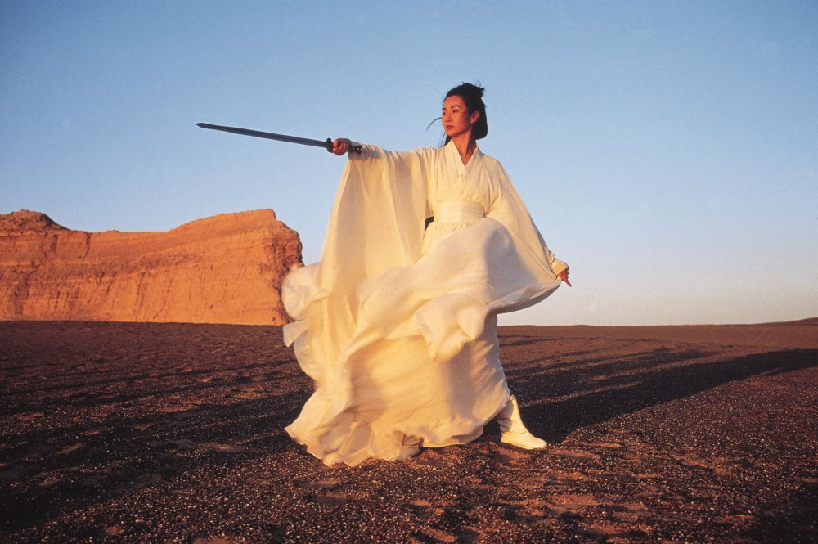
Three issues in studying Chinese genres
Chinese cinema(s)
Genre
Chinese Genre

Slide 3
Some key Dates and Events
1841: Hong Kong ceded to UK
1911: China becoming a Republic
1946-49: Civil War (between Nationalist and Communist)
1949: Martial Law in Taiwan
1966-76: Cultural Revolution in Mainland China
1978: Open door policy & Reform program in Mainland
1982: Margaret Thatcher visited Hong Kong
1987: Martial Law lifted in Taiwan

Slide 4
What is Chinese Cinema?
pre-1949 cinema based in Shanghai?
1949-present cinema of the People’s Republic?
Taiwan cinema, Hong Kong cinema, Macau cinema and Chinese diasporic cinema?

Slide 5
Chinese Cinemas
The presumption that Chinese cinema is the monolithic cultural expression of a Chinese nation has been dramatically undercut by history…. The People’s Republic, Taiwan and Hong Kong and their cinemas are marked as socialist, capitalist and colonialist, respectively. Yet to exaggerate these differences would be to overlook a common cultural tradition of social, ideological, and aesthetic forms that stands behind and informs Chinese cinema as a whole. (1994: 1)

Slide 6
Chinese-Language Film
a more accurate and comprehensive term to cover ‘all the local, national, regional, transnational, diasporic, and global cinemas relating to the Chinese language’ (Lu & Yeh 2005: 2).

Slide 7
Sinophone Cinema
‘Sinophone’ is ‘a network of places of cultural production outside China and on the margins of China and Chineseness, where a historical process of heterogenizing and localizing of continental Chinese culture has been taking place for several centuries’ (2007: 4).

Slide 8
Film Genre
‘Generic forms were one of the earliest means used by the industry to organize the production and marketing of films, and by the reviewers and the popular audience to guide their viewing’ (Christine Gledhill, “Genre”, in The Cinema Book, ed. Pam Cook, London: BFI Publishing, 1985, p. 58).
• As a privileged narrative form
• Not budget or scale-related
• Expectations conforming
• Genre and Audiences
• Codes and Conventions
• Convention and Invention
• Genre and Society
• Genre and Hybridity

Slide 9
Chinese Genre
• Martial arts films
• Opera films
• Minority nationalities and minority nationality films
• Global Genres/Chinese Cinema (Melodrama, Hong Kong Comedy, Hong Kong Horror, and Bio-Pic)

Slide 10
Chinese Genre
• In Search of Chinese Film Style(s) and Technique(s)
• Film Genre and Chinese Cinema: A Discourse of Film and Nation
• Performing Documentation: Wu Wenguang and the Performative Turn of New Chinese Documentary
• Chinese Women's Cinema
• From Urban Films to Urban Cinema: The Emergence of a Critical Concept

Slide 11
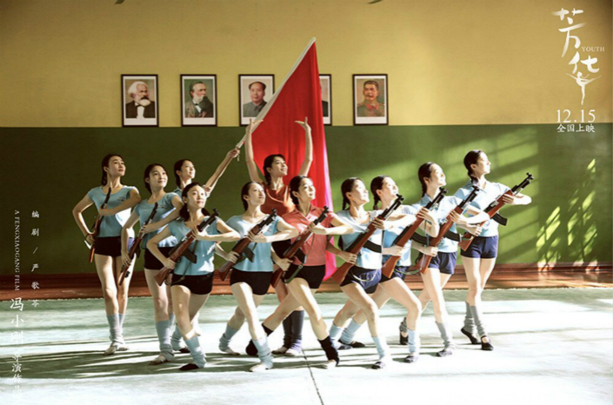
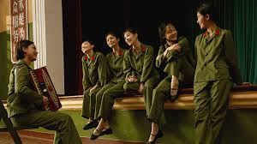
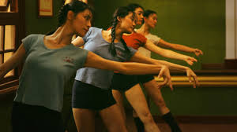
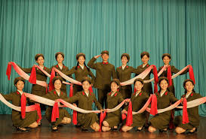
Youth Film (1)

Slide 12
Youth Film (2)

Slide 13
Youth Film (3)

Slide 14
Art Film（1）

Slide 15
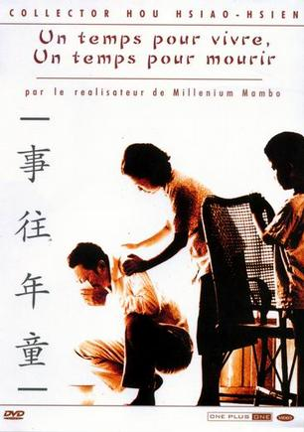
Art Film（2）

Slide 16
Arts Film (3)

Slide 17
Martial Arts Film (1)

Slide 18
Martial Arts Film (2)

Slide 19
Martial Arts Film (3)

