Slide 1
MEDIA 743 Chinese Film Genres
Youth Film (1)

Slide 2
Research Proposal
What is your topic?
What is your perspective?
What is your thesis statement?
What is your research approach?
What is your aim (academic contribution)?
What is your theoretical framework/assumption?
How is your aim to be backed up?
___________
What are my (critical) ideas/observations and how am I to present and structure them?

Slide 3
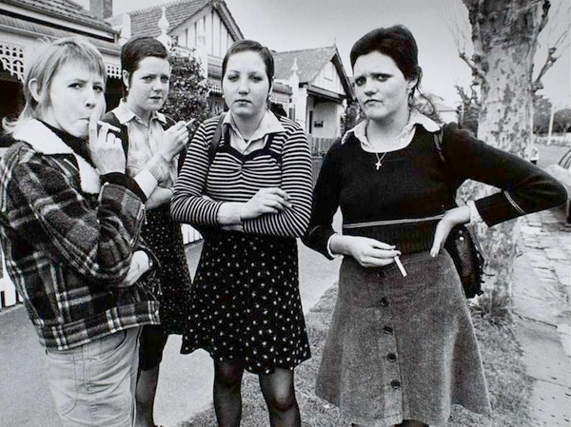
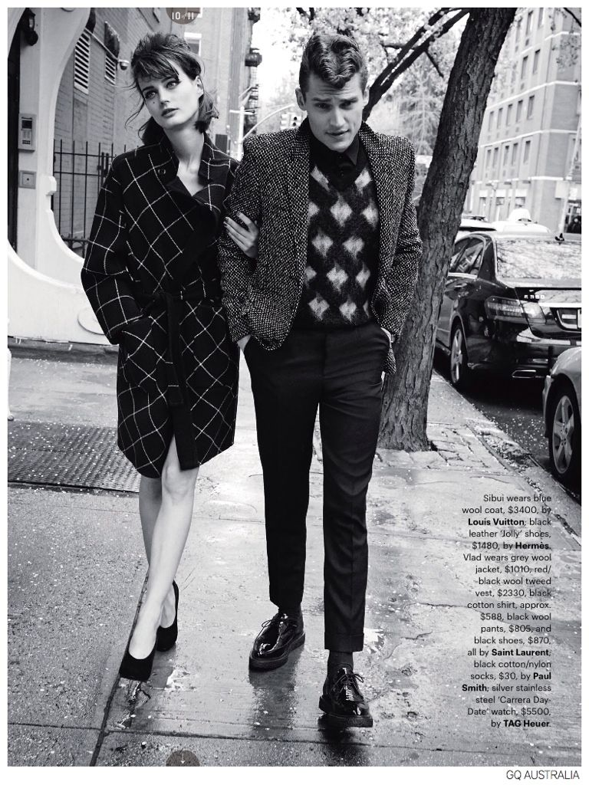
Youth Culture in Post-WWII West
Affluent society
Increasing living standard
Liberal attitudes
Discontent of the conservative/parochial elders/Establishment

Slide 4
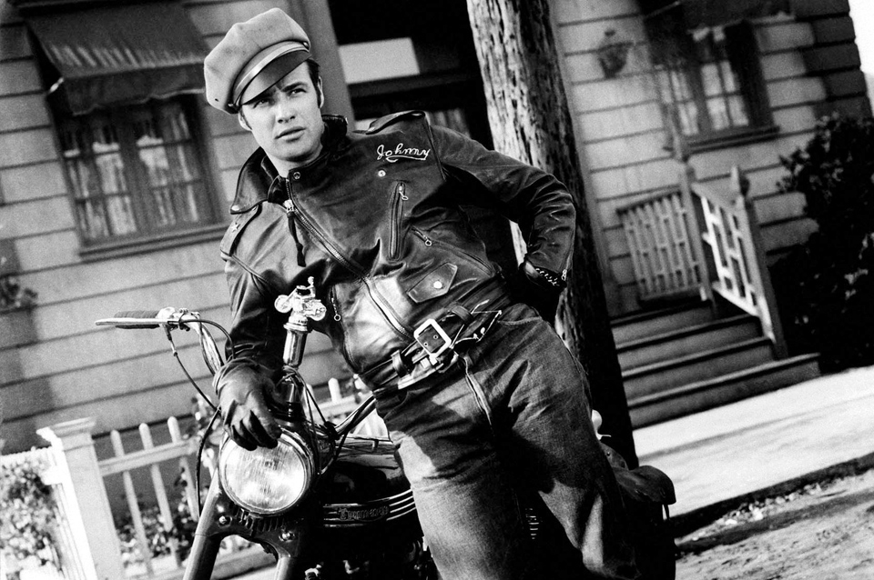
Youth Film as Genre
Films produced for young people, about young people, but catering to a overall market
Featuring young characters
Presenting their (“alternative”) lifestyle and behaviour
study youth as “stage” or as “experience”
from what/whose perspective

Slide 5
Chairman Mao on “Youth”
“The world is yours, as well as ours, but in the last analysis, it is yours. You young people, full of vigor and vitality, are in the bloom of life, like the sun at eight or nine in the morning. Our hope is placed on you. The world belongs to you. China's future belongs to you.”

Slide 6
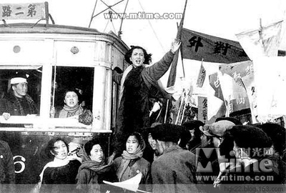
Song of Youth (青春之歌，1959)

Slide 7
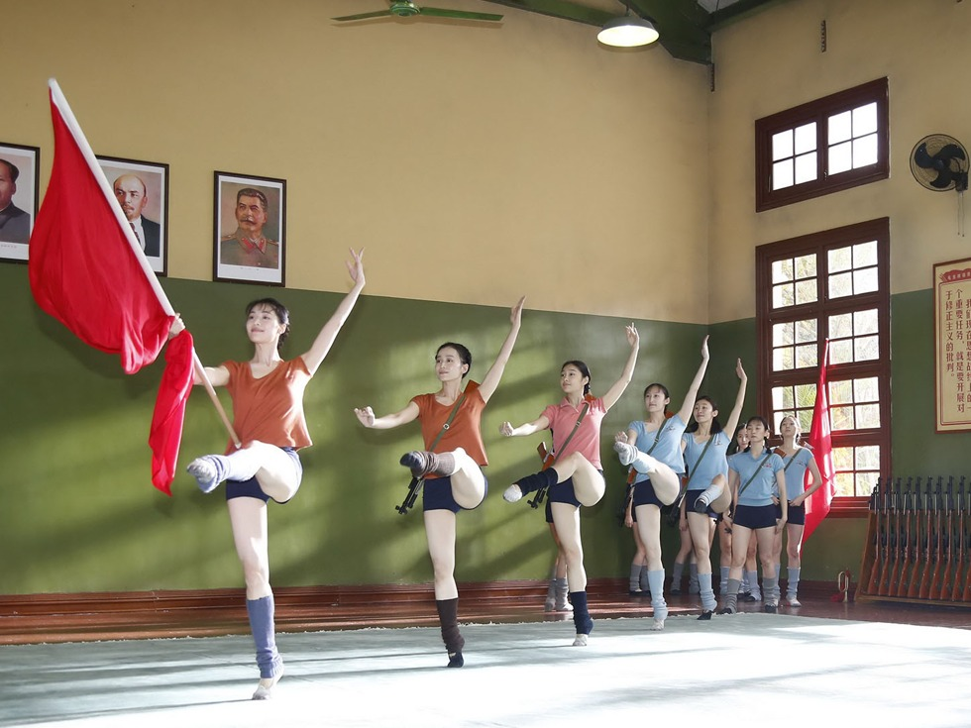
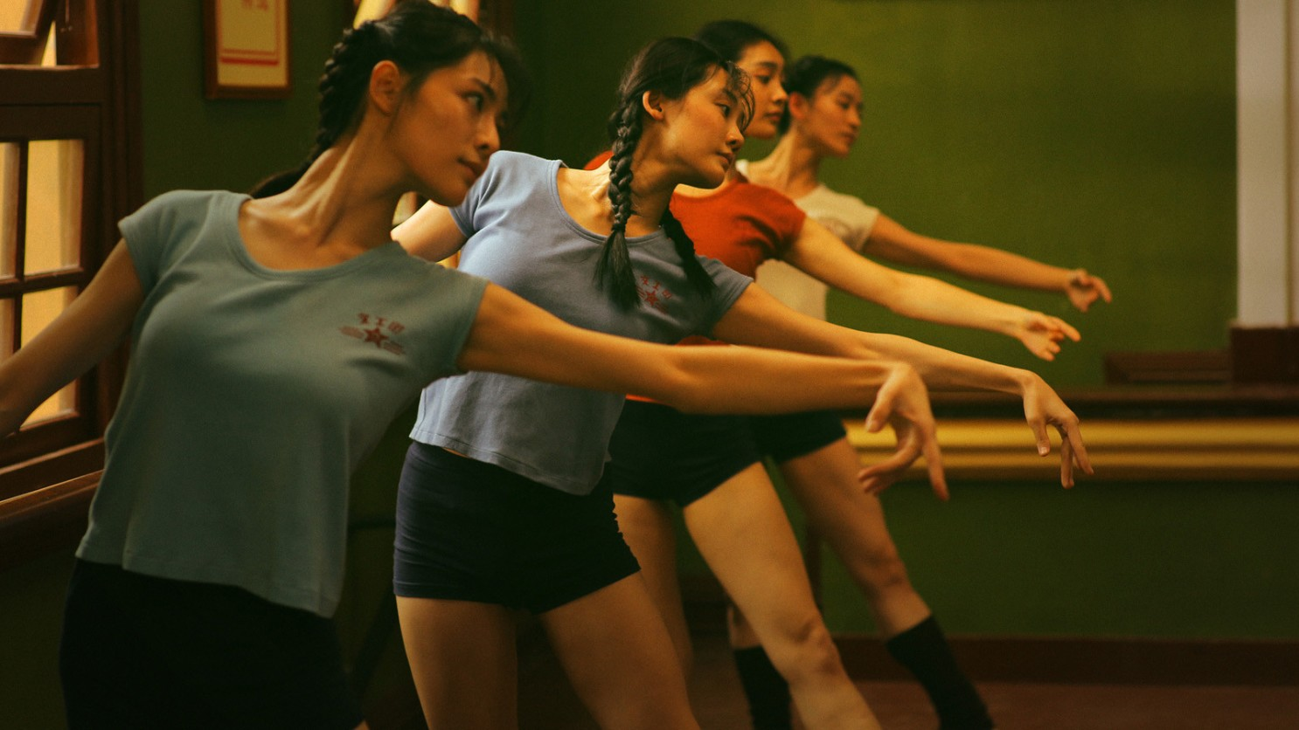
Youth (Feng Xiaogang, 2017)

Slide 8
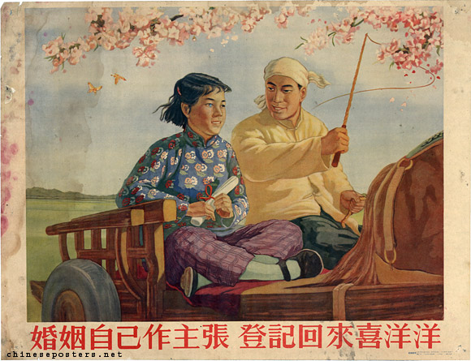
Marriage Law of the People’s Republic of China (1950)

Slide 9
Militia Woman: Inscription on a Photograph (Mao Zedong, February 1961)
飒爽英姿五尺枪，
曙光初照演兵场。
中华儿女多奇志，
不爱红装爱武装。
So bright and brave, with rifles five feet long,
At early dawn they shine on drilling place.
Chinese daughters have desire so strong
To face the powder and not to powder the face。

Slide 10
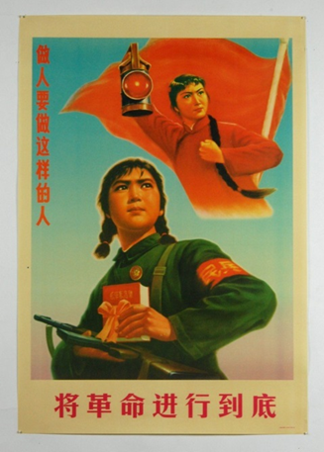
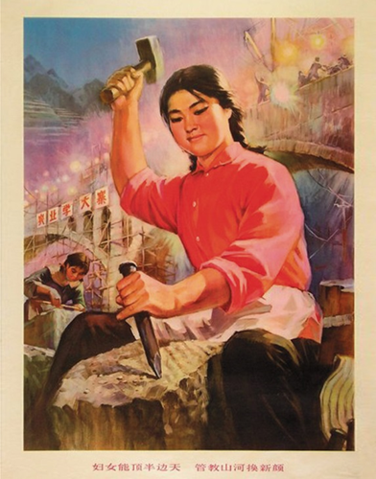
“Women Hold Up Half of the Sky”
“History has changed; men and women are now equal. What a man comrade does, a woman comrade can also do.”
(Mao Zedong, 1969)

Slide 11
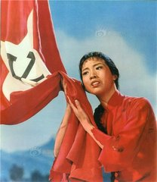
Revolutionary Model Performances (革命样板戏）

Slide 13
Song of the Dragon River (龙江颂, 1972)

Slide 14
On the Docks (海港，1973)

