Slide 1
MEDIA 743 Chinese Film Genres
Art Film (1)

Slide 2
What Is an Essay Topic?
An essay topic is an organizing rubric under which you construct the central argument/critical question of your inquiry.

Slide 3
Sample Essay Topics on Crouching Tiger, Hidden Dragon (from Google Scholar)
Globalizing Chinese martial arts cinema: the global-local alliance and the production of Crouching Tiger, Hidden Dragon
Far away, so close: cultural translation in Ang Lee's Crouching Tiger, Hidden Dragon
Crouching Tiger, Hidden Dragon: Kung fu diplomacy and the dream of cultural China
The China Simulacrum: Genre, Feminism, and Pan-Chinese Cultural Politics in Crouching Tiger, Hidden Dragon
The Woman Warrior: The Feminist Political Economic Analysis of Crouching Tiger, Hidden Dragon
Crouching Women, Hidden Genre: An Investigation Into Western Film Criticism’s Reading of Feminism In Ang Lee’s Crouching Tiger, Hidden Dragon

Slide 4
Writing academic essay in English as a foreign language
think and write in English (avoid translation)
learn to take notes in reading and viewing
put down your thoughts and ideas in English
write multiple drafts
have your writing fully proofread before submission

Slide 5
Recommended Essay Structure (6,500 words; for reference only)
introduction (300)
background/context (1000)
literature review (1500)
aims & methodology (200-300)
discussion & findings (2500-3000)
conclusion (500-700)

Slide 6
Referencing Literature in Chinese
Cai Guorong蔡国荣 (1985), A Study of Modern Chinese Wenyi Films 中国近代文艺电影研究, Taibei: Dianying tushuguan chubanbu.
Huang, Ren 黄仁 & Wang Wei王唯 (2004a) (eds.), One Hundred Years of Taiwan Cinema, vol. 1 台湾电影百年史话 上册 Taibei: Zhongguo dianying pinglun xuehui chubanshe.
--- --- (2004a) (eds.), One Hundred Years of Taiwan Cinema, vol. 2 台湾电影百年史话 下册 Taibei: Zhongguo dianying pinglun xuehui chubanshe.
Lin, Wenchi 林文淇 (2011), “Working girls and the spirit of ‘healthy realism” in Qiong Yao’s films of the 1970s: The Young Ones, The Autumn Love Song and The Heart Has Million Knots” (《彩云飞》、《秋歌》与《心有千千结》中的劳动女性与琼瑶1970年代电影的“健康写实”精神), Film Appreciation Academic Journal 电影欣赏学刊, 8(1), pp. 4-19. https://www.tandfonline.com/doi/abs/10.1386/jcc.4.1.45/7?journalCode=rjcc20 (accessed on 1 September, 2020)

Slide 7
Visual Style and Camera Work in White- Haired Girl
Passionate & fiery music (class hatred/conflicts)
Light on the girl and two men in shadow
Low angle for girl and high angle for men
Girl always occupying the centre; men on the margin

Slide 8
“Three Stresses”三突出 Aesthetic Principle and Revolutionary Model Performance

Slide 9
The 1980s
open door policy
imported ideas and concepts
Reflecting traditional value
“root-seeking” literature
poetry (avant-garde poets)
fine art
popular music (“Northwest wind” style)
films

Slide 10
Root Seeking Literature and One Hundred Years of Solitude

Slide 11
Avant-Garde Poetry
The Answer
Debasement is the password of the base,
Nobility the epitaph of the noble.
See how the gilded sky is covered
With the drifting twisted shadows of the dead.
… … … …
Let me tell you, world,
I—do—not—believe!
If a thousand challengers lie beneath your feet,
Count me as number thousand and one.
I don't believe the sky is blue;
I don't believe in thunder's echoes;
I don't believe that dreams are false;
I don't believe that death has no revenge.
... … … …
- Bei Dao
“a generation:
the black night gave me black eyes
still I use them to seek the light”
― Gu Cheng

Slide 12
Theatre of the Absurd

Slide 13
Father (Oil Painting, 1980)

Slide 14
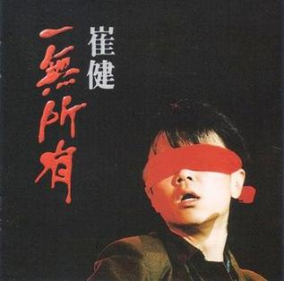
“Northwest Wind”

Slide 15
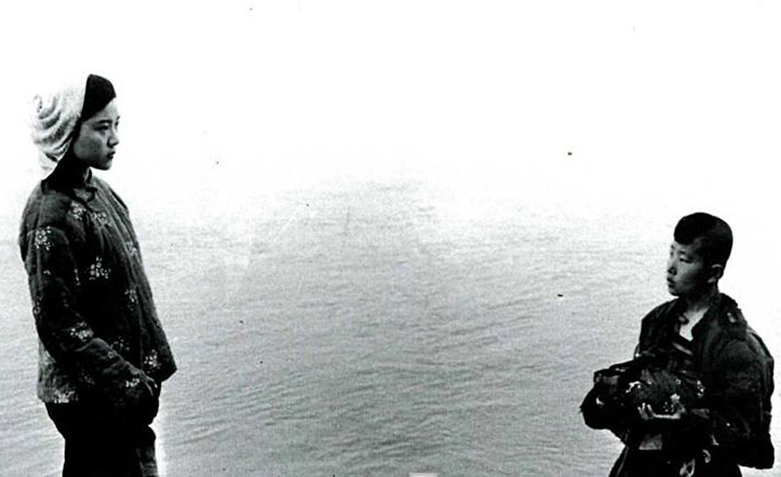
Chinese New Wave Cinema
background: (CR and ‘sacrificed youth’)
western/European influences
break with theatrical conventions
breaking with tradition
critical reflection
Setting (mainly rural; north(ern)-western)
allegorical
ambiguous
minimized story-line
a minimalist approach to dialogue
innovative style (overstatement of visual images)
Audiences (educated and intellectuals)

