Slide 1
MEDIA 743 Chinese Film Genres
Art Film (3)

Slide 2
5 Films set the conventions of art film as an international genre
The Seventh Seal (Ingmar Bergma, 1956)
Wild Strawberry (Ingmar Bergma, 1957)
Hiroshima, Mon Amour (Alain Resnais, 1959)
L’Avventura (Michelangelo Antonioni, 1960)
La Dolce Vita (Federico Fellini, 1960)

Slide 3
Why the 1960s?
a period of modernization (from austerity to affluence)
a period of liberalization (gender – sex and sexuality; class – civil right movement)
a time that marked the beginning of the long process of the secularization of Western society
a decade that saw dominance of consumerism
A decade witnessing movement of cultural rebellion

Slide 4
The rise of art films in Europe and beyond in the late 1950s and early 1960s:
Allan Renair, Jean-Luc Godard, Francois Truffaut and others of the new wave in France
Free Cinema movement in Britain (Lindsay Anderson)
Young German Cinema (Alexander Kluge)
Michaelangelo Antonioni and Federico Fellini in Italy
Ingmar Bergman in Sweden
Japanese new wave (Nagisa Oshima)
Luis Buñuel in Mexico
Roman Polanski (France/Poland)
Clauber Rocha (Brazil)

Slide 5
4 features of “Modernism”
Subjectivity
Point-of-view
Reflexivity
Open texture
And their 4 derivatives
Narrative intransitivity
Estrangement
Multiple diegesis/Intertextuality
Un-pleasure

Slide 6
Black Coal, Thin Ice as Noir (?!)

Slide 7
Commodification of society
“Street-side realism” (e.g.《小武》（1998),《任逍遥》（2002），《扁担·姑娘》（1998），《安阳婴儿》（2002）,《江城夏日》（2006），《盲井》（2003）,etc.
“new force director” (e.g. Zhao Wei 赵薇, Xu Zheng 徐峥, Yu Baimei 俞白眉, Tian Yusheng 田羽生, Guo Jingming, Han Han 韩寒, Xiao Yang 肖央, Lu Zhengyu 卢正雨, Li Fangfang, Jin Yimeng 金依萌， Cao Baoping 曹保平，Xue Xiaolu 薛晓璐 , Wuershan 乌尔善, Li Weiran 李蔚然, Teng Huatao 滕华涛 Lu Yang 路阳， Yang Chao 杨超, Bi Gan 毕赣, Qin Xiaoyu 秦晓宇, and Diao Yinan 刁亦男, etc.
Absence of “noir” in Chinese cinema

Slide 8
三段式线性叙事结构
（《白日焰火》）
第一段
开局
第二段
发展
第三段
结尾
矛盾出现
18分钟
“高潮“ 1
40分钟
中间情节点
(叙事发展不可逆转)
“李队长死”
71分钟
高潮
（“梁志军死”）
105分钟
Hook/铺垫
“发现尸快”
最后高潮
“白日焰火”
李自立人生最低谷
诱发事件
“美容店枪战”

Slide 9
Context of “Film Noir”
As American movies (adapted from the work of American writers and made by Hollywood Studios)
Labelled retrospectively by French critics to reflect significant narrative, stylistic and thematic transformations in American filmmaking
“classic film noir period”: 1941 (The Maltese Falcon) – 1958 (Touch of Evil )
Old-styled auteurs (e.g. John Ford and William Wyler) succeeded by a young generation (e.g. John Huston and Billy Wilder)

Slide 10
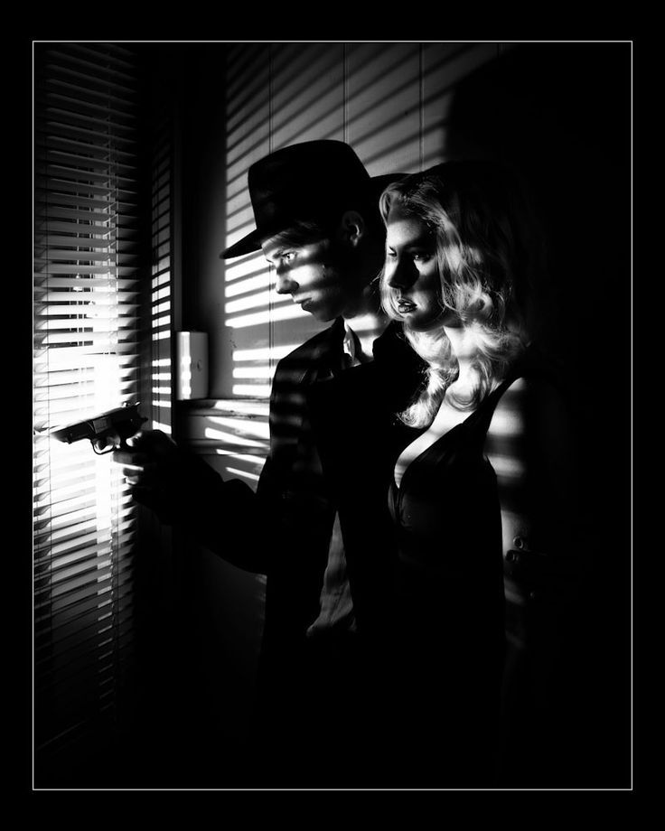
KEY VISUAL NOIR ELEMENTS
Settings
Night scenes
Costumes
Props
Cinematography
Lighting
... ...

Slide 11
Noir Narrative Patterns & Character Relations
The ‘hard boiled’ private eye
The Femme Fatale as destroyer
1. hero - femme fatale - husband
2. femme fatale - hero - domestic woman
3. hero - domestic woman - respectable man

