Slide 1
Kieran Beggs POLITICS 750 Immigrants and Migrant Workers

Slide 2
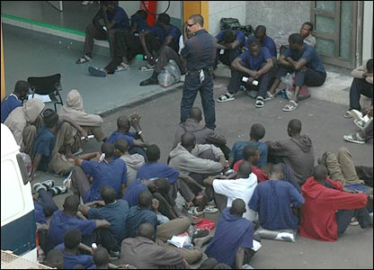
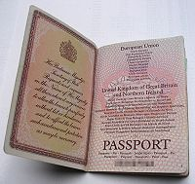
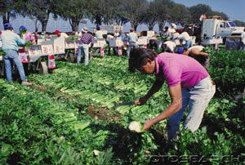
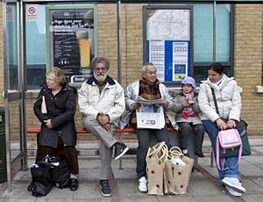
What is an immigrant, a migrant worker, an illegal immigrant ?. What rights does each have ?.

Slide 3
Today, one person out of 35 is an international migrant.
The number of people living in a country other than that of their birth is estimated at 175 million worldwide.
This represents 3 per cent of the world population, about the same as the population of Brazil.

Slide 4
What is an immigrant ?.
(United Nations own definitions)
An immigrant is someone who has left his/her country of nationality with the intention of residing in another.
A key context in this, is that the movement is voluntary and that the person will receive protection of his / her government upon return.
The term "migrant worker" refers to a person who is engaged or has been engaged in a remunerated activity in a State of which he or she is not a national.
The term is also used in other contexts. In China ‘migrant worker’ is the term applied to the millions of people who move from rural areas to cities in search of work.

Slide 5
An illegal immigrant (in some cases referred to as an illegal alien) this term is still used in many parts of the world, although is increasingly seen as politically incorrect.
In The United States – Illegal Immigration refers to the act of foreign nationals voluntarily staying or resettling in the United States in violation of U.S. immigration and nationality law. Those who have entered the United States in violation of the Immigration and Nationality Act are subject to deportation, often after a civil removal proceeding before an Immigration Judge.

Slide 6
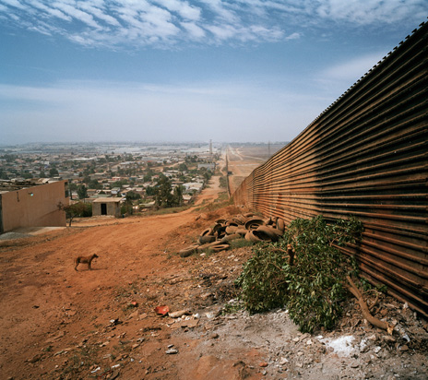
Paragraph (a), Title 8, Section 1325 of the U.S. Code refers to "Improper Entry By Alien", any citizen of any country other than the United States who-
Enters or attempts to enter the
United States at any time or
place other than as
designated by immigration
officers. – or Eludes
examination
or inspection by immigration
officers – or - Attempts to enter or obtains entry to the United States by a willfully false or misleading representation or the willful concealment of a material fact;

Slide 7
While the 1951 Convention on Refugees, offers protection to people fleeing war and/or persecution, it does not specifically offer any protection towards migrant workers.
In recognition of this, in 1990, The UN drafted and adapted The Migrant Workers Convention (MWC). The official name of the convention being The International Convention On The Rights Of Migrants and their Families.

Slide 8
Regardless of their legality, all migrant workers are said to be protected by the MWC.
Although being adapted by The UN in 1990, the convention required the ratification of 20 countries before it could come into effect.
For this reason the convention was not able to come into effect until 2003.
Many countries have not signed up to the MWC. To date the only states to ratify the treaty have been largely developing nations.
The original proposal for The Convention was first proposed in 1980, by a working group of nations, of which Mexico was a leading force.

Slide 9
Most of the member states who have ratified are typically Migrant Sending Countries. The Philippines, Mexico, Turkey and Morocco have all ratified The Convention.
All three of these nations are amongst the worlds largest senders of migrants.
India and China, are two major migrant sending nations who haven’t ratified.
To date no major migrant receiving country has ratified The Convention.
For migrant sending countries the Convention is an important vehicle to protect their citizens living abroad.
In the Philippines, for example, ratification of the Convention took place following the mistreatment of Filipino workers abroad.

Slide 10
When El Salvador and Guatemala ratified the convention on 14 March 2003 this figure of 20 countries was finally reached.
As of 2007, 37 countries had ratified the Convention.
In addition, several countries have signed the Convention. This means that their governments have expressed their intention to ratify the convention.
One of these signatories' being Indonesia, identified as a transit country for many migrants heading southwards to Australia.

Slide 11
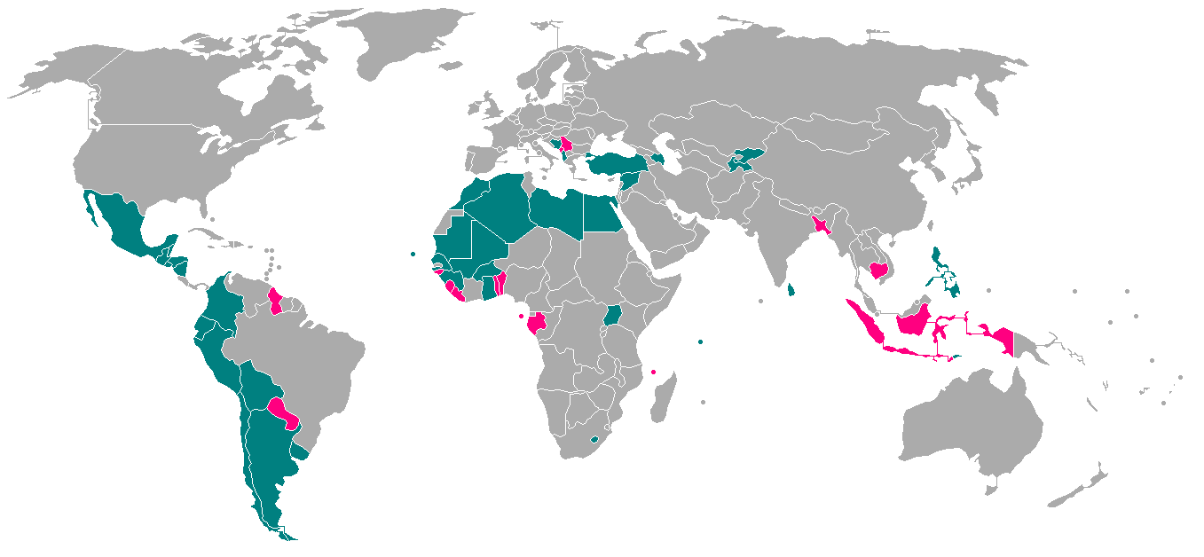
Countries coloured in blue have all ratified the treaty.
Countries coloured in red have all signed the treaty but not ratified it.

Slide 12
The Convention constitutes a comprehensive international treaty regarding the protection of migrant workers’ rights.
The Convention is aimed at guaranteeing equality of treatment and working conditions for migrants and their dependents.

Slide 13
The application of the Convention is monitored by a panel composed of 10 experts known as the Committee on the Protection of the Rights of All Migrant Workers and Members of Their Families).
These experts are elected by the states that have ratified the Convention.
The number of committee members will be increased from 10 to 14, once The Convention has been ratified by 41 countries.

Slide 14
A Campaign for the Ratification of the Convention was launched in 1998. The Steering Committee of the Campaign was created by an NGO called Migrants Rights International, with the aim of establishing a global campaign in support of the convention.
Currently, the Steering Committee of the Campaign is made up of 14 organizations: UN agencies, trade unions, NGOs and other international organizations.
The United Nations High Commissioner for Human Rights (UNHCHR) has a Special Rapporteur dealing with the human rights of migrants.
Some important members of The Steering Committee.
The International Labour Organization (ILO) deals with the promotion and protection of labour standards.
The United Nations Educational, Scientific and Cultural Organization (UNESCO) is concerned with the promotion of migrants’ social integration, and aims to promote cultural diversity.
The International Organization for Migration (IOM) is also a member of the Steering Committee

Slide 15
The convention applies throughout the entire migration process of migrant workers and members of their families, this process includes.
Preparation for migration.
Departure and transit.
The entire period of stay and remunerated activity in the State of employment.
Return to the State of origin.
In addition to actual migrant workers, The Convention also covers, Frontier Workers, and Seasonal Workers.

Slide 16
The Convention does not apply to the following people.
Refugees and stateless persons (unless legislation is provided for them in the country concerned.
Students and trainees.
Those contracted by the government of their own country to work in another.
Seafarers and those employed on offshore installations.
Those who settle in another country with the intention of becoming investors.

Slide 17
The Convention states that ‘workers are considered as ‘documented or in a regular situation, if they are authorized to enter, to stay and to engage in a remunerated activity in the state of employment, in accordance with the law of the state and to international agreements to which that state is a party’.
‘Are considered as non-documented or in an irregular situation if they do not comply with the conditions stated above.

Slide 18
PART III – Article 8.1 of The MWC States that- Migrant workers and members of their families shall be free to leave any State, including their State of origin.
This right shall not be subject to any restrictions except those that are provided by law, as being necessary to protect the public or national security of the state(s) concerned.

Slide 19
Amongst other points the convention states that - Migrant workers and members of their families are guaranteed their basic right to life.
Also states that no migrant or member of their family should be subjected to torture or any other cruel or inhuman treatment.
No migrant or member of their family should be required to perform forced or compulsory labour, nor shall they be held in slavery or servitude.
In States where imprisonment with hard labour may be imposed as a punishment for a crime, the performance of hard labour should be subject to the sentencing of a competent court.

Slide 20
Migrant workers and members of their families shall be entitled to effective protection by the state against violence, physical injury, threats and intimidation, whether by public officials or by private individuals, groups or institutions.
More practical measures are mentioned in articles 7,8 and 9.
When a migrant worker or a member of his or her family is arrested or committed to prison or custody pending trial or is detained in any other manner: (a) The consular or diplomatic representative of his or her State of origin shall, be informed without delay of his or her arrest or detention.

Slide 21
The person concerned shall have the right to communicate with the said authorities.
The person concerned shall be informed without delay of this right and of rights deriving from relevant treaties, if any, applicable between the States concerned.
The person is also free to correspond and to meet with representatives of the said authorities and to make arrangements with them for his or her legal representation.
On attending court proceedings, the said person shall have the assistance, if necessary without cost to them, of an interpreter, if they cannot understand or speak the language used.

Slide 22
The Convention in principle is groundbreaking in the sense that it covers both lawful and irregular migrants and provides the first international definition of ‘irregular migrant workers.
Furthermore, the Migrant Workers Convention recognizes that-
Workers who are non-documented or in an irregular situation are frequently paid lower wages and are forced to work under less favorable conditions than other workers. Employers are of course likely to exploit this.
Part III of the Migrant Workers Convention applies to all migrant workers, irregular as well as regular, and includes the right to enjoy treatment that is at least equal to nationals of the state of employment in respect of
The right to enforce employment contracts against employers.
The right to join trade unions.
The right to emergency medical care.
The right to basic education, regardless of a child’s or parents’ irregular status.
The Migrant Workers Convention emphasizes that these rights apply to both, irregular and regular migrant workers, and states that workers are not to be deprived of any of these rights.

Slide 23
Obstacles to Ratification
First, some states maintain that their national legislation already protects migrant workers.
This is notably the case with Western countries. They therefore argue that ratifying the Convention would be pointless.
There are also a number of other probable reasons reasons for this situation. Some states have only a small number of migrants on their territory, and do not therefore see the need to legislate on this topic.
In other cases, the Convention is not well-known and is therefore not high on the political agenda.
In other cases, the Convention is not well-known and is therefore not high on the political agenda

Slide 24
Some states do not wish international agreements to interfere with their migration policies, which they view as a strictly national issue.
Economic instability and high unemployment prompt states to give preference to nationals over foreign workers.
States have ungrounded fears Several states are reluctant towards the Convention because they consider that it gives too many rights to migrant workers

Slide 25
The Reluctance of States to Ratify
States are reluctant towards the Convention because they consider that it gives too many rights to migrant workers.
There are several significant points in relation to this.
The Convention incorporates migrants’ families, therefore implying a case for family reunion.
The Convention includes undocumented migrants and, while it does not encourage their presence, ensures that they have access to basic human rights.
Rather than granting rights to undocumented migrants, most countries look toward expelling them.

Slide 26
States are afraid that granting more rights to migrants would make their countries more attractive to migrants.
By signing and ratifying the Convention, states fear that they might be examined as to the way in which they implement it. Thus leading to situations where their own human rights policies might come into question.
Many states would argue that the distinction between migrant workers and refugees is not always clear.

Slide 27
Many states would argue that the distinction between migrant workers and refugees is not always clear.
Asylum-seekers may be economic refugees because they flee economic rather than political problems. Migrants are sometimes incited to present themselves as asylum-seekers because they have no other possibility of legally entering a country.
On the other hand, other migrants are in refugee-like situations but prefer to cross borders as migrant workers to avoid suspicion.

Slide 28
Sending Countries
Countries who are regular senders of migrant workers are likely to object to any restrictions imposed by the more developed receiving nations.
Money sent home by migrants (remmittances) is likely to be beneficial to the economies of sending countries.
In Morocco, for example, the amount of money sent via remittances represents 66 per cent of total financial inflows into the country, and nearly ten per cent of the country’s GDP.
In The Philippines, past leaders (notably, former President Marcos, actively encouraged workers to leave and earn money overseas as a means of generating wealth at home.
The disadvantage for sending countries is the resulting brain-drain of skilled and educated people.

Slide 29
The Success Of The Convention to date
The success of The Convention has so far been limited, due to the obvious lack of ratifications.
In 2002, both the European Parliament and the General Assembly of the Organization of American States supported the ratification of the Convention.
In January 2003, Brazilian President Lula da Silva has reaffirmed his country’s commitment to human rights instruments, including the Convention although Brazil has not signed or ratified.
Italy incorporated many provisions from the Convention in its 1998 Immigration Law.
Eleven EU countries have ratified one of two separate conventions put forward by The International Labour Organization, thereby offering at least some protection to migrant workers

Slide 30
Regional Agreements
The Manila Process – 17 Countries from the Asia / Pacific Region have met yearly since 1996 – This lead to The Bangkok Agreement of 1999, where the 17 countries agreed to co-operate in efforts to counter people smuggling and trafficking.
The Puebla agreement involves The U.S, Mexico and other Cenral American states. The group’s plan of action involves exchanging information on migration policy - Establishing links between migration and development – The prevention of people smuggling / trafficking.
EU Nations signed The Hague Agreement in 2004. Theagreement aims to establish a common approach to policies on migration and asylum.

Slide 31
Current estimates on the total number of international foreign workers, in all countries stands at about 25 million, with a large number number of dependents accompanying them.
An estimated 14 million foreign workers live in the United States, including 4 or 5 million undocumented workers. The largest source country being Mexico.
At present 5 million foreign workers live in Northwestern Europe, half a million in Japan, and around 5 million in Saudi Arabia.
Countries such as India, Pakistan and the Philippines have long experienced a brain drain of highly skilled workers.
.

Slide 32
Current Estimates
Current estimates on the total number of international foreign workers, in all countries stands at about 25 million, with a large number of dependents accompanying them.
An estimated 14 million foreign workers live in the United States, including 4 or 5 million undocumented workers. The largest source country being Mexico.
At present 5 million foreign workers live in Northwestern Europe, half a million in Japan, and around 5 million in Saudi Arabia.

Slide 33
The Benefits for host countries
Migrants fill labour and skills shortages.
This has historically been the main reason behind planned immigration.
By recruiting and actually documenting migrant workers, countries can actual control immigration.
Easier to prevent illegal immigration.

Slide 34
Current trends in immigration.
Since the expansion of the European Union in 2005 large numbers migrants have moved from the former Eastern Bloc countries to the more developed countries of the west.
Interestingly, different groups of immigrants have favoured different countries.
While large numbers of Poles have moved to The UK, Ireland and The Netherlands, Romanians have favoured Spain and Italy.
A totally different trend in migration has been the increased flow of North Europeans moving south to countries such as Spain.
The Financial Times quoted that Spain ‘has now become the number one destination for Brits and other North Europeans choosing to live abroad’. An estimated 1 million Brits are now living and working in Spain.

Slide 35
EU Enlargement and labour (The UK)
UK decided to allow migrant workers access because:
unemployment is low at the moment;
there are skills shortages that accession nationals can fill;
more legal flows will reduce demand for illegal workers;
the UK stands to gain an early starter advantage.
(Source 1PPR – The institute for Public Policy Research).

Slide 36
Figures from The UK
Population: Net immigration has added 1.5 million people to the population of the UK over the last 10 years. Two-thirds of them have come from the continents of Asia and Africa. In 2006 the total UK population was 60.6m.
Figures: People born overseas account for about 10% of the population. This is up from just more than 6% in 1981 and just over 8% in 2001.
(Figures:UK census 2006, retrieved from The Guardian 02/04/09)

Slide 37
New Zealand
New Zealand’s own immigration policy took a turn with the passing of a new Immigration Act in 1987. This was to end the preference for migrants from Britain and Europe based on their race, and instead classify migrants on their skills, education and potential to contribute to New Zealand economy and society.
The introduction of the points-based system came under the National government in the early 1990’s.
This system is very similar to Canada’s, and came into effect in 1991. Effectively the qualities that are sought in the migrants are ranked using a points scale.

Slide 38
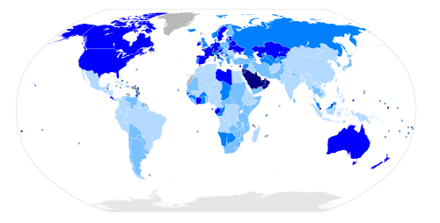
No data
more than 50%
20% to 50%
10% to 20%
4% to 10%
1% to 4%
less than 1%
Map of the world with countries coloured according to their immigrant population as a percentage of total population

Slide 39
Conclusion
The United Nations International Convention on The Rights of Migrants and Their Families has so far not been able to demonstrate any real positive results, due to the reluctance of most countries to ratify it.
In overall conclusion it can be said that illegal immigrants and undocumented migrant workers in most parts of the world will continually be denied their basic rights.

