Slide 1
Human Trafficking and People Smuggling
By Kahukura Bennett
29 April 2014

Slide 2
Definitions
Human Trafficking
“The recruitment, transportation, transfer, harbouring or receipt of persons, by means of threat or use of force or other forms of coercion, of abduction, of fraud, of deception, of the abuse of power or of a position to achieve the consent of a person having control over another for the purpose of exploitation” UNODC, 2003
People Smuggling
“The procurement, in order to obtain, directly or indirectly, a financial or other material benefit, of the illegal entry of a person into a state of which the person is not a national or permanent resident”
UNODC, 2004

Slide 3
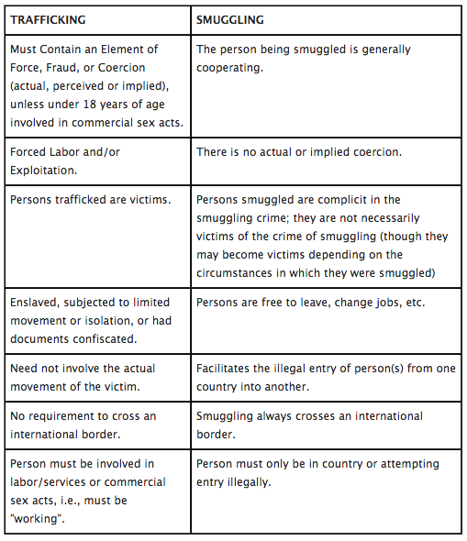

Slide 4
Convention against Transnational Organized Crime
1. The Protocol to Prevent, Suppress and Punish Trafficking in Persons, Especially Women and Children (2003)
- Purpose: To prevent and combat trafficking in persons, paying particular attention to women and children, to protect and assist the victims of such trafficking, with full respect for their human rights and to promote cooperation among States Parties in order to meet those objectives.
- 117 Signatories and 159 State Parties

Slide 5
2. The Protocol Against the Smuggling of Migrants by Land, Air and Sea (2004)
- Purpose: To tackle the facilitation or irregular migration by profit seeking criminals, to cooperate across borders to achieve this goal and to protect the rights of migrants.
- Article 5:
“ Migrants shall not become liable to criminal prosecution under this Protocol for the fact of having been the object of conduct set forth in article 6 of this Protocol”
- 112 signatories and 138 State Parties
Notes:
There aim is to also guide policies and create more cohesion between states. The idea to fight international criminal organisations you need cohesive international actions

Slide 6
Human Trafficking
The International Labour Organization (ILO) estimates that there are 2.4 million trafficking victims globally at any one time. With profits beginning at US$10 billion for traffickers.
Human trafficking is a global phenomenon with victims from at least 127 countries being reported to be exploited in 137 states
Approximately 460 different trafficking routes were identified between 2007 and 2010
Sexual Exploitation is more common in Europe, Central Asia and the Americas
Forced Labour is more common in Africa, the Middle East, South and East Asia and the Pacific

Slide 7
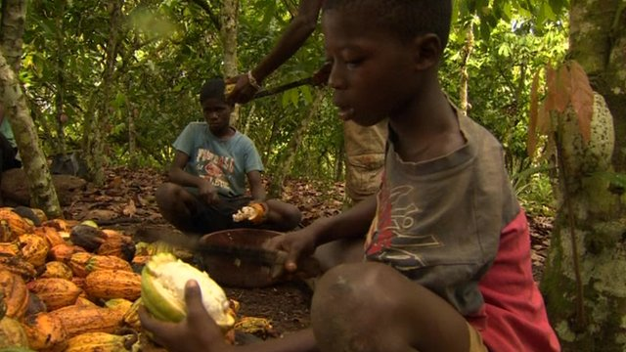
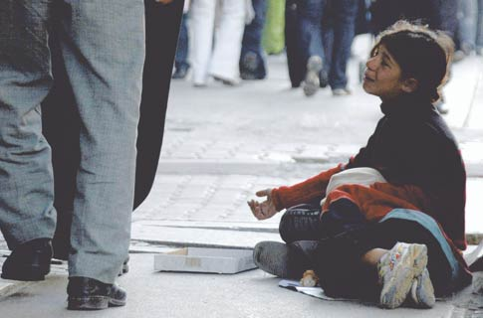
One in five trafficking victims are children….
http://www.knowledgefountain.co.uk/nestle-failing-on-child-labour/#!prettyPhoto/0/
http://www.unicef.org/turkey/sy22/cp47.html
Two in three trafficking victims are women….
http://tbtcreative.blogspot.co.nz/2013/03/human-trafficking-in-south-africa.html

Slide 8
Human Rights Violations
Threats to National Security
The Right to personal autonomy
The Right not to be held in slavery or servitude
The Right to liberty and security of person
The Right to be free from cruel or inhuman treatment
The Right to safe and healthy working conditions
The freedom of movement
Increasing social breakdown
Depriving countries of human capital
Undermining public health
Subverts government authority
Promotes organised crime
Can finance illicit activities and terrorism

Slide 9
Human trafficking - convictions
Human trafficking convictions are still relatively low
- 16% of state signatories to the Protocol to Prevent, Suppress and Punish trafficking in persons recorded zero convictions between the years 2007 and 2010. However, there are still success stories. This January alone a number of convictions have occurred worldwide

Slide 10
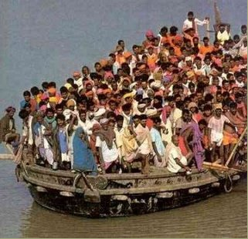
People Smuggling
4 million people smuggled annually
Revenues over US$5 Billion
In comparison to trafficking victims, smuggling victims are often the ones that are prosecuted, as opposed to the smugglers
http://thestringer.com.au/98-bodies-thrown-into-the-sea-32-asylum-seekers-rescued/#.U15O1eaSxR4

Slide 11
Helping the Victims of Human Trafficking and People Smuggling
The dominant perspective taken by the two UNODC Protocols addressing human trafficking and people smuggling is a human rights approach. States can be placed into three categories: 1) Source Country, 2) Transit Country, 3) Destination Country
The Source Country: Create greater social, political and economic stability so that potential victims do not have a desire to leave the country
2) The Transit Country
Monitor the inward and outward flow of peoples. Attempt to stop illegal organizations and also to support victims, including keeping them within the transit country until it is deemed safe for them to return to their country of origin
3) The Destination Country Ensure the human rights of victims. Destination countries may even be asked to assimilate victims if it is too dangerous for them to return to their country of origin

Slide 12
Case Study
The Smuggling of Peoples into the United States of America

Slide 13
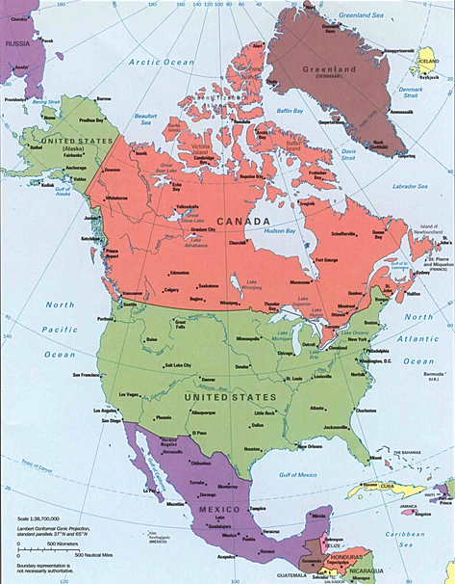

Slide 14
Facts and Figures
There are roughly 11.7 million illegal migrants living in America
In the early 1990s border crossings were largely unmonitored
In 1993 large scale campaigns occurred which applied pressure on congress to deal with the large scale migration of ‘alien’ migrants
After this took place there was a surge of smuggler utilisation, with estimations approaching 80%
Although Mexicans make up 93% of smuggled individuals in the United States there are still large numbers of people coming from Brazil, El Salvador, Guatemala, Honduras and increasingly China
Immigration Reform Act (1990); Immigrant Responsibility Act (1990); Prevention Through Deterrence Policy (1995)
In 1996 Mexico began to alter their own immigration policies and began deporting illegal immigrants.

Slide 15
- Estimates for the number of Chinese smuggled into the U.S.A annually range from 30, 000 up to 100, 000
Routes can be directly from China or more elaborate, going by land to South Africa then Smuggled by air to Brazil they then go by sea or land to Costa Rica or Panama, or by air directly to Mexico.
The use of smaller boats are used to avoid detection particularly when transiting through the Caribbean
Smuggling is a high risk venture for the smuggled individuals. In 2010 417 would be migrants died on route to the U.S.A with the causes of death primarily being through exposure, dehydration, heatstroke and drowning.
Fees can vary between $2, 000 between Mexico and America and beyond $10,000 for those that must pass multiple borders
The push factors for the source countries vary. In Central and South America it is often due to poverty and lack of opportunities. In China it is usually the middle class who attempt to be smuggled into U.S.A as they know of the potential for a better life in U.S.A and can afford the smuggling fees

Slide 16
Americas approach to ‘controlling the border’ and a potential alternative
Is very much an enforcement-only approach
They control and monitor the borders between Mexico and Canada as well as 2,000 miles of coast
Although the total number of smuggled peoples shows that it is on the decline, the number of deaths due to smuggling is increasing.
A potential alternative, as proposed by the National Foundation for American Policy is to increase the avenues of legal migration, such as providing more temporary work visas and making them more accessible, or perhaps creating seasonal work visas.
Additionally a change in mentality from seeing those who are smuggled as victims as opposed to criminals. This could allow for a greater focus upon stopping the criminal organisations
Notes:
Although the total number of smuggled peoples is showing a decline, the number of deaths due to smuggling is increasing

Slide 17
QUESTIONS
1. There is a lot of attention put upon the ‘push’ and ‘pull’ factors in attempting to understand illegal migration. Would it be beneficial to expand our conception of what it is that lures people to other countries and what motivates them to leave their own, such as historical and family reasons?
2. Is a human rights approach an adequate way of addressing the issue of human trafficking and people smuggling victims, as it may undermine state sovereignty and security

