Slide 1
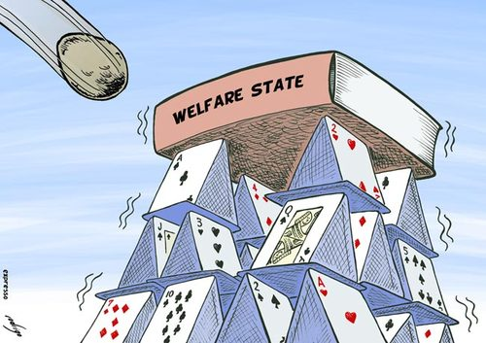
SOCIOLOGY OF THE WELFARE STATE
http://www.zerohedge.com/news/2015-03-31/world-without-welfare-state
SOCIOL 317
Lecture 4
Challenges to welfare states
12 March 2020

Slide 2
Lecture outline
Common challenges to welfare states 1960s-1980s
Shifts in the social context
Shifts in the economic context
Shifts in the political context
Different routes taken by differing welfare regimes
Further shifts in the economic context 1990s+

Slide 3
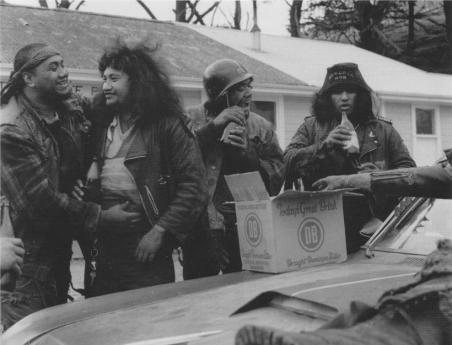
Shifts in the social context
Demographic changes since 1960s
Growth of middle-class
Population boom - youth culture
Ageing population
Changing family structures
Increasing participation of women in paid workforce
Increasing urbanisation and
immigration
http://publicaddress.net/speaker/damian-christie-interviews-ans-westra/

Slide 4
Shifts in the social context
New social movements since 1960s have encouraged new claims against the welfare state
Feminists challenged the way in which the welfare state assumes and has
promoted the gendered division of
labour – but also saw it as a way of
improving women’s wellbeing
e.g. 1972 NZ Equal Pay Act
e.g. 1973 NZ Domestic Purposes Benefit
http://www.goodreads.com/book/show/414923.Counting_for_Nothing

Slide 5
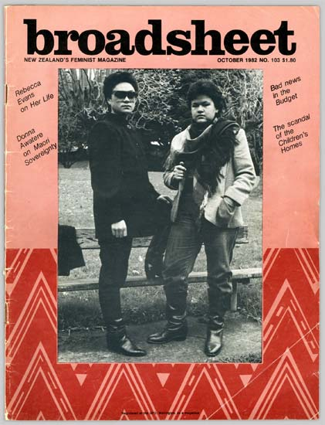
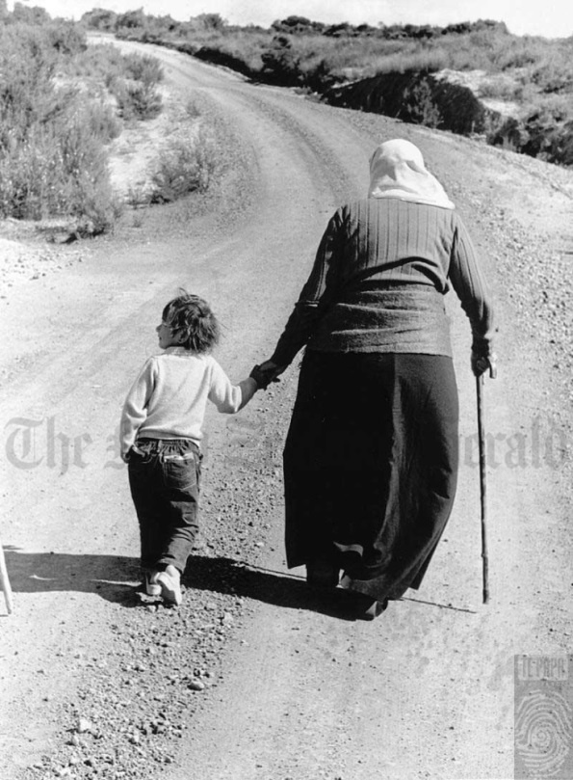
Shifts in the social context
http://www.teara.govt.nz/en/document/29815/wahine-toa-donna-awatere-and-ripeka-evans
Anti-racists challenged the way that welfare state policies had promoted colonisation and racism – but also saw welfare state
as a way of achieving anti-racist goals
and improved distribution of resources
e.g 1975 NZ Treaty of Waitangi Act
e.g 1984+ biculturalism endorsed
By 1970s, less focus on right to minimal decency and greater focus on equal right to participate and belong in society
https://horiwood.wordpress.com/tag/dame-whina-cooper/

Slide 6
Shifts in the economic context
Long-term trends have had a significant impact on the welfare state:
Shift from norm of low-skilled industrial jobs to service jobs = de-industrialisation
Increasing levels of global connectivity and inter-relationships in labour market, policy learning = globalisation
Increasing dominance of financial institutions (instead of manufacturing or agricultural institutions) = financialisation
Periods of economic crisis have also provided a political rationale for welfare state retrenchment …

Slide 7
Shifts in the economic context
1970s-1990s global economic crisis
1971 collapse of Bretton Woods monetary order
- unstable exchange rates
1973 OPEC price shock
International trade stagnation
Falling industrial profits
Low growth, increasing inflation
Expanding budget deficits, deteriorating balance of payments
Rising volume of national/international debt
Impacted negatively on the material wellbeing of all but the richest citizens
Changed the relations between workers and employers
Challenged the appropriateness of state intervention in the economy/Keynesian orthodoxy in many countries, especially those in the ‘liberal welfare regime’
Raised questions about the sustainability of the welfare state
http://www.gettyimages.co.nz/pictures/garage-during-the-petrol-shortage-of-1973-displaying-a-no-news-photo-3253512

Slide 8
‘Crisis of the welfare state’ 1970s-1980s
Different welfare states faced similar pressures:
Wanted to defer wage increases and cut labour costs to deal with immediate financial crisis BUT
To do this had to increase public expenditure on welfare state to compensate YET
Tax revenue was not very high because low wages/ unemployment
The welfare state was increasingly seen as a barrier to (not facilitator of) economic recovery and as having reached its upper limit
None of the regime types managed full employment and sustained balanced growth after 1973
BUT
Some combined welfare state expansion with full employment and reasonable rates of economic growth for some years

Slide 9
Responses to the ‘crisis’
Social democratic | Corporatist | Liberal
Expanded welfare state employment, while maintaining existing social security standards | Induced reduction in labour supply, while maintaining existing social security standards | Deregulated wages and labour market, while eroding welfare state services
Active labour market policies e.g. subsidies to employers | Subsidise exit of unemployed, primarily through early retirement | Greater labour market and wage flexibility
Expansion of public sector service jobs – especially affected women | Discourage female participation | Greater selectivity for welfare assistance
This worked till early 1990s, then: | Trimming of social insurance entitlements only minor | Workfare – activity tests, work for the dole
Stronger emphasis on work and training for unemployed, especially young AND tightening of social security system | This led to poor job growth/labour market flexibility, significant social exclusion | Wage deregulation generally led to employment growth but also increased wage inequality and poverty
Drift towards privatisation BUT basic principles of social democratic welfare state remain

Slide 10
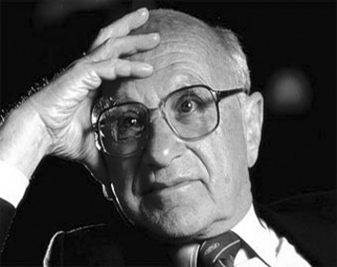
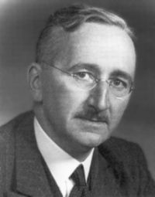
Shifts in political context
http://oll.libertyfund.org/people/friedrich-august-von-hayek
http://www.theimaginativeconservative.org/2015/09/the-free-market-
wisdom-of-milton-friedman.html
Although most evident in the ‘liberal welfare regime’, neoliberalism has come to dominate the political/economic sphere in many countries
Neoliberalism = an amalgam of different ideas, including:
Neo-classical economic theory
Market best institution for conduct of economic matters because most efficient = consumer sovereignty
Low inflation best way to ensure economic growth (monetarist policy)
Public choice theory
Individuals act in own self-interest to rationally maximise benefits, including public bureaucrats - so need to introduce competition in public services
Neo-conservatism
Moral values and ‘enterprise culture ’ promoted – poverty culturally determined
by the values, attitudes, mores and lack of aspirations transmitted across generations
In policy terms: greater privatisation of social services; deregulation of economy; focus on low inflation as key macro-economic goal; individual (rather than government) responsibility for addressing social risks etc

Slide 11
Further shifts in the economic context
As economic conditions improved in the mid-to-late 1990s and 2000s, however, public less tolerant of retrenchment and of growing inequality/poverty
Many citizens wanted change but decreasing distinctions between Left and Right left them with little electoral choice … the political Left thus reinvented itself with increasing talk about:
‘Modernising’ the European social model
The ‘Third Way’
A ‘new social democracy’
In policy terms:
Neoliberal economic policies BUT
State facilitates (not provides) services through social investment
State facilitates integration of people into the market by building human capital (rather than protecting them from the market)
A future-focused interest in preventing social exclusion
http://www.dw.com/en/britain-france-lock-horns-over-budget/a-1617092

Slide 12
Even further shifts in the economic context
2007-2008 global financial crisis again challenged the neoliberal orthodoxy
Bank bail-outs
Stimulus packages (tax cuts, corporate subsidies, increased welfare provision)
Reversed or stalled economic growth so
less tax revenue yet more spending needed
because of growth in unemployment
But also provided the rationale for a new wave of welfare state retrenchment (see later lectures)
Often
referred to
as ‘pseudo-
Keynesian’
responses

Slide 13
Lecture summary
The last 50 years have seen significant social, economic and political shifts
These are linked to the emergence of new ‘social risks’ e.g.
Work: Insecure/part-time work, reduced employment protections/wage adequacy, multiple careers across the life-course etc
Family: Divorce/family break-up more common, multiple family forms
Many of these are common to welfare states across the developed world but their responses reflect differences in their institutional and political context and have resulted in different levels of inequality/poverty

