Slide 1
SOCIOLOGY OF THE WELFARE STATE
http://blogs.oregonstate.edu/katherinemain/
SOCIOL 317
Lecture 7 (a)
From social protection to social investment:
Child Protection
Week 4: 31 March 2020

Slide 2
Lecture outline
Early focus on child protection
Recent trends in child protection
National-led government’s reforms 2013-2015
Labour-led government’s response 2017+
What could NZ learn from the Family House and Whānau Ora models ?

Slide 3
Early focus on child protection
Welfare regimes have differed in their views about the role of the state in child welfare
Historically, there was greater tolerance of autonomy in parental discipline than now BUT
State intervention has been more evident in social democratic welfare regimes than corporatist, southern European and liberal welfare regimes ones
In most countries there was a tendency to place orphaned/neglected/abused children in institutions until the 1970s and 1980s – for more info on NZ experience, see http://www.teara.govt.nz/en/childrens-homes-and-fostering
There is growing evidence that many such institutions were the sites of abuse for children, see https://www.abuseincare.org.nz/ and https://www.occ.org.nz/assets/State-of-Care.pdf

Slide 4
Recent trends in child protection
There has since been a process of deinstitutionalisation, a greater focus on fostering rather than adoption and a greater focus on children’s rights
In NZ, the Puao-Te-Atata-Tu report in 1988 highlighted institutional discrimination towards Māori in social welfare (including child welfare), leading to the 1989 Children and Young Person’s Act’s focus on children rights and emphasis on whānau placements for Māori children
More recently, there has also been public debate about acceptable forms of parental discipline. The ‘Anti Smacking’ legislation (Crimes (Substituted Section 59) Amendment Act 2007) removed the defence of reasonable force for parents prosecuted for assault of their children

Slide 5
Recent trends in child protection
The Cumulative Prevalence of Maltreatment Among New Zealand Children report (Rouland & Vaithianathan 2018) followed 55,443 children born in 1998 until 2015 – by age 17:
Almost 1 in 4 NZ children had been reported to child protection services
Almost 10% had been a victim of abuse or neglect
3% had been put into foster or other care
½ of the substantiated neglect occurred by age 6 years, whereas the medians for emotional abuse, physical abuse, and sexual abuse were 9 years, 11 years, and approximately 13 years respectively
Girls were more likely to have reports of concern and be found to been maltreated (e.g. 3.2% of girls had been sexually abused by age 17 compared to 0.8% of boys)
The number of children/young people in custody increased overall 2013-2017 (overall and for all ethnic groups except NZ Pakeha and ‘other/multiple ethnicity’)
https://www.occ.org.nz/assets/Uploads/20200116-OCC-StatisticalSnapshot2.pdf
https://www.nzherald.co.nz/nz/news/article.cfm?c_id=1&objectid=12005194
https://www.msd.govt.nz/about-msd-and-our-work/publications-resources/statistics/cyf/kids-in-care.html

Slide 6
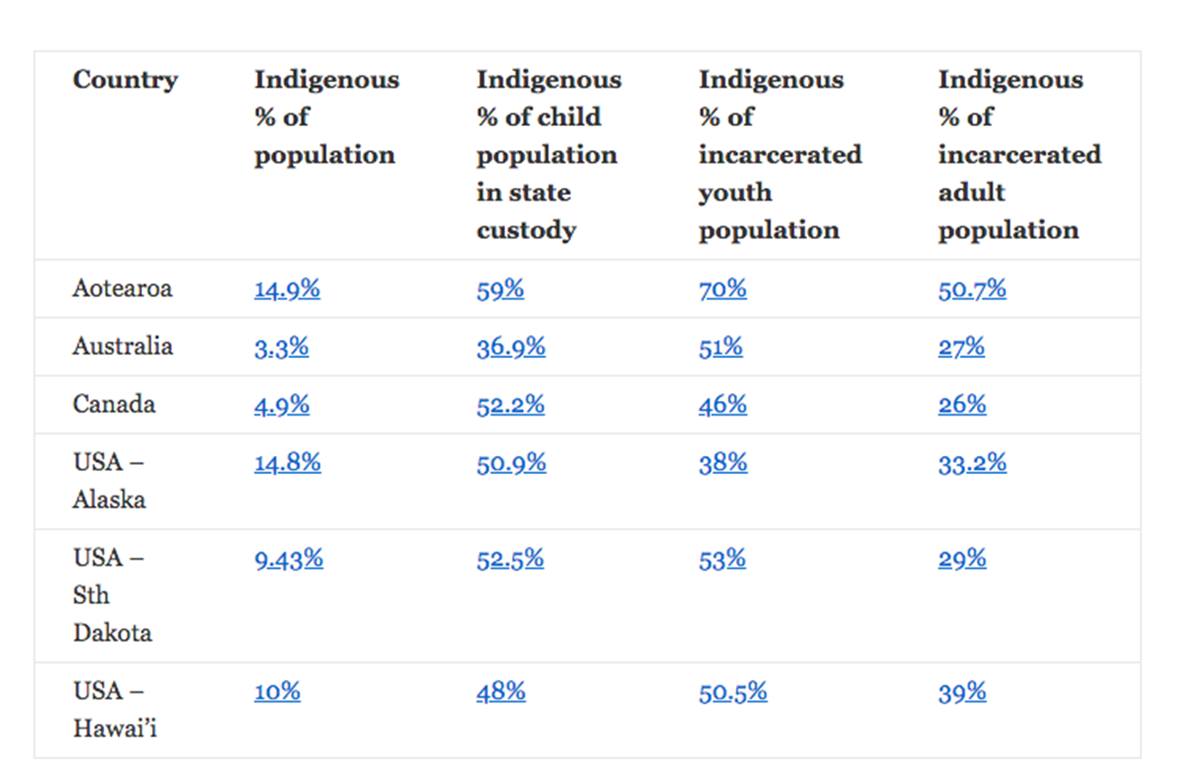
Recent trends in child protection
In June 2019, 6,429 NZ children were in state custody (69% Māori despite tamariki Māori making up only 25 percent of all children) – thus they are most likely to be targeted for intervention
This is linked to the ongoing impacts of colonisation and the suppression of protective Māori culture and practices – see Leonie Pihama speak about these issues at http://mediacentre.maramatanga.ac.nz/content/tiakina-pa-harakeke
Indigenous peoples
are also more like to
be in receipt of a
government
benefit …
https://thespinoff.co.nz/atea/19-06-2019/uplifting-children-is-not-a-maori-problem-its-a-colonisation-problem/

Slide 7
Revision
What did the National-led government’s social investment approach involve?

