Slide 1
SOCIOLOGY OF THE WELFARE STATE
http://blogs.oregonstate.edu/katherinemain/
SOCIOL 317
Lecture 7 (b)
From social protection to social investment:
Child Protection
Week 4: 31 March 2020

Slide 2
Lecture outline
Early focus on child protection
Recent trends in child protection
National-led government’s reforms 2013-2015
Labour-led government’s response 2017+
What could NZ learn from the Family House and Whānau Ora models ?

Slide 3
Revision
What did the National-led government’s social investment approach involve?

Slide 4
National’s child protection reforms 2013-2015
Image sourced from
http://www.parliament.nz/en-nz/mpp/mps/current/51MP2511/bennett-paula
Shifted from focusing on all children to targeting ‘vulnerable’ children
Plans to use actuarial risk-prediction modelling to identify ‘vulnerable children’ not implemented for ethical reasons (e.g. stigmatising of Māori/sole parents) so ‘vulnerable’ never fully defined
BUT largely identified by the
income source/ethnicity/
sole parent status of parents
http://www.treasury.govt.nz/publications/research-policy/ap/2016/16-01/ap16-01.pdf

Slide 5
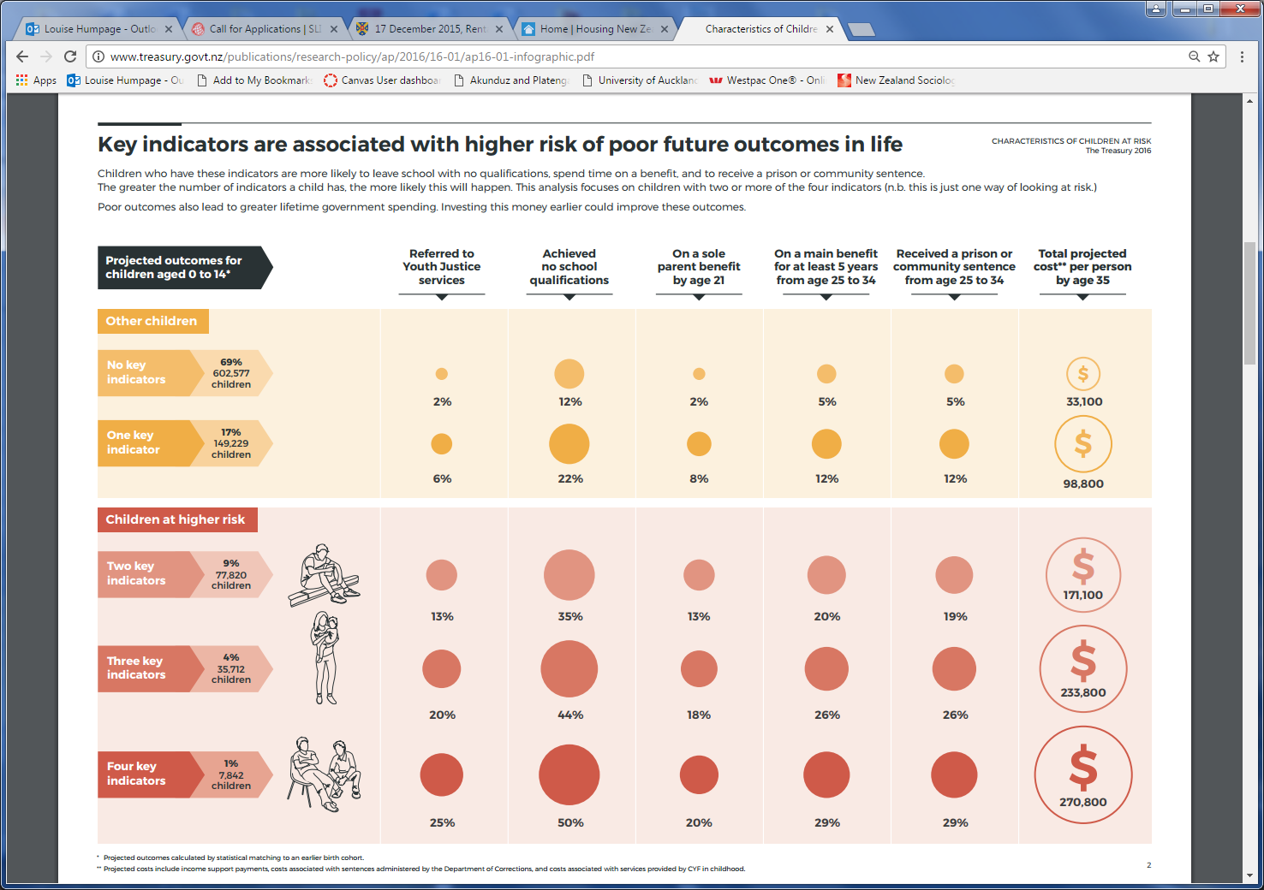
http://www.treasury.govt.nz/publications/research-policy/ap/2016/16-01/ap16-01-infographic.pdf

Slide 6
Wynd’s (2013) analysis of Child Youth and Family (CYF) data on substantiated child abuse cases notes difficulties in determining causality because multiple factors work together in complex ways
The CYF site offices with the highest rates of child abuse are located in some of the most deprived areas of the country (although can vary a lot from year to year)
Māori children are abused at a rate far higher than might be expected given their relative proportion of 0-17 year olds but the relationship between abuse amongst Europeans is less than indicated by their population proportions and the pattern for Pacific and Asian/Other is more mixed
Extreme caution needed because: ethnicity given that of the child; strong link between socio-economic deprivation and ethnicity; Māori and Pasifika peoples have younger population structure; racial discrimination and ‘profiling’ may play a part.
Highest rates of substantiated abuse were found in offices where higher proportion of 0-17 year-olds within the population, suggesting environmental factors (e.g. clustering of younger families perhaps living in overcrowded households) may influence risk of child abuse
Only weak relationship between benefit receipt and child abuse, likely caused because of link between abuse and low income

Slide 7
National’s child protection reforms
Parental rights curtailed:
Parents who seriously abuse or kill children must prove they are safe to parent if go on to have another child
Courts can curtail and define guardianship rights of birth parents in extreme cases
Children removed from their parents due to severe abuse and neglect can be placed with Home for Life carers who can provide a safe, stable home
Plans for Child Harm Prevention Orders (to restrict people thought to be at risk of abusing from living with children, going to places where children are found) were put on hold

Slide 8
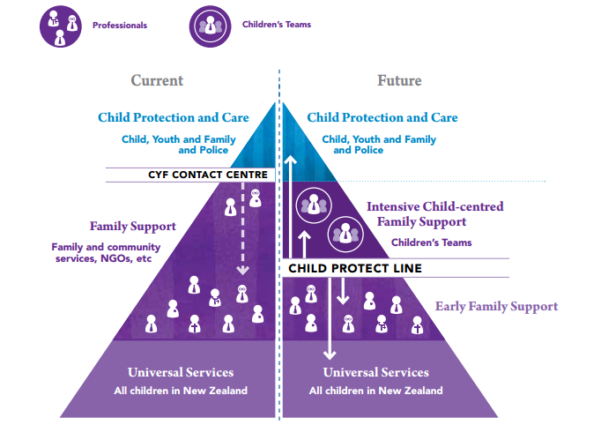
National’s child protection reforms
Greater emphasis on responsibility of organisations/communities for reporting abuse
Heads of NZ Police and the Ministries of Health, Education, Justice, and Social Development new, legislated responsibilities to be accountable for protecting and improving the lives of vulnerable children
Greater requirements for vetting and checking of people working with children or within government’s ‘children’s workforce’
Professionals, community agencies and communities must ensure abuse is reported, assessed and dealt with through information-sharing across departments about ‘vulnerable’ children and high-risk adults and offenders
New Children’s Teams brought multiple agencies together to develop a single plan for each vulnerable child, with someone taking responsibility for overseeing it and ensuring it is implemented
NZ Government (2012: 4) White paper for vulnerable children, vol 2.

Slide 9
National’s child protection reforms
Modernising Child Youth and Family Expert Panel (2015) found:
Vulnerable Children Act 2014 did not overcome fragmentation and lack of clarity about who has statutory authority to intervene
Interventions often too late, needed greater focus on prevention
Staff dedicated – but needed an effective professional practice framework, allowing them to use their professional judgment and cultural competence to support children based on clear principles not rules, compliance and time-driven practice
Reiterated the idea that the state is not responsible for poor child welfare outcomes
Recommended a new child-centric operating model for CYF = Ministry for Vulnerable Children (Oranga Tamariki) established 2017
Sourced from https://www.msd.govt.nz/documents/about-msd-and-our-work/work-programmes/cyf-modernisation/interim-report-expert-panel.pdf
https://www.stuff.co.nz/national/politics/90177920/youthdesigned-logo-for-oranga-tamariki-ministry-for-vulnerable-children-unveiled

Slide 10
National’s child protection reforms
Resulted in amendments to the Children, Young Persons and Their Families Act 1989
Increased age of children in care from 17 to 18+
Ensured the views of children and young people taken into account as part of decision making at an individual level and in the development of services and policy
Supported the establishment of an independent youth advocacy service called Voyce
Enabled broader range of professionals with specialist skills to widen the expertise performing some functions under the Act
BUT
Weakened preference for placing Māori children within whānau, hapū and iwi (note there was no Māori representation on the Expert Panel)
https://mvcot.govt.nz/assets/Uploads/About-Us-Brochhttps://mvcot.govt.nz/assets/Uploads/About-Us-BrochureMAR2017.pdf ureMAR2017.pdf

Slide 11
Decreased 2013-2017?
Total yes
Māori yes
Total no
Māori no
https://orangatamariki.govt.nz/assets/Uploads/OIA-responses/children-in-care/20190628-Babies-and-children-entering-Oranga-Tamariki-care.pdf

Slide 12
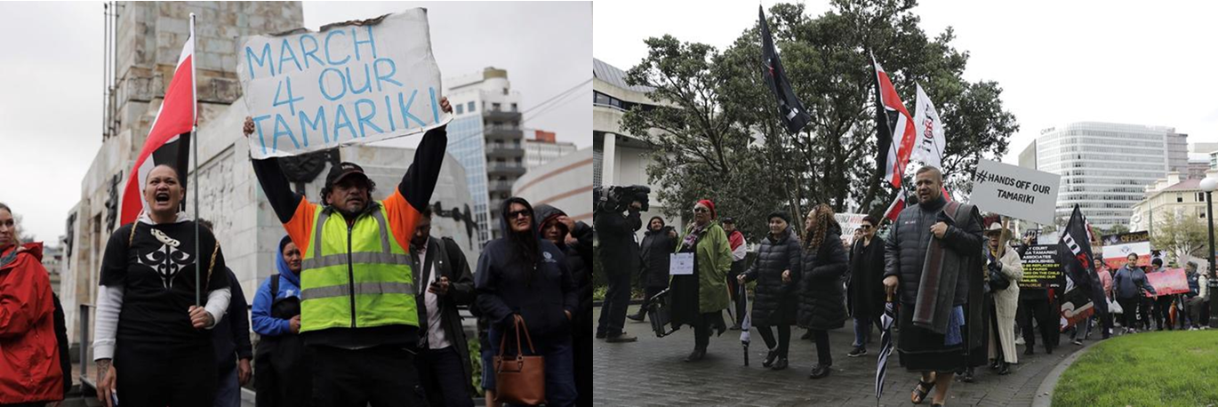
Video
BUT growing Māori protest around continuing uplifts of Māori babies has led to calls for a ‘by Māori, for Māori’ approach in child protection based on Māori values
See these links to learn more:
https://www.tvnz.co.nz/one-news/new-zealand/m-ori-oranga-tamariki- hui-reveals-want-look-after-their-own
https://www.newshub.co.nz/home/shows/2019/07/m-ori-at-war-with-oranga-tamariki.html
https://www.tvnz.co.nz/one-news/new-zealand/ive-seen-dark-sides-country-oranga-tamariki-social-workers-describe-working-frontline

