Slide 1

SOCIOLOGY OF THE WELFARE STATE
SOCIOL 317
https://www.genevahealth.com/news/news-info/prime-minister-jacinda-ardern-other-vips/
Policy briefing workshop
7 April 2020

Slide 2
What is a policy briefing?
A succinct, standalone document written for a non-expert audience that is designed to support more informed evidence-based policy-making or decision-making within relevant agencies or organisations
It outlines the rationale for choosing a particular policy alternative or course of action in a current policy debate
  Explains an issue and its context
  Explores any known causes, links or relationships involved in the issue
  Summarises research findings in simple, easily understood manner
  Typically weights up costs and benefits of policy options
  Distils lessons learned from research as basis for policy advice

Slide 3
What is a policy briefing?
It always has the intention of trying to convince reader to adopt a particular policy/set of policies, whether:
  The briefing is a response to a request directly from a decision-maker (thus purportedly politically ‘neutral’)
  OR
  Is written by an organisation that intends to advocate for the position detailed in the brief

Slide 4
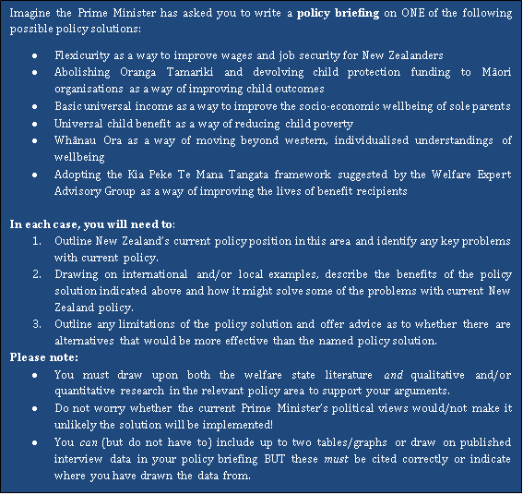
Compulsory
Optional

Slide 5
Policy briefing structure
Introduction – summarise what your briefing will cover and key recommendations made
Overview of NZ’s general policy position
  Identify any key problems
Benefits of policy solution
  What does it involve?
  How successful has it been elsewhere?
  Why would it improve NZ situation?
Limitations of policy solution
  What potential negative impacts might it
  have/any barriers to implementation?
  Alternative/s
    Brief description of what involves/success elsewhere
    Why would it improve NZ situation better than named policy solution?
Conclusion – What has been learned from this briefing? Summarise your recommendations as a result of this learning
Around 1/4
Around 1/3
Around
1/3

Slide 6
Please look at the policy briefing reading list!
  This is a research assignment and you are expected to draw upon 15-20 resources to write it
  I have made this easier by providing a reading list found on the Home page under ‘assessment-policy briefing’ OR under ‘modules’ - ‘other course documents’ in Canvas
    It includes general readings, general NZ readings and useful journals govt departments etc
    It then provides specific lists for each essay topic
  Make sure you have a good look through the entire list because sometimes other briefing topics provide interesting example of alternative policy solutions

Slide 7
Please look at the policy briefing reading list!
  You are welcome to use any resources noted there but try to find some of your own
  Most of the resources listed will be online but some will be hardcopy books – check the library website and Google, but it is possible some may not be available ☹
  The list does NOT include references used in lectures or readings – but you are welcome to also use these resources ☺

Slide 8
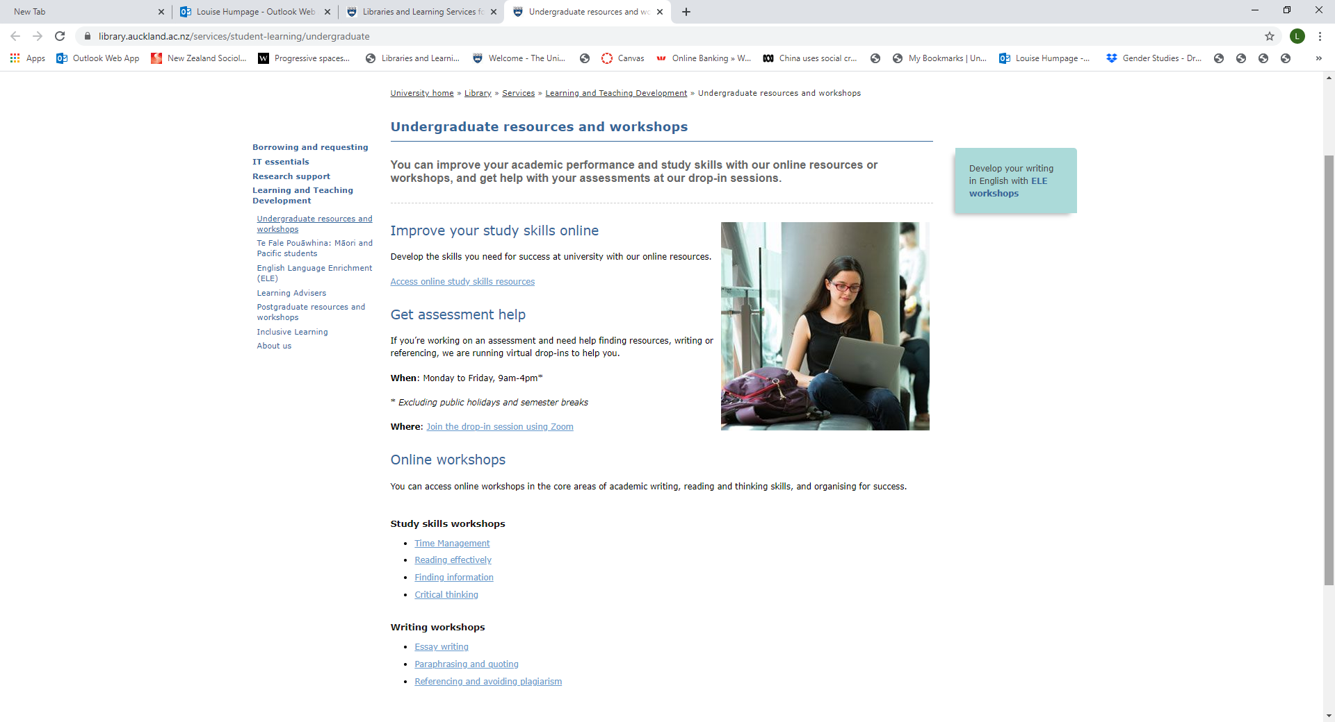

Slide 9


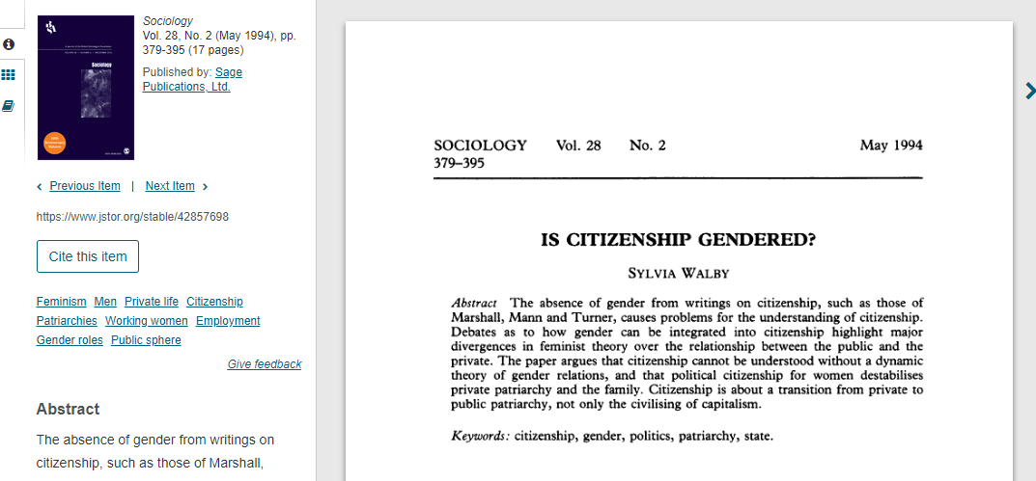
‘Welfare state (theoretical) literature’
Notes:
Now when we are thinking about the welfare state literature this is sometimes emprirical but also sometimes theoretical (ie telling us about how the world works) or a mix of both
Esping-Andersen DID do empirical research but you will likely draw upon him to explain differences between countries ie the welfare regime typology which is a ‘theory’. Those doing the wellbeing briefing might well draw upon Mason Durie who is a Maori scholar who has done a lot of work looking at Maori indicators of wellbeing – this is generally not based on empirical research but cultural traditions or theories about how the world works. If you are interested in gender, you might draw upon the work of feminist scholars like Sylvia Walby who again tend not to draw upon empirical data but historical examples and experiences to explain how malestream theories of welfare states are problematic

Slide 10
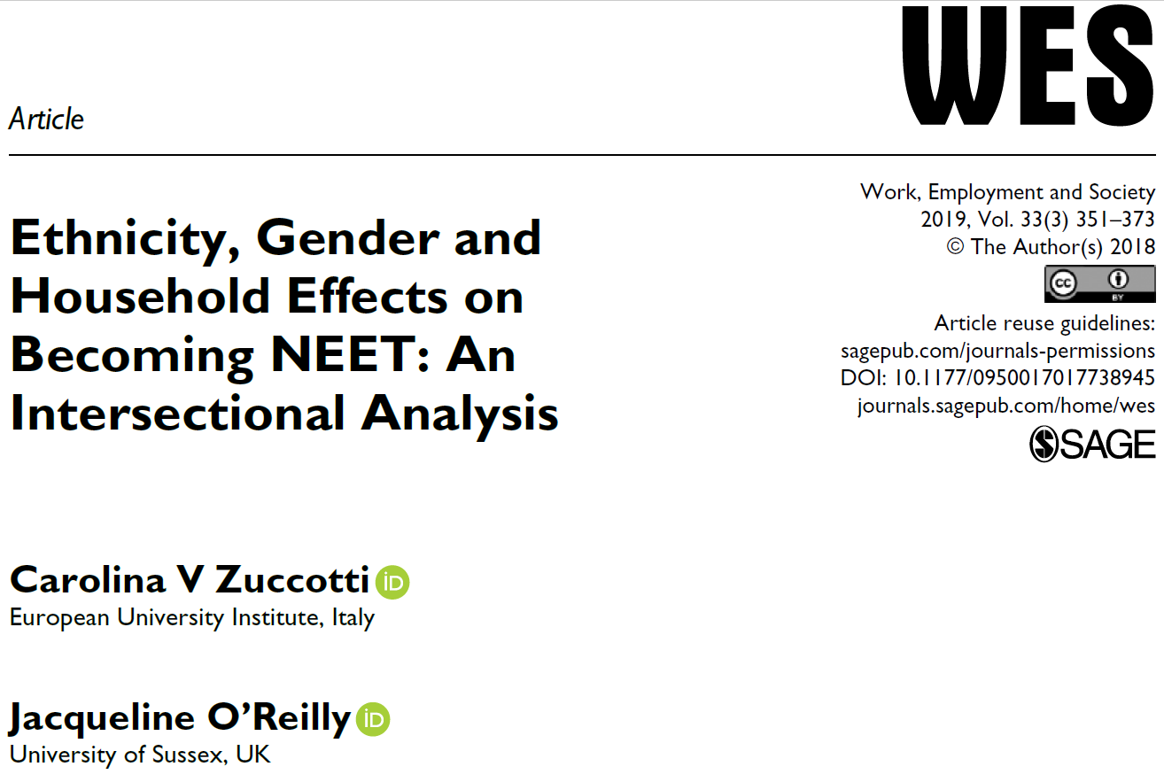
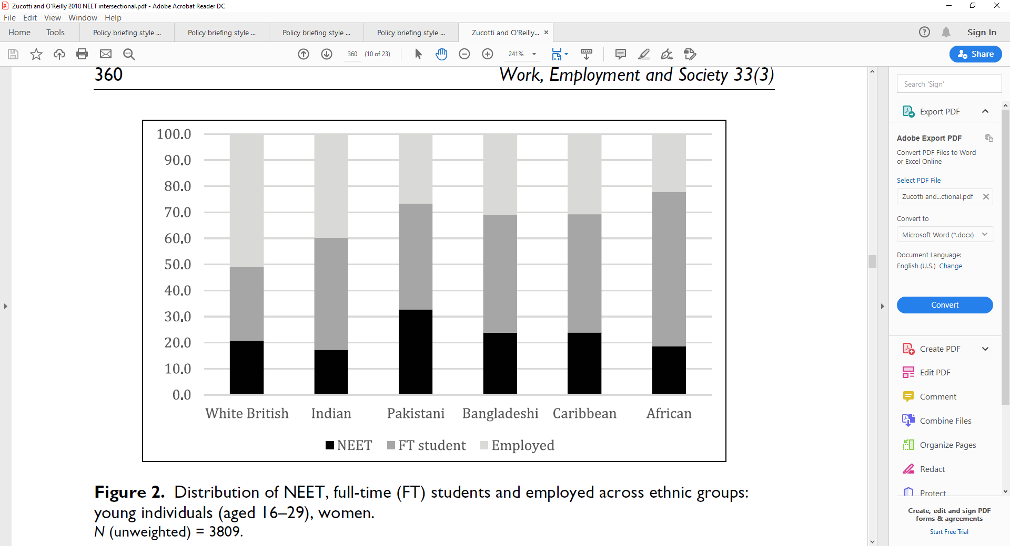
Quantitative ‘empirical literature’

Slide 11
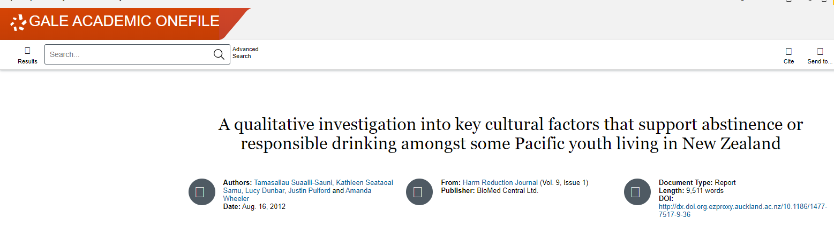
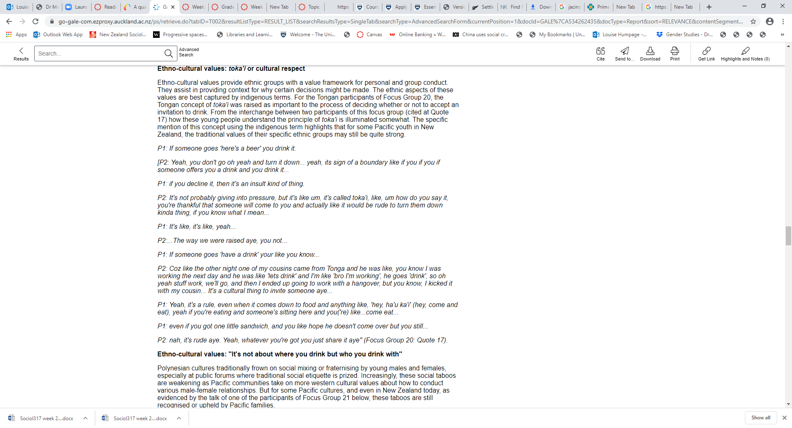
Qualitative
‘empirical literature’

Slide 12
Useful online resources
The OECD has a lot of tools that might be useful for your policy briefing essay. For example:
Employment: https://data.oecd.org/benwage/working-hours-needed-to-exit-poverty.htm#indicator-chart
Inequality: http://www.oecd.org/statistics/compare-your-income.htm
Unemployment: https://data.oecd.org/unemp/unemployment-rate.htm
Better life index: http://www.oecdbetterlifeindex.org/countries/new-zealand/
How would you reference facts sourced from these info tools?
Organisation of Economic Cooperation and Development. (2017). Compare your country: OECD Employment Outlook. http://www.oecd.org/els/oecd-employment-outlook-19991266.htm

Slide 13
Useful online sources
You will notice that I have included some newspaper articles, opinion pieces, press releases, policy documents etc in the policy briefing reading list – and for some topics, current information will more likely come from these sources rather than books or journal articles
But use your judgement to try to AVOID blogs and other social media information that is often not draw upon reliable (if any) sources or data
  If you are uncertain if a source is appropriate, email me (or use the discussions thread) to check it out

Slide 14
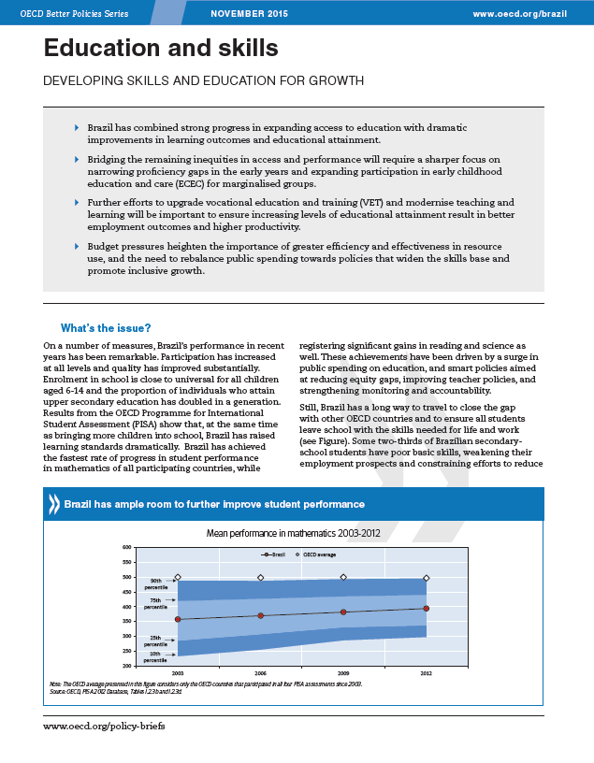
Formatting

Slide 15
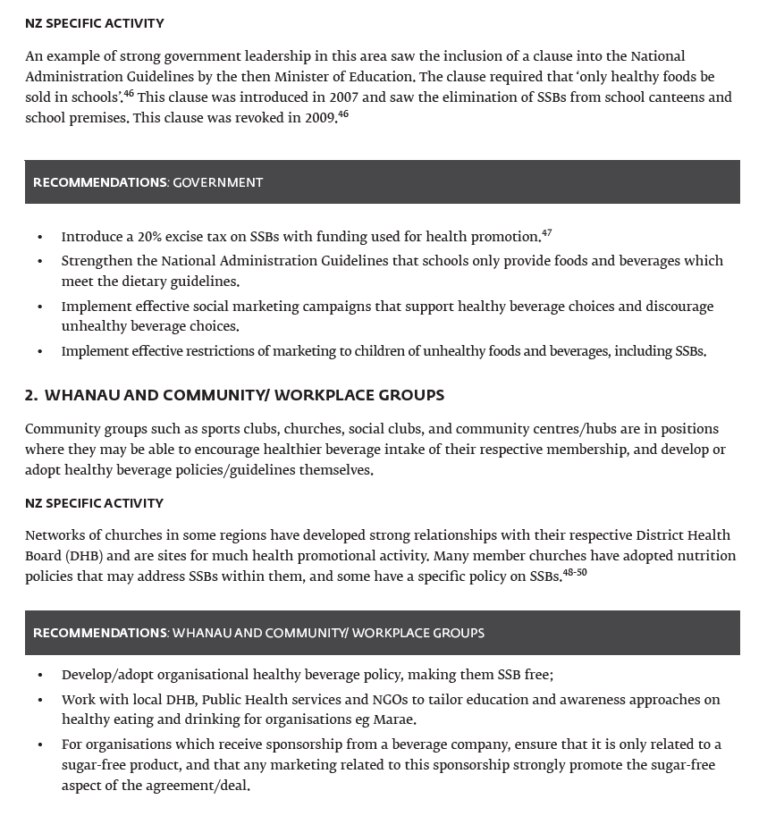
Activity
In your own time, find the 4 examples of policy briefing formatting styles found on the Home page under ‘assessment- policy briefing’ OR in modules under ‘policy briefing resources’
Think about what formatting ideas you might adopt to make your ideas clear and easy to read!

Slide 16
Policy briefing marking criteria: Mōhio/knowledge, wahapū/eloquence and manaaki/respect are still important, with each embedded in the three key areas by which your briefing will be graded.
Please use the following marking guide as a check list to make sure you have met all expectations.
What is the
difference
between these
two criteria?

Slide 17
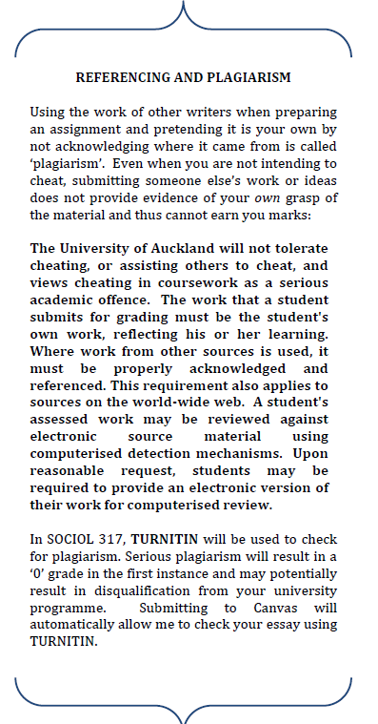
SUBMISSION, EXTENSIONS AND PENALTIES
ALL assignments must be submitted to electronically in Canvas by 5pm NZT on the due date (except weekly reading responses which are due at 2pm Tuesdays NZT). You do NOT need to submit a hardcopy.
Please try your hardest to meet coursework deadlines. However, given the extremely unusual context in which we find ourselves, please contact Louise if you need an extension for any reason via email (l.humpage@auckland.ac.nz).
Ideally extensions should be requested before the due date. However, please contact me if extenuating circumstances mean you could not apply before the assignment was due. I will treat these on a case-to-case basis.
Late submission of coursework is possible without an extension, so long as you are ready to accept a penalty by losing marks. Late penalties help ensure fairness, otherwise some students would have more time to complete work than others.
The penalties for submitting work late when you do not have an extension are 2% per day (including weekends, given electronic submission is available), with no coursework being accepted if more than seven days late.
Everyone confronts difficulties at some point. So please talk to or email me if you are experiencing troubles finishing or submitting coursework. I will work with you wherever possible and, of course, it is better to get an assignment in than not at all (even if it is incomplete).

Slide 18
Remember …..
The due date for the policy briefing has been pushed back to Monday 25 May, 5pm (to ensure we cover all of the topics relating to briefings in lectures)
BUT
It is now worth 40% (rather than 30%) of your overall grade
Instead of panicking, develop a plan ....

Slide 19
Example of a policy briefing study plan
Week starting
6 April (this week) | Decide on your briefing topic Identify & read lectures and readings from the course reading list that are relevant and save them in one file (and don’t forget to submit your reading response collation!!)
27 April | Research NZ’s current policy position (eg on child protection or wages and jobs – draft this section and collect all sources in your policy briefing file
4 May | Research the policy solution identified for your topic (eg universal basic income, abolishing Oranga Tamariki) – draft this section and add sources to your file
11 May | Research policy alternatives – draft this section and add sources to your file Decide on your key arguments and recommendations – draft these sections
18 May | Revise all the draft sections and make sure they connect together, refine arguments/recommendations Format the document in policy briefing style Format and check your references and add them to your document PROOFREAD!
Ask via email or discussionthread
Ask me to review your plan via email
Talk through last minute questions via live chats

