Slide 1
SOCIOLOGY OF THE WELFARE STATE
SOCIOL 317
https://www.artarmonunited.com/things-all-know-about-disability-services/
Lecture 17
From well-fare to workfare:
Supported Living Payment vs ACC for sick and disabled people
19 May 2020

Slide 2
Lecture outline
Early focus on disability
Recent trends in disability policy, especially income support
Comparing Supported Living Payment and Accident Compensation Corporation
Do these differences constitute discrimination?
Alternatives
Expand ACC
Kia Piki Ake Te Mana Tāngata framework

Slide 3
Early focus on disability
Disabled/sick people were initially supported (financially and in terms of care) by family but, as industrialisation progressed, many were institutionalised
However, industrialisation (and the growth of unions) led to a policy need to address the growing number of people injured on the job e.g.
In NZ, a workers’ compensation law was passed in 1990, putting an end to an employers’ liability regime for work-related accidents and industrial diseases and introducing compulsory no-fault insurance
Two world wars also saw a significant increase in the number of disabled/sick people and greater awareness of and expertise in post-injury rehabilitation – thus in the 1930s-1940s incapacity benefits were developed e.g.
NZ’s Pension Amendment Act 1936 saw provision extended beyond war veterans, miners, and the visually impaired to include an “Invalid’s” Benefit for those permanently incapable of work and viewed as part of the deserving poor = ‘decommodified’ so not subject to the rigours of the competitive jobs market
NZ Social Security Act 1938 also saw the introduction of a Sickness Benefit for those with a temporary ‘incapacity’ for work through sickness or accident
Duncan (2019) National’s fortunate failure to deregulate accident compensation, New Zealand Sociology 34(20), 259-278.

Slide 4
Recent trends in disability policy
During the 1970s, the care of people with a disability also shifted from institutionalisation to community care – this was linked to a shift in thinking away from the medical model of disability …
Focuses on individual impairments that may stop someone doing something (ie. a deficit approach) – ‘people with disabilities’
To participate fully in society, everyone needs a non-disabled body and mind (so we should try to ‘fix’ or modify bodies via medical or technological interventions)
… towards a social model of disability
Focuses on disability = disadvantage created by a society which treats ‘impairments’ as abnormal, thus excluding people from full participation in society – ‘disabled persons’
Highlights society’s moral responsibility to address barriers such as: prejudice; labelling; ignorance; lack of financial independence; families being over protective; not having information in formats which are accessible to them.
Hickey & Wilson (2015) Whānau Haua & https://www.mentalhealth.org.uk/learning-disabilities/a-to-z/s/social-model-disability

Slide 5
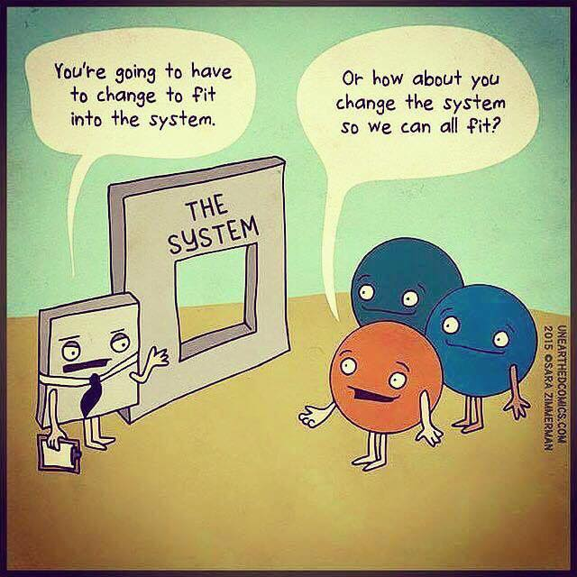
https://www.facebook.com/ThisIsMyAFK/photos/what-is-the-social-model-of-disabilitythis-cartoon-perfectly-captures-the-differ/1579287352107956/

Slide 6
Recent trends in disability policy
Many sick/disabled peoples wish to enter or retain work as a way of fully participating in society BUT employers and broader society make this difficult
Access may be limited
(due to a lack of ramps/
poor transportation options)
When supply of workers
is high, employers may not
wish to fund
modifications to enable
disabled/sick workers
When there is a focus on
‘efficiency’, employers may not
wish to employ workers who can
only work limited hours/do part
of their job
OECD (2010) Sickness, Disability and Work: Breaking the Barriers

Slide 7
Recent trends in disability policy
In times of austerity, there has been growing policy convergence as governments have become concerned with increases in the number of people on disability/sickness benefits in many OECD countries – NZ is one of the countries where these numbers have grown fastest
OECD (2010), Sickness, disability and work: Breaking the barriers.

Slide 8
Compensation dimension = overall assessment of policy features related to the benefit system
Integration dimension = intensity of measures for activation and employment integration
Boheim & Leoni (2017) Sickness and disability policies: Reform paths in OECD countries between 1990 and 2014, International Journal of Social Welfare
27(20): 168-185.

Slide 9
https://data.oecd.org/socialexp/public-spending-on-incapacity.htm

Slide 10
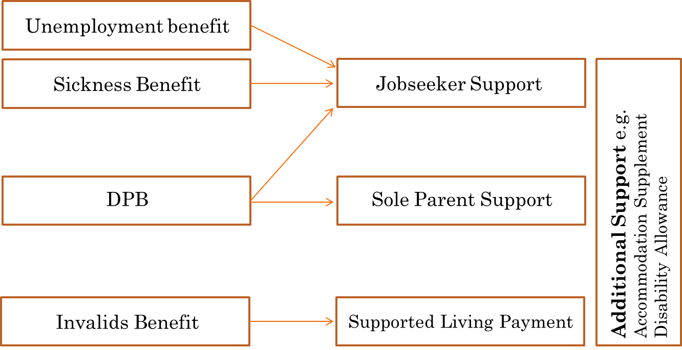
Recent trends in disability policy
Given the cost of such benefits (and the broader neoliberal emphasis on paid work as the main form of welfare), there has been increasing government emphasis on getting sick/disabled people into work (or retaining jobs)
Simplification of benefit categories has seen many sick or disabled people become classified as ‘unemployed’
Work expectations/obligations have been introduced or increased for disabled peoples
Time limits have become more common (for sickness rather than permanent disabilities)
Revision
= Full-time work obligations
= Part-time work obligations
Diagram sourced
from Baillie (2014)
New Zealand’s welfare
reforms: National’s
response to “welfare
dependency”

Slide 11
Welfare Expert Advisory Group (2019: 14 & 17) Whakamana tangata

Slide 12
Supported Living Payment (SLP)
This benefit is for individuals over the age of 16 who are:
permanently and severely restricted in their ability to work because of a health condition, injury or disability – this means they:
have a condition affecting their capacity to work for more than 2 years, OR
have a life expectancy of less than 2 years AND
can’t regularly work 15 hours or more a week in open employment
OR
totally blind
OR …
https://www.workandincome.govt.nz/products/a-z-benefits/supported-living-payment.html#null

Slide 13
Supported Living Payment (SLP)
… Individuals over 16 who are caring full-time for someone at home who would otherwise need hospital-level or residential care (or equivalent) who is not their partner. The person can be:
their child
a family member (other than your partner or spouse)
a member of your community
Like all other main social security benefits in NZ, SLP is a flat-rate benefit funded through general taxation
Only about third of SLP recipients are not subject to regular requirements to provide medical evidence of ongoing need and/or work obligations
Many people are transferred to Job Seeker Support
(with part-time work obligations) if their condition improves
High abatement rates disincentive SLP recipients from
working more than 15 hours
Neither receive much
return-to-work/
rehabilitation
assistance
https://www.workandincome.govt.nz/products/a-z-benefits/supported-living-payment.html#null
Welfare Expert Advisory Group (2019: 152-153)

Slide 14
Welfare Expert Advisory Group (2019: 31)

Slide 15
The Accident Compensation Corporation (ACC)
Following a Royal Commission of Inquiry (1967), ACC was established in 1974 so that all New Zealanders and visitors are covered, on a 24/7 basis and regardless of circumstances or fault, for:
personal injury caused by accident (including through medical treatment)
work-related illnesses
mental injury caused by crimes of a sexual nature
It abolished the English common law tradition that upheld the right of the individual to sue for compensation for losses arising from personal injury where negligence could be alleged AND created an administrative appeals system based upon “inquiry and investigation” not “adversary techniques”
National-led governments tend to want to open up ACC to competitive private-sector insurance provision, while Labour-led governments favour a state monopoly
Attempts to reduce claims liability (ie. the cost to the state) have seen changes to make it harder to enter the system and encourage earlier exit and ACC receives many complaints about the fairness of its decisions BUT it also funds a lot of preventative programmes to increase safety and thus reduce injuries
Duncan (2019) National’s fortunate failure to deregulate accident compensation, New Zealand Sociology 34(20), 259-278.

Slide 16
The Accident Compensation Corporation (ACC)
ACC payments are funded by:
pay-roll levies on employers and (since 1992) employees (making it partially a social insurance model)
a portion of motor-vehicle registrations
a petrol levy and
a government contribution from general taxation for non-earners
In 2019, there were over 2 million registered claims with 84,000 receiving weekly compensation for lost earnings (normally at 80% of prior income) plus other claims for medical treatment and vocational and social rehabilitation that is not usually available to SLP recipients

Slide 17
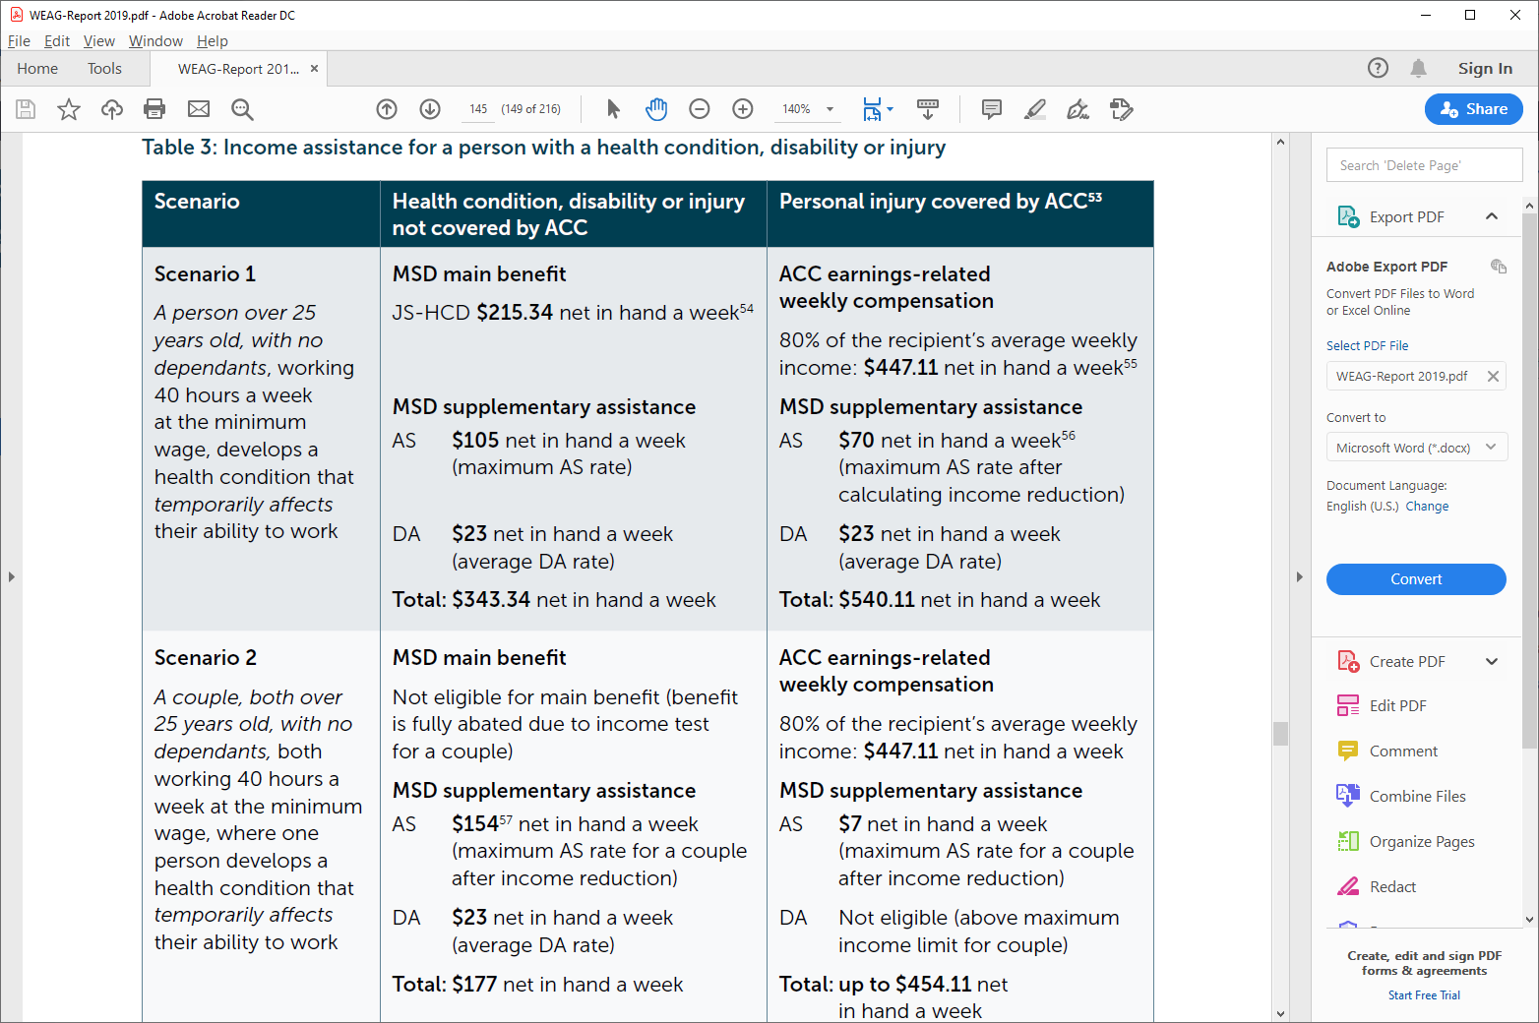
Welfare Expert Advisory Group (2019: 145)

Slide 18
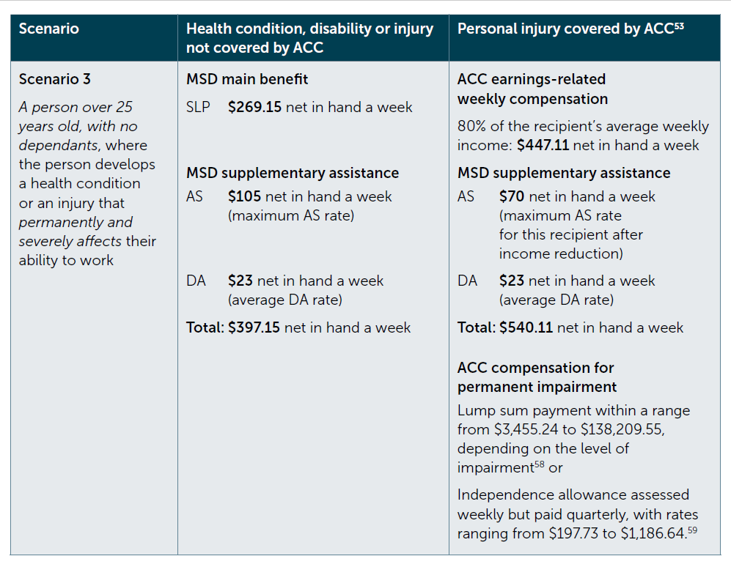
Welfare Expert Advisory Group (2019: 146)

Slide 19
Do these differences constitute discrimination?
These differences have been the focus of court cases:
It was unsuccessfully argued that the different entitlements provided by ACC and the Ministry of Health, being based purely on different causes of disability, are a form of discrimination that contravenes the Human Rights Act 1994
A woman who suffered from severe multiple sclerosis and used a wheelchair argued that she received significantly less support than an ACC claimant with similar needs
Even where it has been accepted that “there is prima facie discrimination” (Trevethick v Ministry of Health [2008] NZCA 397, para. 18), this was found to be justified under section 5 of the New Zealand Bill of Rights Act 1990 which states that “the rights and freedoms contained in this Bill of Rights may be subject only to such reasonable limits prescribed by law as can be demonstrably justified in a free and democratic society.”
It was successfully argued that individuals who provide assistance to family members with disabilities should qualify for paid disability support from the Ministry of Health
They were excluded because family members are “natural supports” that do not come under a supposed “social contract” to pay for disability support but the court decided that the cause of disability was not relevant here
The National-led government introduced a family-carers policy in 2013 but because this was inconsistent with the New Zealand Bill of Rights Act 1990, it also passed the New Zealand Public Health and Disability Amendment Act 2013 to bar any further human-rights actions on the matter – a move heavily criticised by lawyers and constitutional experts
See Duncan (2019)

Slide 20
Alternatives: Expand ACC
The Royal Commission of Inquiry (1967) had envisaged that ACC would eventually include all disability and incapacity, regardless of cause, sickness or injury.
The Royal Commission on Social Policy (1988) and the Law Commission (1988) noted the inequity between disabilities caused by accident and those due to sickness, leading to the Rehabilitation and Incapacity Bill in 1990, which would have applied to all incapacity for employment regardless of the circumstances from which it arose or whether it was a physical or mental condition. This legislation did not survive the change of government later that year.
Could we afford to expand ACC (without prohibitive rises in levies)?
We are already paying taxes for illness-related disability through SLP.
Spending more on rehabilitation for SLP recipients might see them get back to work earlier, thus reducing costs in the long-term
To cope with the rather lengthy transition period to full coverage, ACC reserves are sufficiently large to absorb a temporary fluctuation in expenditure
Duncan (2016) at https://www.interest.co.nz/opinion/82117/grant-duncan-calls-acc-be-extended-originally-intended-cover-major-health-issues-not

Slide 21
Alternatives: Kia Piki Ake Te Mana Tāngata
Welfare Expert Advisory Group (2019: 26)

Slide 22
Alternatives: Kia Piki Ake Te Mana Tāngata
Welfare Expert Advisory Group (2019: 154)

Slide 23
Lecture summary
The social model of disability has shaped recent policy shifts, alongside neoliberal emphasises on work activation and concern about the fiscal costs of welfare dependency, to see greater policy focus on disabled/sick peoples returning to (or staying in work)
Yet the cause of disability/sickness dictates the level of income and other supports offered to New Zealanders, leading to discrimination and inequity
Alternatives include covering all disabled/sick people under ACC and focusing more on the dignity rather than dependency

