Slide 1
Gender, Sexuality, and Religion
THEOREL 211/311

Slide 2
Course description
An introduction to understandings of the intersections between gender, sexuality and religion.
We will look at a number of current issues and debates surrounding gender and sexuality as they are expressed within religious communities, religious writings, teachings, and theologies, as well as in ‘secular’ politics, academia, the media and popular culture.
We will consider the different meanings and significances of the terms gender and sexuality, and the various ways that these are understood within religious traditions.

Slide 3
Weeks 1 and 2: definitions and debates
Notes:
1. How do we define gender and sexuality?
How does queer theory contribute to our understandings of gender and sexuality?
What is the theory of intersectionality and why is it important to the study of gender and sexuality?
What do we mean by identity politics?
What do we mean by heteronormativity?
2. This week, we will consider some of the questions and issues often raised in discussions around gender, sexuality and religion, and which we will return to time and again during the rest of the course. These questions and issues have no easy answers, but this week we can at least start thinking about them.
What do we mean by 'religion' and why do we need to study religion with a 'hermeneutic of suspicion'?
Religious or cultural (or both?) - how do we recognize a belief or practice as 'religious'?
Tradition or (mis)interpretation? Evaluating religious responses to gender and sexuality.
Cultural relativism versus universalism - do we have to choose one or the other?
Colonizing communities and speaking 'for' - (how) do we avoid doing this?

Slide 4
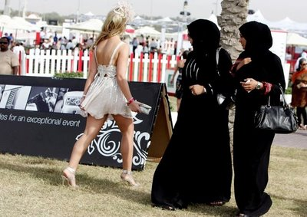
Week 3: Policing bodies 1 - Purity culture, modesty and dress
Notes:
This week, we will consider the meaning of religious purity, and how these ideas of purity can become gendered. We will focus particularly on embodied purity - the prescriptions in religious teachings around dress and the meanings given to gendered bodies. Topics will include: purity culture, modesty, and menstruation. Next week, we will continue this discussion, considering purity issues around sex and sexuality, as well as religion and reproductive rights.
For Monday's class, you should prepare by reading the articles by Jonah Steinberg and Aru Bhartiya about purity and menstruation in different religious traditions.
Tutorial
Read one or more of the articles in the reading list on modesty, dress and religion - in class, we will discuss the significance of modesty as an external display of religious belief and also as a sign of wider cultural attitudes around gender and sexuality.

Slide 5
Week 4: Policing bodies 2 - desires and intimacies
Notes:
In this second week of 'Policing Bodies', we continue our discussion of purity culture, turning from considering external signs of embodied religion and gender to look at some of the ways religious traditions attempt to prescribe and proscribe our bodies and behaviour, particularly when it comes to the issue of sex, sexual desire, and reproductive choices.
Tutorial
We will discuss in particular the chapter by Yip and Page (see reading list), who have researched the ways that young people negotiate the intersections between religion and sexuality. As you read this chapter, think about some of the discourses used by the interviewees to make sense of sexuality in light of faith, and how they deal with clashes and contradictions between these discourses.

Slide 6
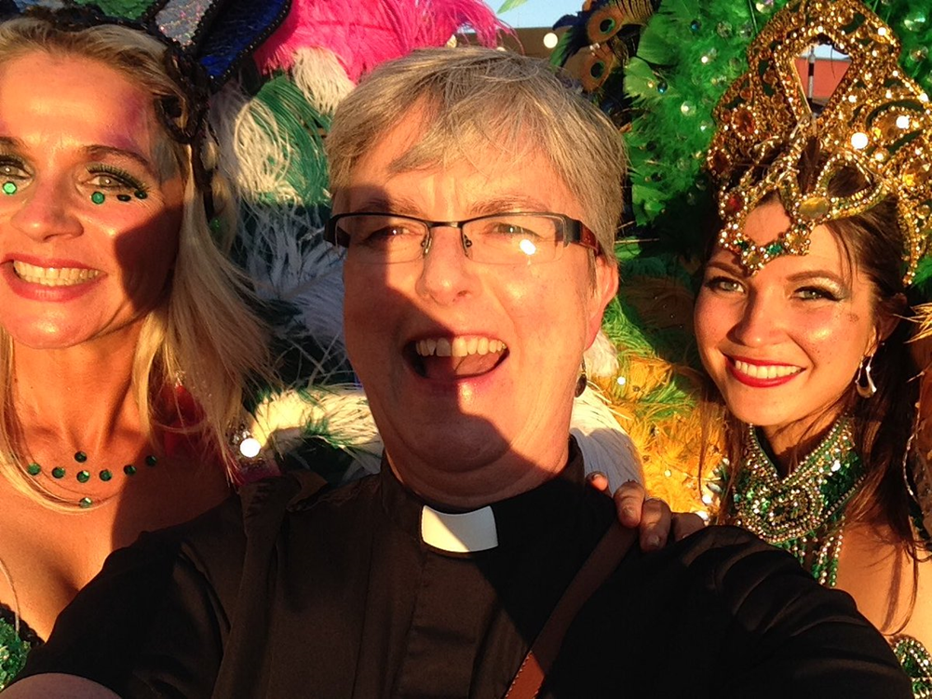
Week 5: Queer identities and religion 1 – religion and heteronormativity
Notes:
This week we will start considering the complex and often contentious relationship between queer sexualities and religion. We began discussing this last week (see particularly last week's tutorial reading) and we will continue to investigate how dominant discourses of sexuality (particularly heteronormativity) are both affirmed and challenged within different religious traditions. Topics will include religious tolerance to queer sexualities, as well as religious homophobia and transphobia.
Tutorial
We will consider the issue of same-sex marriage, and the ways that different religious communities engaged with the debates around same-sex marriage, both in New Zealand and further afield.

Slide 7
Week 6: Queer identities and religion 2 - queer spiritualities and queer theologies
Notes:
In this week's class, we will continue looking at queer sexualities and religion, turning our attention to the experiences, beliefs and faiths of members of the queer community. In particular, we will consider the ways that queer people negotiate the sometimes hostile discourses at play within their faith traditions or spiritualities, and also how queer theologies and queer spiritualities can offer new discourses that allow queer faith to flourish.
Tutorial
We will focus this week on the experiences of queer people who belong to particular faith communities, thinking about the impact of heteronormativity, homophobia, and transphobia on both their faith and their wellbeing, in light of what we have discussed in class about queer theology.

Slide 8
Week 7: Gender binaries in religious traditions
Notes:
This week we will take a look at the way that gender binaries and stereotypes are both upheld and challenged within different religious traditions. We will consider the traditional gendering of religious participation and leadership within a number of established religions, and the way these may be subverted in new religious movements. We will also consider the gendering of faith and worship, focusing in particular on the phenomenon of men's and women's ministries within Christian evangelical traditions.
Tutorial
We will consider men's and women's ministries in more detail, looking at examples of these (see weekly readings) and considering the gender discourses they draw upon to shape their theologies.

Slide 9
Week 8: Gender violence and religion
Notes:
This week, we'll be talking about the complex intersections between gender violence, rape culture, and religion. We will first attempt to define gender violence and rape culture, before considering some of the challenges involved in attempting to study the impact of religion on rape culture and gender violence.
Tutorial
For the tutorial, we will focus in particular on two cases where religious texts and traditions appear to be used as theological justification for sexual violence (one ancient, the other contemporary). We will discuss the implications of these texts and traditions in light of our discussions during the week's classes. In preparation for the tutorial, please read Rukmini Callimachi's article ('ISIS enshrines a theology of rape') and also my own conference paper (which I've linked to below).

Slide 10
Week 9: Part 2 Gender violence and religion.
Notes:
This week we continue to discuss gender violence, rape culture, and religion. After beginning with gender violence in the name of religion, we will look at the evidence relating to gender violence during war and ask whether it is culturally or religiously based or whether it is more related to power. In the second part of the lecture, we examine biblical texts of terror.
Tutorial
In this week’s tutorial, we will examine 1-2 biblical texts on gender violence in greater detail. Students may bring texts from other religions if they wish to discuss perspectives outside of Christianity.

Slide 11
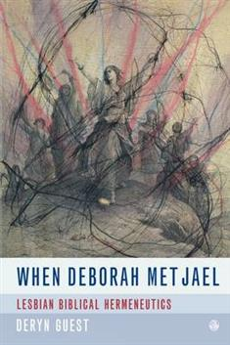
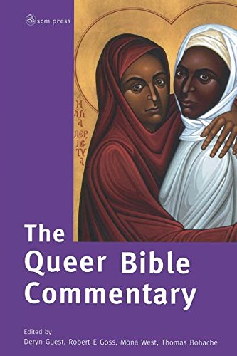
Week 10: Reading Sacred Texts Queerly
Notes:
This week, I will introduce you to queer biblical interpretation, a method of reading the texts of the Jewish and Christian Bibles that is becoming increasingly popular within biblical and religious studies. After talking about this methodology more broadly (and thinking about its application to other sacred texts), we'll 'practice' it ourselves by looking at one or two biblical passages and thinking about how we might read them queerly.
Tutorial
In this week's tutorial, you will practice your queer interpretation of a biblical text (I'll let you know which one very soon).

Slide 12
Week 11: Religion, gender, and sexuality in pop culture
Notes:
This week, we will consider the ways that religious iconographies are utilized in popular culture, and think about how these can (implicitly or explicitly) make powerful statements about gender and sexuality. We will focus in particular at advertising and music videos, as well as some forms of new/social media.
Tutorial
We will concentrate in today's tutorial on Beyonce, considering the significance of religious iconography that appears often in her performances, videos, publicity, and music.
Week 12 – revision/essay workshop week, and/or anything you think I’ve left out.

Slide 13
Readings
Essential readings: most important for the weekly topic.
Further readings: FYI and to help with assignments
Tutorial readings: see notes on reading list and read these in preparation for the tutorial.

Slide 14
Assignments – full instructions on Canvas
211/311 – reflective diary (due 16 June)
211 – worksheet (due 14 April)
311 – critical review (due 14 April)
211/311 – essay (due 9 June)
Late policy and extensions – see Canvas homepage

Slide 15
Please come to class!

