Slide 1
DEFINING GENDER AND SEXUALITY

Slide 2
Weeks 1 and 2: Defining gender and sexuality
Gender is…
Sexuality is…
Queering gender and sexuality

Slide 3
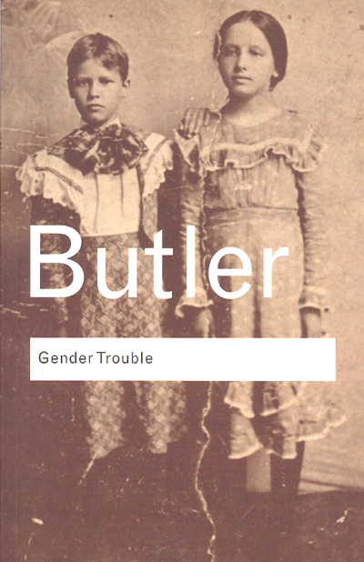
What is queer theory?
The term queer theory is credited to Teresa de Lauretis, “Queer Theory: Lesbian and Gay Sexualities,” special issue of Differences: A Journal of Feminist Cultural Studies 3 (1991).
Developed from feminist studies, gender studies and lesbian and gay studies of the 1970s and 1980s that began to question the notion of gender and sexuality as fixed entities.
Seminal work published in 1990, Judith Butler’s Gender Trouble.

Slide 4
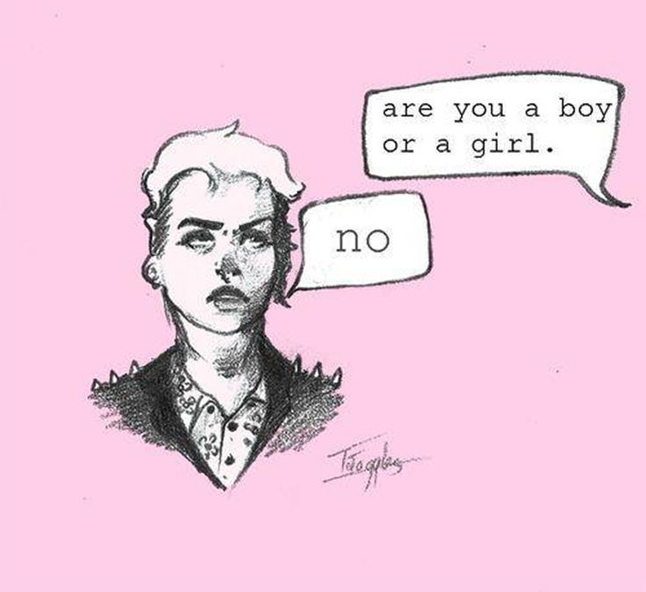
QUEER THEORY
Insists that traditional binaries of gender and sexuality are not ‘fixed’ stable categories of identity, but always shifting and changing across time and space.
Challenges heterosexuality as the standard by which all sexual identities are ‘measured’.
Also considers other social identity markers, e.g. race, class.
Binaries/categories are not ‘benign, but determine allocations of social power and authority – who has power and who is marginalized.

Slide 5
Traditional understandings of gender and sexuality
Queer theory
See reading by David Gauntlett
I am born with a fixed sex
My sex determines my gender
I have desire for the opposite sex
I am born with a body
I am assigned a sex and gender
I am taught to perform an identity
I may have desires

Slide 6
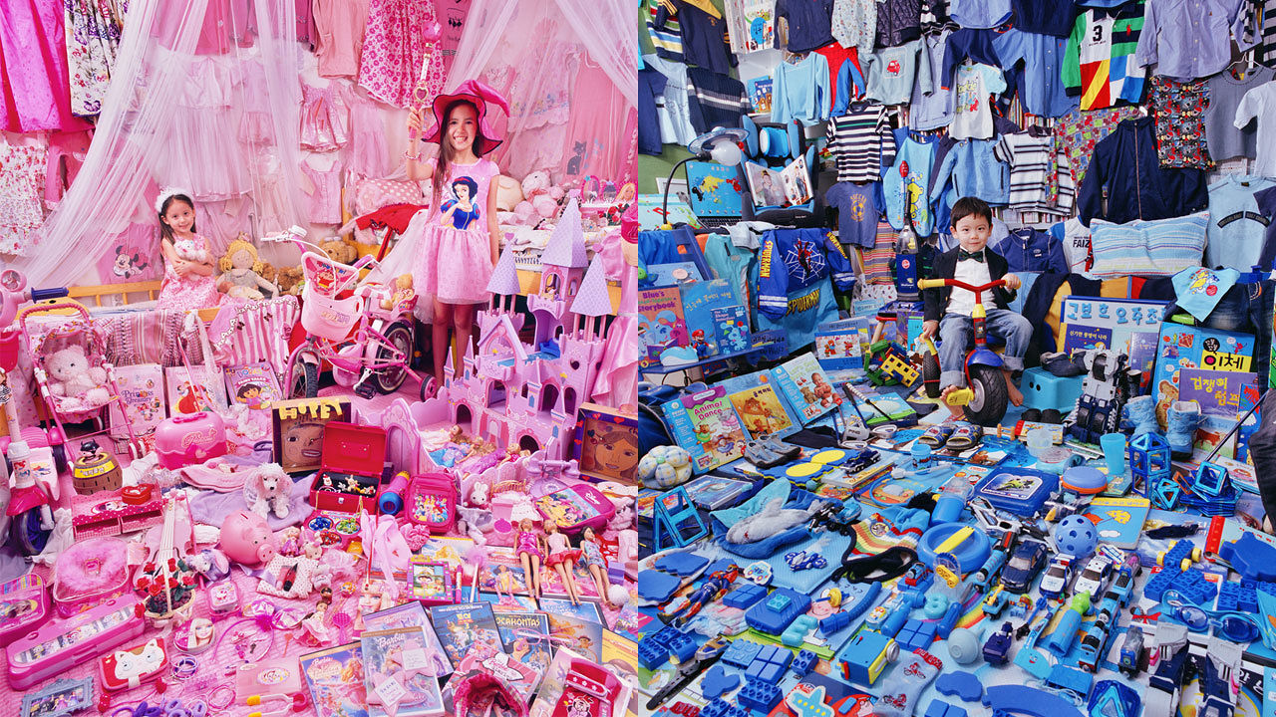
Gender is performative: We learn how to ‘do’ gender

Slide 7
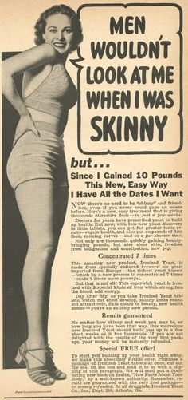
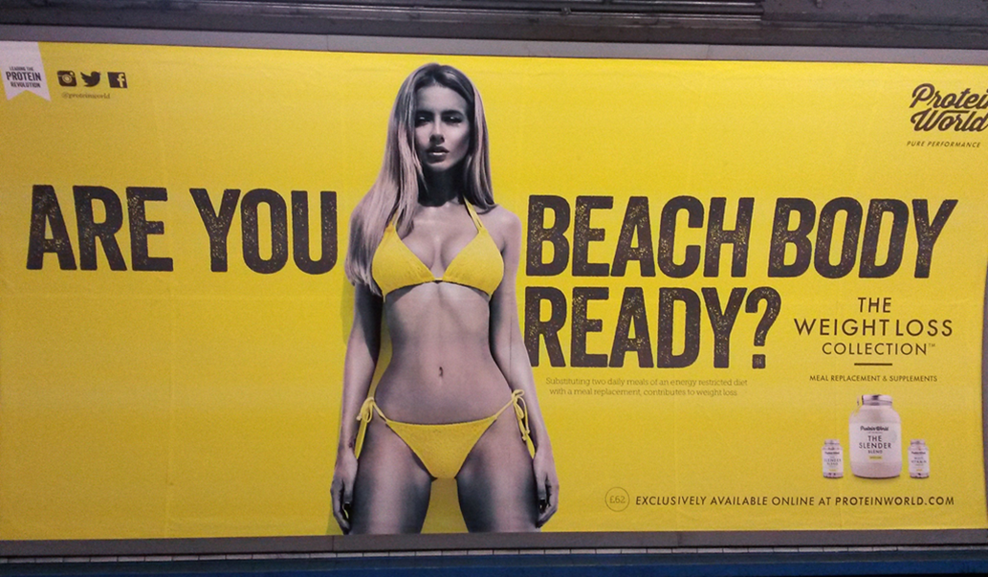
Gender norms change over time and space – they are not transhistorical

Slide 8
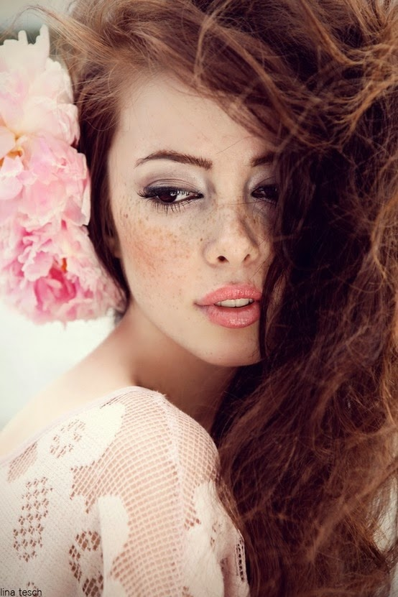
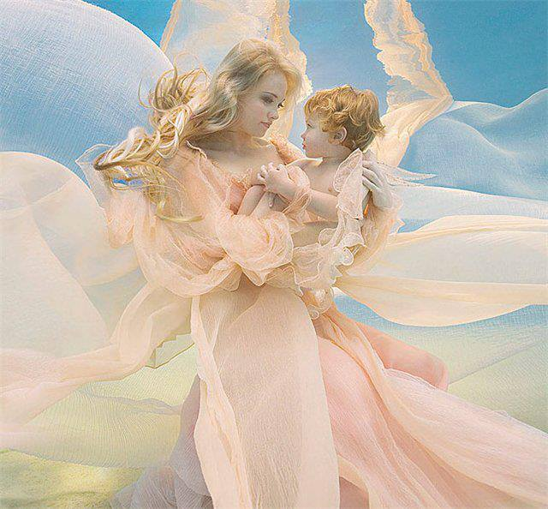
Do a Google Images search of ‘feminine’

Slide 9
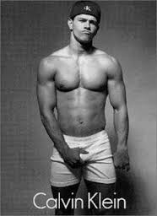
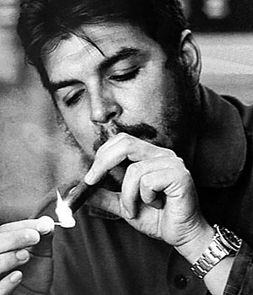
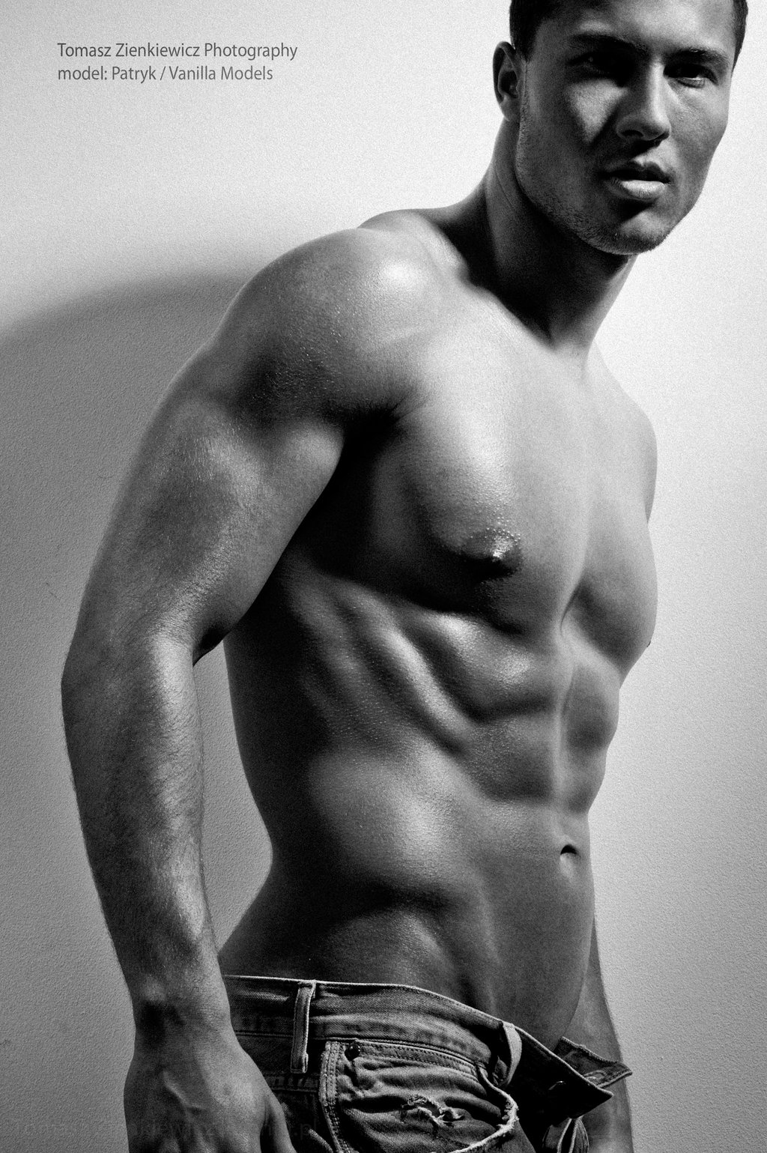
Now do a Google Images search of ‘masculine’

Slide 10
Defining gender in the Oxford English Dictionary
Feminine: ‘having qualities or an appearance traditionally associated with women, especially delicacy and prettiness’. E.g. ‘these flowers add a feminine touch to the table’.
Masculine: ‘having qualities or an appearance traditionally associated with men’. E.g. he is outstandingly handsome and robust, very masculine’.

Slide 11
Defining gender (from Thesaurus.com)
Masculine is…
Feminine is…
Manly
Muscular
Brave
Adult
Honourable
Powerful
Strong
Virile
Red-blooded
Male is…
Masculine, macho, potent, virile
Ladylike
Soft
Dainty
Female
Tender
Womanly
Modest
Gentle
Womanish
Effeminate
Female is…
Feminine, fertile, maternal

Slide 12
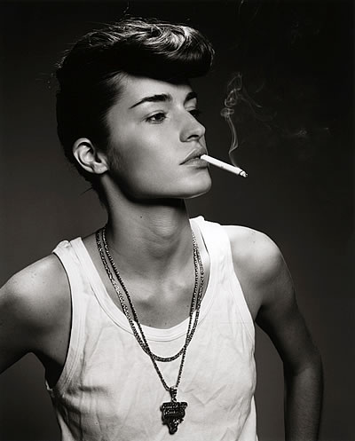
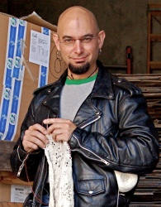
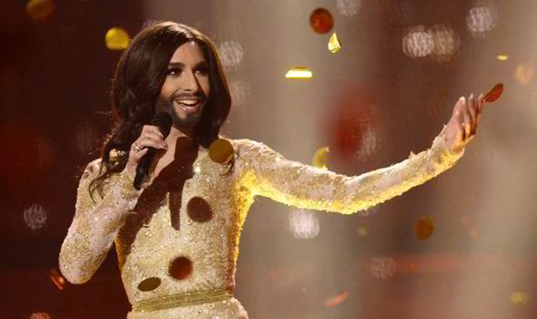
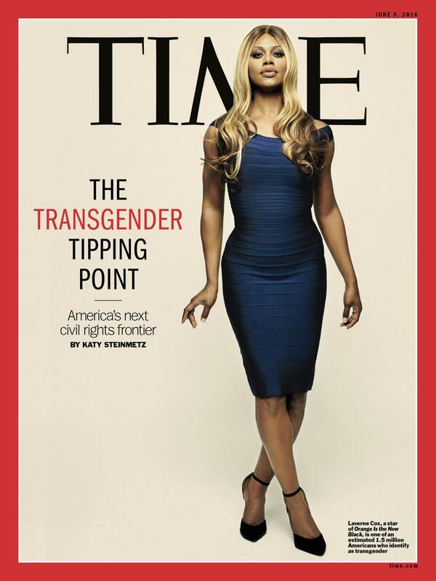
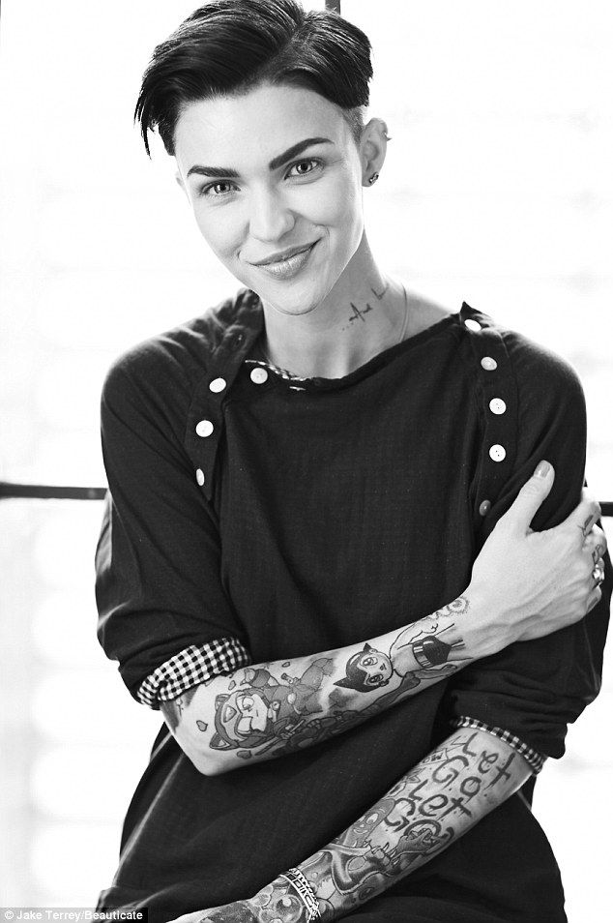
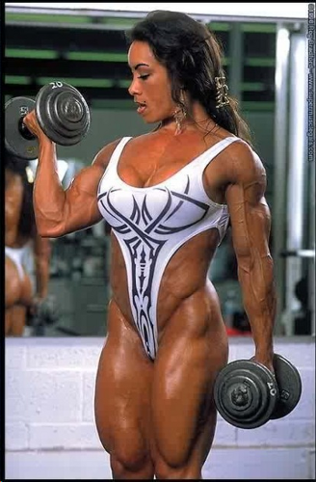
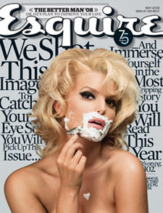
Gender trouble
Notes:
Butler – we can never stop our gender performativity entirely – we are required to do this thousands of times a day – but we can learn to subvert these performances a little, through parody or other gender performances that will challenge expectations. We can therefore call into question these binaries around gender.
Gender trouble is showing the multiplicity and fluidity of gender and sexuality – there are no binaries, or at least, these binaries can be constantly renegotiated, subverted, and shifted (and they are, constantly, throughout history)

Slide 13
Queer also theory breaks the connection between sex, gender and sexuality (see chapter by David Gauntlett)
I am born with a fixed sex
My sex determines my gender
I have desire for the opposite sex
I am born with a body
I am assigned a sex and gender
I am taught to perform a gender
I may have desires

Slide 14
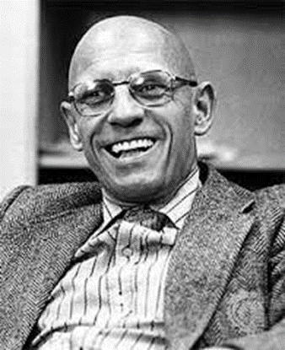
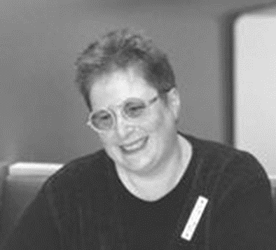
Sexuality: Coming out of the closet
Key thinkers in queer sexualities: Eve Sedgwick, Epistemology of the Closet (1990) and Michel Foucault, The History of Sexuality (1976)
We live according to a set of sexual ‘scripts’ – these are not fixed or natural, but socially-constructed.
Scripts and discourses change over time – Foucault refers to sexuality as a ‘historical construct’.
Our sexuality is not dependent on our sex or gender identity.

Slide 15
Heteronormativity
Coined by Michael Warner (1991)
The ‘normal’ pattern of attraction is one man and one woman who embody conventional gender roles.
Other forms of sexuality, gender and desire are treated as less ‘normal’ or natural.
Straight privilege = having certain privileges because you’re heterosexual (including within education, employment, public life, and your representation in the media and pop culture)

Slide 16
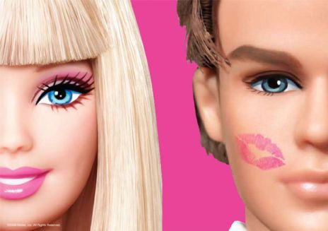
Heteronormative social forces ‘pull a cloak of virtue around themselves by manufacturing a deviant other into which a great many people can be dumped and dismissed’ (Eve Sedgwick, Epistemologies of the Closet).

Slide 17
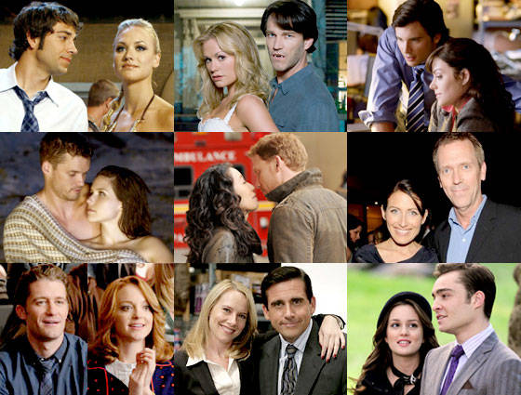
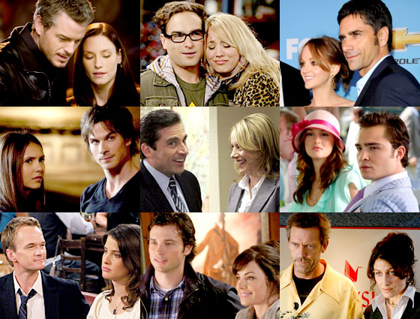
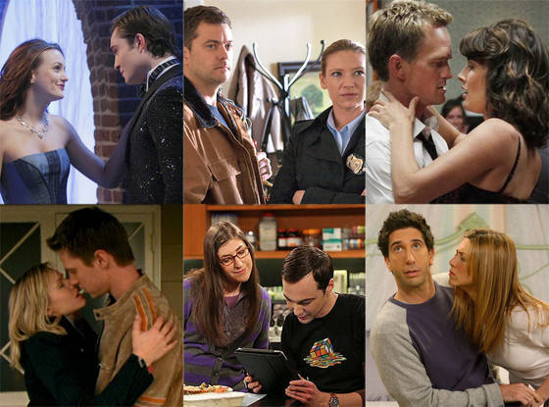
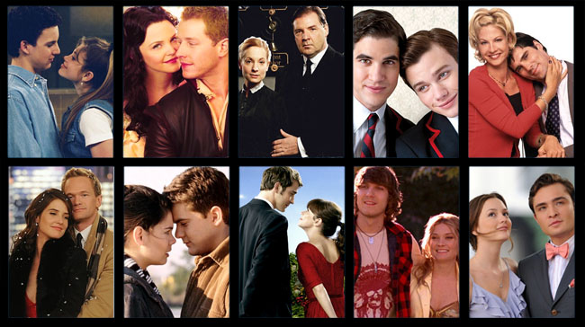
Representation
Notice something about these famous movie/TV couples?
Notes:
Notice something about these famous movie/TV couples?

Slide 18
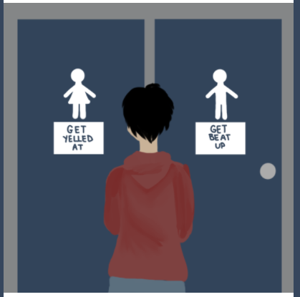
Cisnormativity
The belief that people naturally or normally continue to identify with the gender they were assigned at birth.
Marginalization of trans-identifying people as ‘abnormal’ or a threat.
“When trans people can’t access public bathrooms we can’t go to school effectively, go to work effectively, access health-care facilities — it’s about us existing in public space…It’s really about us not existing — about erasing trans people.” Laverne Cox, 2017.

Slide 19
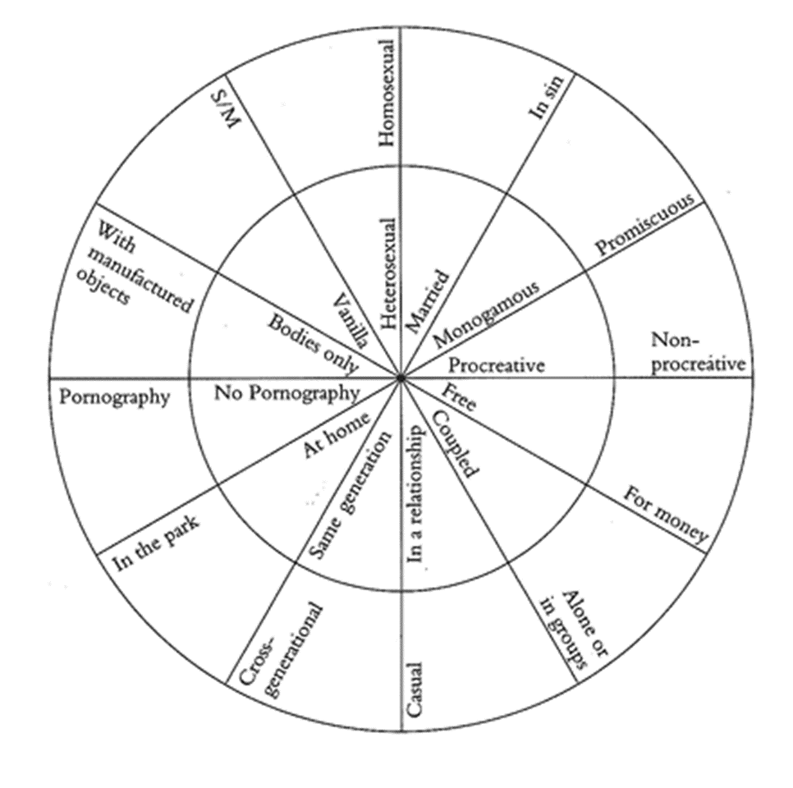
Other normativities
Gayle Rubin’s ‘charmed circle’ of sexual preferences and desires (from Thinking Sex, 1984)
Notes:
Sexuality is constantly policed in societies – it is a very private event but one that is constantly evaluated and prescribed by public bodies, institutions, laws, etc.

Slide 20
In this course, we prefer …

Slide 21
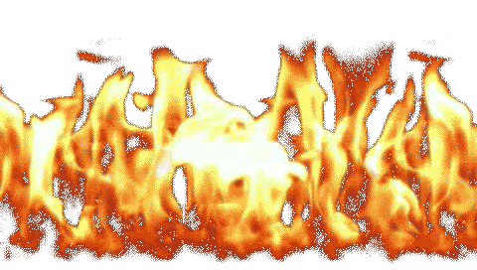
In this course, we are burning the binaries
 | ATTRACTED | TO
GENDER | MEN | WOMEN
Male | gay | straight
Female | straight | gay

Slide 22
Queer theory vs. identity politics
Notes:
Criticisms of queer theory – and Butler’s gender trouble is its focus on individualism rather than collective identities.
Some postcolonial, feminist and race theorists argue though that it is expedient at times to identify with a collective, either because it is politically expedient, or it gives a person a vital element of their identity.
Also, we can’t ignore the embodied, material experiences of our multiple identities. This leads us on to intersectionality, which is another vital facet of our course’s general approach to gender and sexuality.,

Slide 23
Intersectionality
Kimberlé Crenshaw: focussing on either race or sex does not fully capture the experiences of marginalized women who are at caught at the intersection, simultaneously experiencing multiple forms of discrimination.
Criticism of second wave feminism – white, middle-class, heterosexual
‘Dominant conceptions of discrimination condition us to think about subordination as disadvantage occurring along a single categorical axis...[This] marginalizes those who are multiply-burdened and obscures claims that cannot be understood as resulting from discrete sources of discrimination’ (Crenshaw, ‘Demarginalizing the Intersection of Race and Sex ’, 140)

Slide 24
Categories of identity intersect, or overlap – creating multiple oppressions

Slide 25
What makes me who I am? Think about your own intersecting identities and how these will shape your engagement with this course

