Slide 1
FRAMING THE DEBATE

Slide 2
This week
What is religion, and how do we study it?
Terms of the debate when we study religion, gender and sexuality:
Culture or religion?
Cultural relativism or universalism?
Tradition or (mis)interpretation?
Wadjda movie screening in Wednesday’s class.

Slide 3
What is religion? how would you define it?

Slide 4
What is religion?
Religion can be defined in many different ways, but some common definitions include:
A system of beliefs and practices organized and observed by a community.
Usually involves rituals and traditions that acknowledge, communicate with, or approach the sacred, divine, or ultimate truth/reality.
Upholding a moral code of belief and behaviour
Often associated with faith – in a divine being, set of principles, or truths.
Religions may hold as sacred a set of scriptures or teachings.

Slide 5
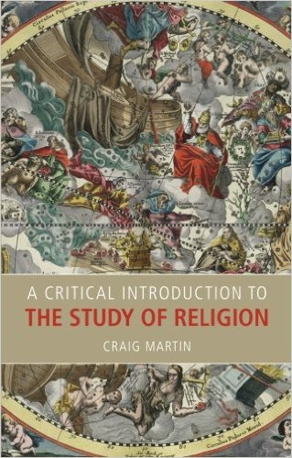
Why is “religion” so hard to define?
There are no features that are uniquely common to all the traditions we typically call religions.
E.g. rituals and moral codes exist outside of religion
We cannot always distinguish “religion” from other cultural traditions.
E.g. sport fandom, celebrity ‘worship’, nationalism
We cannot make generalizations about those traditions we identify as “religion”
E.g. Buddhism is not a theistic religion, some religions may not have sacred ‘scriptures’
See Craig Martin reading

Slide 6
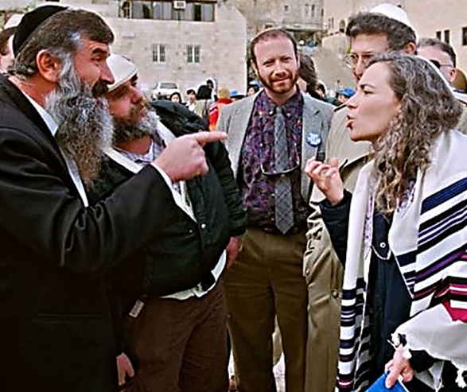
Avoiding generalizations
There’s so much diversity within religions – avoid statements such as ‘All Muslims are…’ (they probably aren’t) or ‘Judaism is…’ (it possibly isn’t)
Most members of religious groups do not share an exact-same, fixed belief system.
Religious practitioners will usually have beliefs and will practice behaviours that contradict the ’official’ beliefs of their stated faith (e.g. contraception use among Catholic women)
Most religious practitioners are influenced by other things apart from their faith (cultural, social, political, etc.)

Slide 7
Hermeneutic of suspicion
From Craig Martin’s chapter.
Hermeneutic = method of interpretation.
Hermeneutic of suspicion – approach the object of study with scepticism, rather than accepting everything at face value – I.e. don’t believe everything you hear.
Methodological atheism– taking an “outsider” [etic] view, rather than “insider” [emic]. What ideologies and beliefs do we bring to class? How can we be aware of these and the ways they might influence our ideas and attitudes about the topics we are studying?
We are interested in the cultural functions and the implications of religious engagements with gender and sexuality.
E.g. religious teachings that tell women to obey their husbands: religious function = it preserves God’s will … but what might the cultural function be?

Slide 8
Questions to keep asking about religious engagement with issues of gender and sexuality
Who is granted a voice? And who is silent/silenced?
Who is being addressed? Who is absent from the audience?
What/whose interests are being protected/promoted?
What rhetoric is being used? [I.e. how are the audience being persuaded?]
What are the consequences – what cultural function is being served?
Who wins, and who loses? Who holds the power in this relationship?

Slide 9
Some other questions to keep in mind as we travel through this course

Slide 10
Culture or religion?
Certain practices and traditions may be attributed to religion, but are they always ‘religious’?
Other factors may be involved, such as cultural norms and beliefs.
E.g. women’s veiling is associated with Islam, but is a cultural practice that predates this religion. Yet it has also taken on religious/spiritual significance.
E.g. ‘honour’ killings (or shame killings) occur in some Muslim and Christian honour-shame cultures – is this a ‘religious’ response, or cultural, or both?
Other examples?

Slide 11
Rescuing … or colonizing?
Universalism: all people deserve to be treated with dignity and respect, according to core human rights. We have the right to call out injustice in cultures other than our own.
Cultural relativism: we can’t judge other cultures for their beliefs and practices if they don’t fit with our western ideas about ‘rights’ and ‘justice’. To say we want to ‘rescue’ someone from another culture is just a way of colonizing that culture with western values.

Slide 12
Is cultural relativism a luxury for people with privilege?
Menstruation huts in Nepal

Slide 13
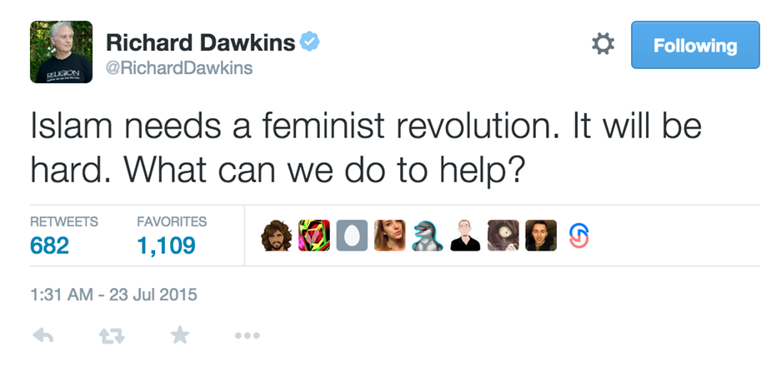
Can universalism sometimes have a hidden agenda?
‘Concerns’ about gender/sexual inequalities often serve particular agendas (including intolerance of certain religious communities).

Slide 14
Notes:
Video made after burkinis were banned in parts of France

Slide 15
Tradition or (mis)interpretation?
When we look at religious beliefs and practice, are we studying the actual religion, or the (mis)interpretation of that religion?
What other factors also come into play in people’s religious beliefs? Religious communities and their members do not exist in a vacuum. And, religion can serve as a ‘prop’ to validate cultural attitudes and discourses.
E.g. why do some religious communities prohibit same-sex marriage? Do their sacred scriptures really say this is forbidden? Or are these scriptures being misinterpreted to reflect wider cultural attitudes?

Slide 16
Religious responses vary – a lot

