Slide 1
Policing bodies
Purity, Purity Culture, Modesty

Slide 2
Questions to keep in mind
Who is speaking? And who is silent?
Who is being addressed? Who is absent/excluded from the audience?
What rhetoric is being used? [I.e. how are the audience being persuaded?]
What/whose interests are being protected/promoted? And whose interests are being challenged/threatened?
What are the consequences – what religious and cultural functions are being served?
Who wins, and who loses? [or ‘who has the power in this relationship?’]

Slide 3
This week:
What is ‘purity’ in religious and cultural terms?
Religious teachings on sexual purity and modesty
What are the cultural functions of purity and modesty regulations?
Focus on the Christian purity movement (or purity industry)
Looking at purity with a hermeneutic of suspicion.
Check out week 3 essential readings by Breanne Fahs and Sarah Moslener

Slide 4
Defining purity
The condition or quality of being pure; freedom from anything that debases, contaminates, pollutes, etc.
Things in their ‘correct’ place – impurity is caused by ‘matter out of place’ (Mary Douglas, Purity and Danger, 1966).
Physical chastity; virginity.
Ceremonial or ritual purity.
Freedom from guilt or evil; innocence, spiritual purity.
Adapted from dictionary.com

Slide 5
Religious purity regulations
Bodies and body fluids
Foods
Diseases
Spaces and places
Other objects, including sacred texts
Ritual (im)purity
Moral (im)purity

Slide 6
What cultural functions do purity regulations serve in religions?
A means of cohesion within a group – purity rituals ‘create unity in experience’ (Douglas).
A way to draw group boundaries and exclude the ‘Other’, particularly among close-dwelling communities.
A means of social control and validating political/social authority, hierarchies and segregation (according to gender, race, sexuality, class, etc.)
A symbolic means of “moral” control.
Practical wisdom, which is given religious meaning to reinforce it (e.g. skin diseases are considered defiling - if you touch them, wash your hands)

Slide 7
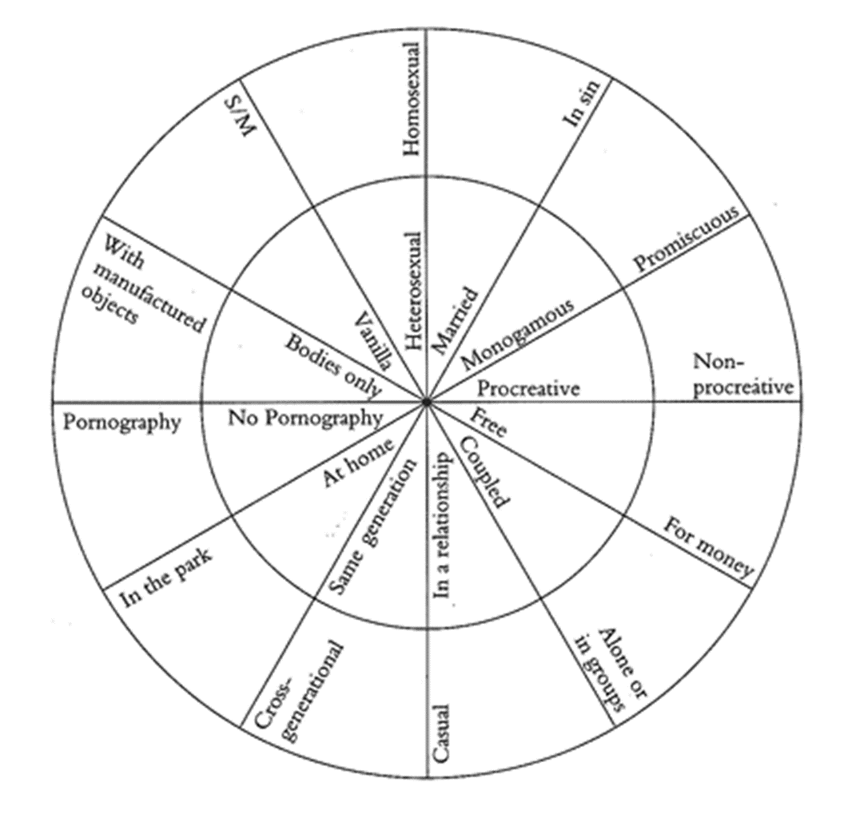
Sexual purity
Many religious traditions connect issues of purity to sexual behaviour.
‘Moral’ or ‘spiritual’ purity – a moral value judgment is placed on certain sexual behaviours.
Gayle Rubin’s charmed circle – those outside the charmed circle may be regarded as sources of impurity within some religious traditions.
And for others, anything in the circle is ‘impure’.

Slide 8
Virginity in religious traditions
Virginity as a prized ‘commodity’ for a woman’s male kin in many religious traditions. A woman is more ‘valuable’ if she is a virgin.
Pre-marital virginity is a commandment in Jewish sacred texts. A woman’s sexuality belonged to her father, and was ‘bought’ by her husband’s family (Exodus 22.16-17).
Hindu marriage ceremony focuses on Kanyadaan ritual (‘gift of a bride’) – father ‘gives’ his daughter’s hand to her husband, signalling his approval.
Think of contemporary Western weddings – bride (dressed in white) is ‘given away’ by her father.

Slide 9
Virginity in religious traditions
Premarital sex is immoral in most Christian and Islamic teachings. Virginity and chastity are prized, particularly for women.
According to Sikh sacred texts and traditions, virginity prior to marriage is an important part of spirituality for all sexes.
Chastity and abstinence, rather than virginity, is important in Buddhist teachings – sex is a distraction from enlightenment. Chastity (or celibacy) is also idealized in some Christian texts and traditions.

Slide 10
Can you think of the religious functions of sexual purity?
To be pleasing to God/gods and avoid sin
To obey sacred scripture and tradition
To foster marital relationships

Slide 11
Cultural functions of sexual purity
Validating existing cultural controls over (mainly) girls’ and women’s bodies and sexual agency.
Reinforcing gender stereotypes
Reinforcing belief that womens’ social, religious and moral “value” is determined by their sexuality.
Creating a culture of shame and stigma for those who do/can not conform.
Reinforcing women’s virginity as a valuable commodity, and source of economic exchange
Safeguarding patrilineal inheritance, ensuring husband’s paternity

Slide 12
Purity is coded for gender
Sexuality becomes a means of defining a person’s social ‘worth’ – particularly for women.
‘Lack’ of virginity = less ‘good’, less ‘valuable’, less ‘moral’.
The sexual double standard.
Perpetuates the myth of women as passive gatekeepers of their sexuality.
Profoundly affects many women’s lives – they can be ‘judged to death’ on the grounds of their sexual ‘purity’.
Who determines this? And who is silenced in the debate?
How does it impact power and privilege?

Slide 13
Purity and intersectionality
Purity discourse is heteronormative – queerness is never ‘pure’.
It often associates purity with youth, beauty, able-bodiedness, and whiteness.
Purity discourse thus marginalizes certain groups and communities as ‘lesser’, less ‘valuable’ or less morally or spiritually worthy – is this another of its cultural functions?

Slide 14
Purity and sexual stereotypes
Female sexuality is framed as naturally passive, resisting, sexless
Male sexuality is naturally aggressive – men ‘hardwired’ to want sex (God created them that way).
Girls and women are therefore tasked with protecting and policing their own bodies so as not to ‘tempt’ men or cause them to ‘stumble’ because of their appearance or behaviour.
This gender pattern reinforces various rape myths: ‘men can’t help themselves’, victim blame, a woman’s ‘no’ means ‘yes’.

Slide 15
Modesty Culture
A shame-based discourse – (women’s) purity is compromised by ‘immodest’ dress and therefore shames her.
Men are ‘visually stimulated’ by the sight of women’s and girls’ bodies. The male gaze is normalized.
Women may ‘tempt’ men by immodest dress, and will be held (at least partly) to blame for men’s sinful thoughts and actions.
Women must take responsibility for men’s ‘natural’ sexual impulses.
Consent is absent from the conversation – girls are expected to accept the ever-present male gaze.

Slide 16
Modesty checks: Dannah Gresh’s Secret Keeper
Girls have a unique power – their ‘allure’.
Girls have to keep their allure ‘under wraps … a secret to be shared with your husband’ (ch3).
Gresh lists various ‘tests’ and checks girls have to perform in order to ensure their ‘allure’ remains hidden.

Slide 17
Self-policing in The Secret Keepers
Stand up ‘lifting your hands up in the air with your arms fully extended. Is this exposing any belly skin?’
‘Bend over and check yourself out in the mirror … can you see a distinct outline of your panties through your pants, skirt, or shorts? … [D]o your tank tops and wide-necked shirts leave your bra straps exposed?’
‘Sit in front of a full-length mirror. Sit both cross-legged on the floor and with your legs crossed in a chair. What do you see? If you can see too much thigh or your panties, guess what? So can everyone else’.
‘Sit cross-legged on the floor. Bend forward as if you’re about to devour a great magazine. Now reach behind you and get a feel of what might be the featured view if your jeans are too low’.
‘[W]hen we get cold or nervous, sometimes we can “get nippy” … When this happens, it is visible to others IF our bras are not thick enough’.
‘When wearing a button-down shirt, stand sideways and look in the mirror. Is the space between the buttons gaping open, even just a little bit? If it’s pulling enough to cause a gap, you’re in danger of exposing way too much’.
‘Take your hand and hook your thumb onto that little shelf under your neck [the collarbone] … Is there any skins showing below your hand? If so, you really need to rethink this shirt’.

Slide 18
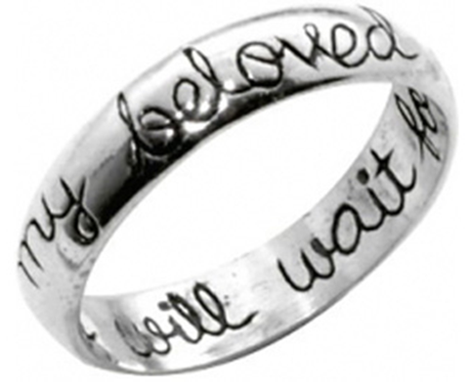
The Christian purity obsession
Pre-marital virginity is prioritized
Virginity pledges
Purity pledges, balls, rings, tee-shirts, etc.
Modesty books, courses, websites etc.
Abstinence-only sex education (which has been shown to be ineffective).
Heteronormative (homosexuality is pathologized as sinful and/or caused by some underlying psychological disorder)
Aimed at both girls and boys – but stronger focus on girls – girls’ sexuality becomes an obsession.

Slide 19
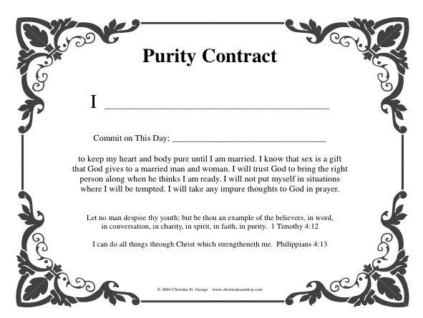
Virginity pledges

Slide 20
Father’s pledge at some purity balls
I, [daughter’s name]’s father, choose before God to cover my daughter as her authority and protection in the area of purity. I will be pure in my own life as a man, husband, and father. I will be a man of integrity and accountability as I lead, guide, and pray over my daughter and as the high priest in my home. This covering will be used by God to influence generations to come.

Slide 21
Purity balls

Slide 22
Purity balls
Watch these two purity ball videos here and here
What gender stereotypes are being reinforced here?
How do we distinguish between protection and control of daughters?
What are the religious and cultural functions of purity rings?
Are girls sexualized by purity discourse?
Are there dynamics of race and class at play in purity balls?
Do girls have the agency to embrace or reject their commitment to purity?
How might we critique purity without ‘colonizing’ girls’ and women’s choices to embrace purity?

Slide 23
Teen Bibles
A product of conservative evangelical Christianity (primarily US-based)
Heavily promote purity and modesty.
Purity and modesty teachings embedded within the biblical text, granting them authority.

Slide 24
Perpetuating gender norms

Slide 25
Commodifying Christian purity culture

Slide 26
Commodifying Christian purity culture

Slide 27
Tutorial: look at these Bibles and books
What do they have to say about sexual purity?
How do they reinforce discourses of female purity and modesty?
What other gendered discourses are being voiced here?
Is purity being gendered in these books (i.e. having different meanings and significances for girls and boys)?
Who has a voice and who is silenced? Who is given the power to control girls’ bodies and sexuality?
Teen Bibles: purity messaging is embedded within the biblical text (literally) – what effect does that have?

