Slide 1
Policing bodies 2
Desires and Intimacies

Slide 2
Purity and modesty
Religious function/rationale:
To be pleasing to God/gods and avoid sin
To obey sacred scripture and tradition
To foster marital relationships
Cultural function/impact of these beliefs in wider culture
Validating existing cultural controls over (predominantly) girls’ and women’s bodies and sexual agency.
Reinforcing gender stereotypes of “passive” female sexuality.
Reinforcing belief that womens’ social, religious and moral “value” is determined by their sexuality.
Creating a culture of shame and stigma for those who do/can not conform.
Granting validation to people who choose to adopt modesty and purity.

Slide 3
This week: heterosexuality
How do religious traditions attempt to prescribe and proscribe bodies and behaviours, regarding issues of heterosex, sexual desire, and reproductive choices?

Slide 4
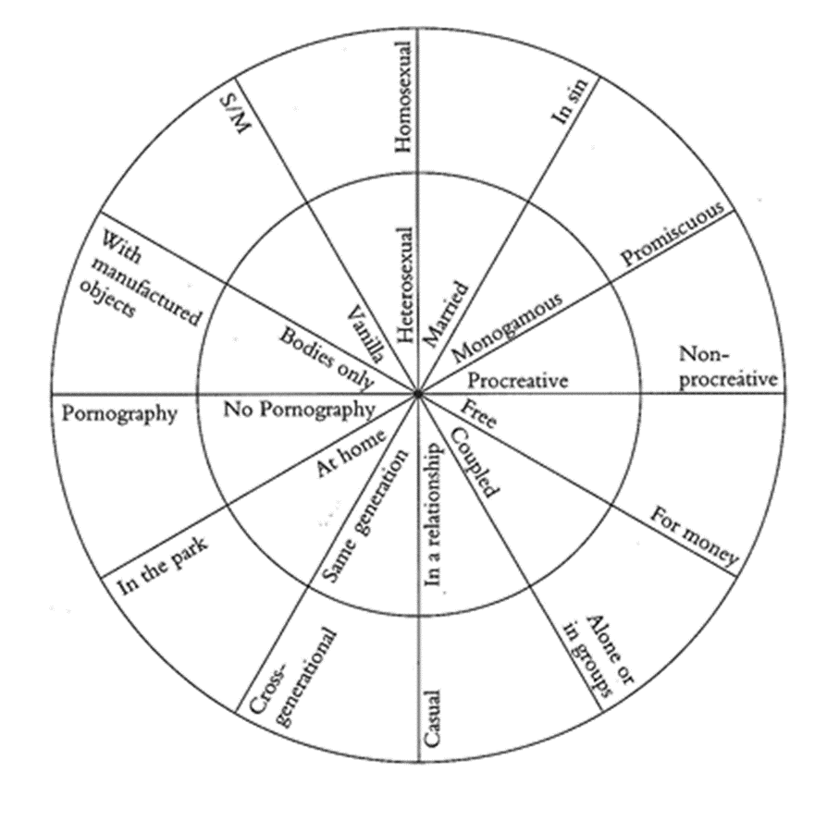
Are religions anti-heterosex?
No, but …
Only some kinds of heterosex are acceptable
Prescriptions and rules about heterosex are typically gendered
Sex is only acceptable in certain situations and for certain groups.
These attitudes are in constant flux – not fixed or stable.
See Dag Ølstein Endsjø, Sex and Religion, ch.4.

Slide 5
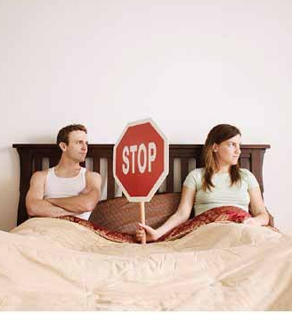
Sex before marriage
Typically prohibited (or at least disapproved of) in many religions – but particularly for women.
Sexual double standard – concepts of ‘masculinity’ and ‘femininity’
Variation among religious communities – e.g. Reform Judaism vs. Hasidic Judaism.
Pre-marital sex may be punished within religious and cultural communities.

Slide 6
Sex before marriage 2
Women’s sexuality may be heavily policed:
Religious functions – purity issues, conformity to divinely mandated gender relations, preventing impediment to enlightenment.
Cultural implications– honour and shame, sexuality as commodity, policing women’s sexualities to authorize patriarchal control.
Men’s sexuality is less open to question – e.g. toleration of prostitutes, or sex with women outside the religious community:
Religious functions – no explicit justification given in religious texts or traditions.
Cultural implications – preserving traditional notions of masculinity; granting authority to male control of women’s sexuality.

Slide 7
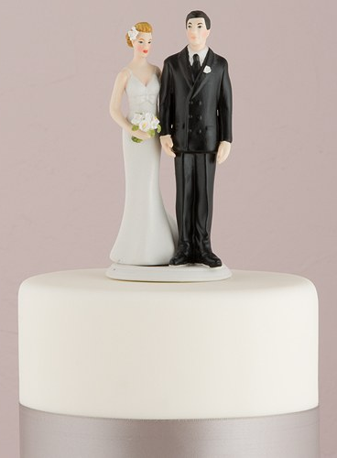
Sex within marriage
Religious claims that marriage has been unchanging over time and place are erroneous.
Dialectical relationship between religion and culture:
Religious teachings and beliefs may validate existing cultural norms around marriage and sexual relationships.
Religious teachIngs and beliefs may influence or shape cultural norms around marriage and sexual relationships.

Slide 8
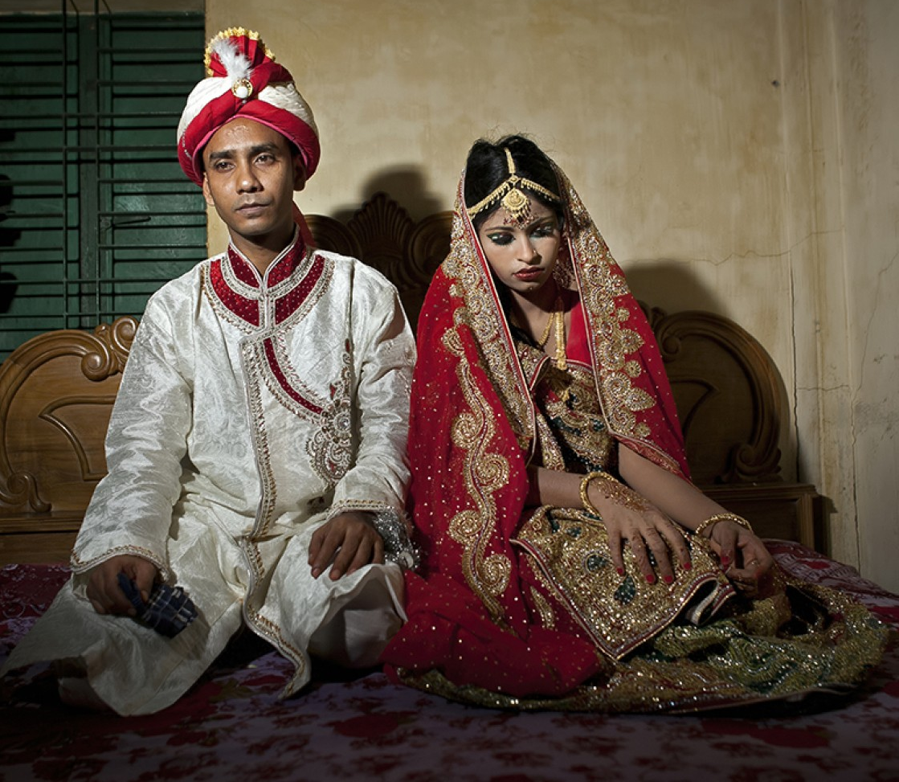
Marriage
Multiple understandings of marriage across and within religious traditions:
Lifelong vs. temporary
Undesirable vs. sacred obligation
Forced vs. consensual
Procreative vs. chaste
Monogamous vs. polygamous

Slide 9
Who are you marrying?
Marriage between people of different races, castes, and religions have been (or remain) prohibited in certain religious traditions:
Christianity and Judaism:
Biblical basis – inter-racial marriage posed a threat to religious fidelity and community ‘purity’ (see e.g. book of Ezra in the OT/HB). But, there were exceptions – Jewish Bible/Old Testament is multivocal on intermarriage.
Interfaith marriages prohibited according to official RC doctrine.
Biblical arguments of racial/religious purity used to justify prohibitions of mixed marriage in the US, Nazi Germany, and South Africa.
Hinduism:
Marriage across castes is strictly prohibited in some Hindu communities.
This has been a significant source of violence for those who choose to disobey.
Islam:
Stipulations for Muslims to marry other Muslims (or Muslim converts) in Koran and Hadiths.

Slide 10
Cultural function
“The religious rules defining who may have sex with whom, whether based on gender, colour, ethnicity, caste or religion, all have one thing in common: they reinforce the fundamental rule, important to many religions, that there are differences between people, that there should be differences between people, and that a different value is attached to different people depending on who they are (or are defined as being). Gender, colour, ethnicity, caste and religion are all factors that define people’s worth within a religious world view. Sex rules contribute to the upholding of these definitions.”
Endsjø, Dag Ølstein. Sex and Religion, p. 196.

Slide 11
How many is too many?
Not all sacred texts or traditions insist on monogamy (for men):
Hebrew and Christian bibles
Kamasutra
Koran
Some religious traditions tolerate concubines and sexual slaves.
Attitudes to polygyny often influenced by cultural norms or secular laws.
Culture clashes – how do religions change with the times?
Reflects gendered differences in culture and religion.

Slide 12
Adultery – the great taboo
Punishable by death in a number of religious texts and traditions.
Still punishable by death/corporal punishment In some religious communities today.
Adultery = a man has sex with another man’s wife.
Religious function: adultery is a sin and can ‘pollute’ the community – not pleasing to god(s).
Cultural function: reinforcing ideology of women as male property and source of male honour/shame; protecting paternity.

Slide 13
The hows, whens, and wheres of sex within marriage
Sex prohibited in marriage at particular times.
‘Sexpectations’ – frequency of sex may be regulated
Sex prohibited in particular places (particularly sacred spaces)
Certain sexual practices forbidden (e.g. anal sex, oral sex).
Some of these have scriptural precedents, others arise in later traditions and may reflect cultural values and taboos.
Not fixed or stable, but subject to change.
Religious and cultural functions?

Slide 14
Divorce
Religious texts and traditions stipulate when a marriage can end and who can end it.
These teachings may show gender bias.
Some religions allow divorce, others ban it completely.
Differences among and between religious communities – often influenced by socio-cultural context.

Slide 15
Reproductive rights and religion
Sex is tolerated in marriage if it is procreative.
Religious restrictions around birth control (other than abstinence).
Religious teachings may or may not be adopted in practice.
Cultural functions: maintain population of religious community; another means of controlling community members (particularly women).

Slide 16
Abortion
Religious traditions have various attitudes towards abortion – from outright condemnation, to acceptance in particular circumstances.
Religious reasons focus on the sanctity of life – of both the foetus and the mother.
Abortion as a moral decision? Or a religious decision?
To what extent should religions influence state/national laws around sex and sexuality, including contraception and abortion?

