Slide 1
Queer identities and religion

Slide 2
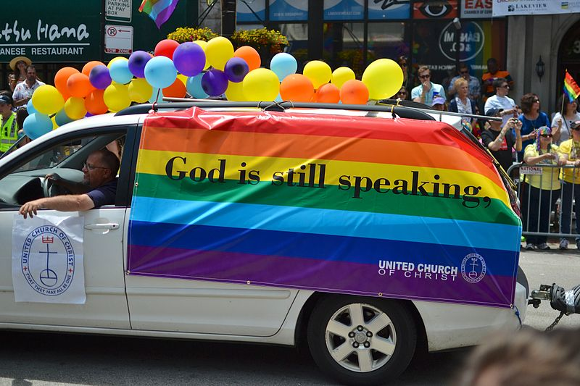
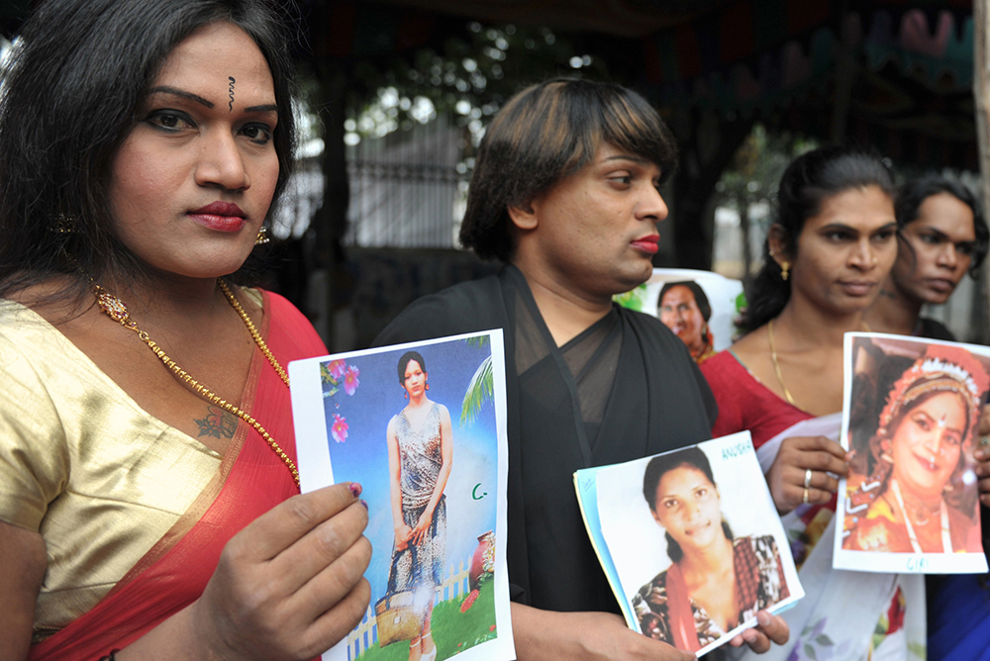
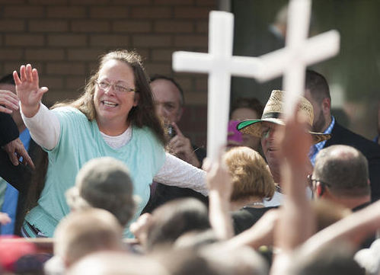
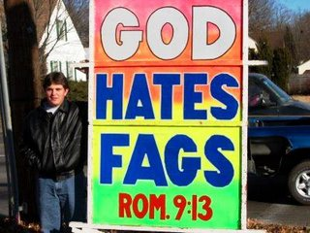
Queer sexualities and religion
How are dominant heteronormative discourses of gender and sexuality affirmed and challenged within religious traditions?
See this week’s readings from Dag Ølstein Endsjø, Sex and Religion, ch.5.
Religious functions
Cultural functions

Slide 3
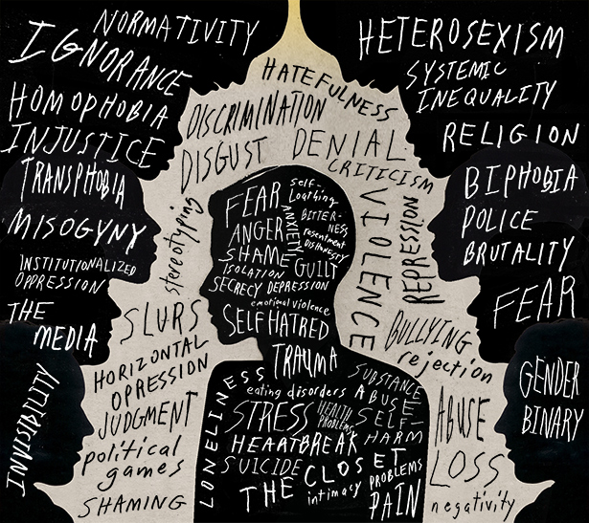
Culture or religion?
‘The connections between religion and homophobia [and transphobia] … cannot be analysed without reference to cultural norms … Religion alone is not always the primary agent of creation of homophobic [and transphobic] attitudes, and sometimes does not contribute to homophobic [or transphobic] attitudes at all. Indeed, in some cases, religion may reinforce or sanction existing positive attitudes towards homosexuality [and the trans community]’
James Wilets, “Religion and Homophobia,” in Encycolopedia of Gender and Sexuality Studies, p. 1.

Slide 4
Gender and sexuality are social constructs … remember?
There are no universal, fixed or timeless understandings of ‘normative’ gender and sexuality.
The meanings ascribed to genders and sexualities is in constant flux across space and time.
The terms ‘homosexual’ and ‘heterosexual’ were first used in the 1860s by journalist Károly Mária Kertbeny. Adopted as a medico-legal term in 1886 by Richard von Krafft-Ebing in his book Psychopathia Sexualis.
The word ‘bisexual’ dates to the early 20th century; transgender was first used in medical discourses in 1965.

Slide 5
Religious attitudes to sexual desires change over time and space
Buddhism: a long tradition of same sex desires being tolerated between some Japanese Buddhist monks and younger novitiates. Desires between women less tolerated.
Islam and Judaism: some toleration of same sex desires during Middle Ages and beyond.
Hinduism: Vedic texts (c. 1500 BCE) and Kamasutra both regard male same-sex desires and non-binary genders as acceptable.
Ancient Greece: Sexual desires between men tolerated in cultural and religious contexts – a reflection of divine activities.

Slide 6
Religious traditions challenging gender binaries
Indigenous Americans - ’two spirit’ people who embody both masculine and feminine.
Voudou religion – wide acceptance of male same-sex desires and different gender identities.
’Third gender’ in Hinduism (hijras)
Mukhannath (transgender identity) recognized and tolerated in some Islamic hadith.
But, can we say that religions condone or sanction homosexuality or trans identities per se?

Slide 7
Religious roots of homophobia
Prohibition of same-sex desire between men found in many religions.
Often grouped with other forms of sexual behaviour identified as illicit.
Religious rationale:
Contradicts divinely-mandated order
A source of impurity – matter ‘out of place’
A marker of ‘outsider’ sexuality
A consequence of ungodliness – divine punishment.

Slide 8
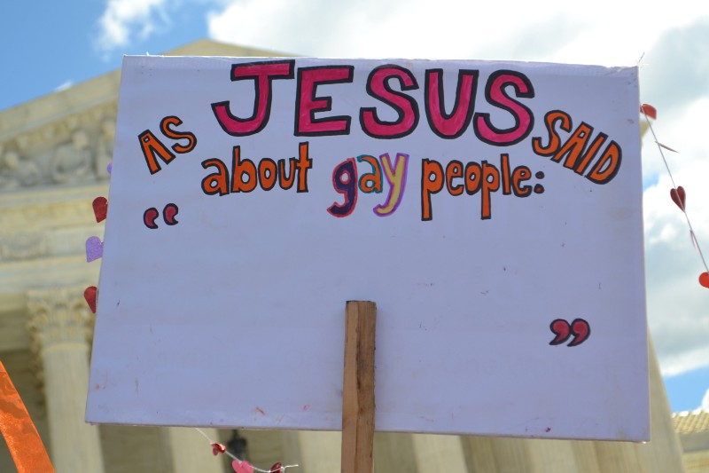
How seriously are same-sex desires and trans identities taken within religious traditions?
Do not appear to be a priority in sacred texts.
Not always easy to determine – how were sexuality and gender understood when these texts were written?
They are no more serious than other offences involving opposite-sex desires (e.g. adultery, pre-marital sex, divorce).
Differences between the way male and female same-sex desires are treated.
Again, we have to be cautious when evaluating these contemporary terms in relation to older texts and traditions.

Slide 9
Tradition – or interpretation?
Creation of ‘male and female’ (Genesis 1-2).
Sodom and Gomorrah (Genesis 19).
Laws against “homosexuality” (Leviticus 18.23; 20.18)?
Jesus and divorce (Matt. 19.3)
Paul and undesirable sex (Romans 1.26-7)

Slide 10
Transphobic and homophobic violence in religion and culture
Subjective violence: physical violence
Symbolic violence: violence of language
Structural violence: institutional, legal violence.

Slide 11
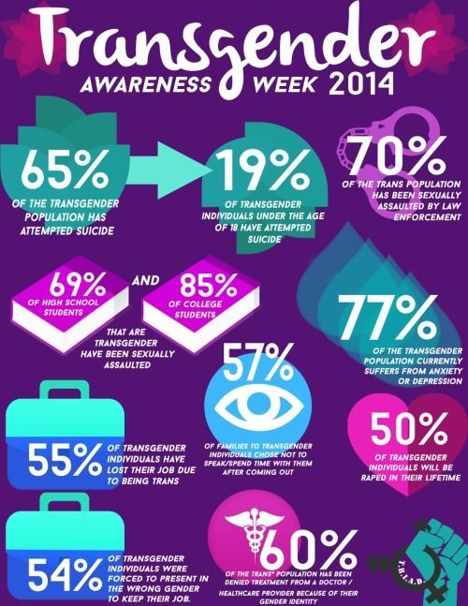
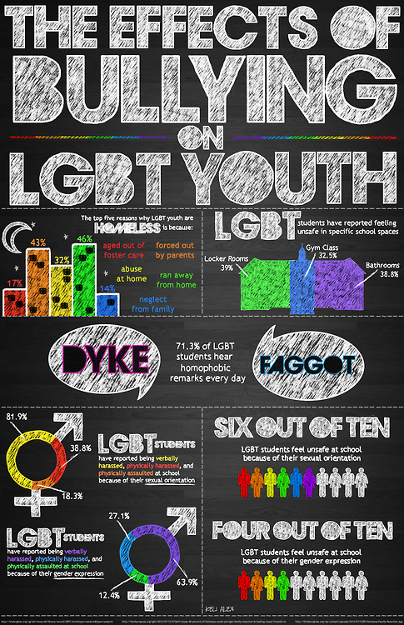
Queer rights are human rights…right?

