Slide 1
Gender violence and religion

Slide 2
Talking about gender violence
This week’s topic can be emotionally challenging to discuss.
We will engage with it sensitively, and encourage everyone to consider the tutorial on Friday as a safe space where we can learn about this difficult content empathetically and thoughtfully.
If you find the subject distressing, please feel free to absent yourself from the tutorials.

Slide 3
What is gender violence?
Violence that arises from normative gender roles and expectations within a given society, which result in unequal power relationships between different gender groups.
Gender intersects with other identity markers (e.g. race, sexuality, age, ability, class) to create multiple sites where people are marginalized, disempowered, and vulnerable to violence.
Gender violence can include:
Subjective violence – physical and sexual violence, intimate partner violence, coercive control
Symbolic violence – the violence of sexist and misogynistic language
Structural/systemic violence – the violence of inequitable gendered laws, regulations, institutions, etc.

Slide 4
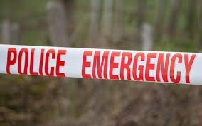
What about Intersectionality?
Oranga Tamariki review: “Treatment of Māori women has been inhumane” - Dame Naida Glavish
“Julia Whaipooti on Police and State Racism”- Maori women: fear state authorities more than abusive partners.
Maori men: Police more likely to arrest young Maori men and initiate car chases against them – Moana Jackson

Slide 5
#SayHerName Because Black Women’s Lives Matter Equally
African American Policy Forum: Breaking the Silence (2014)
Black women and girls face more:
arrests at school
prison sentences
community alienation
violence, trafficking and sexual assault
Find out more about #SayHerName and AAPF here

Slide 6
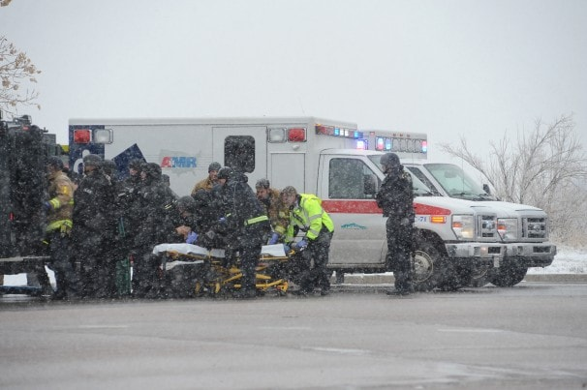
“Killing in God’s Name”
Violence outside abortion clinics.
Male perpetrators, victims are medical staff and women.
Reframing of commandment “thou shalt not kill.”
Recast as “killing in God’s name.”

Slide 7
“Killing in God’s Name”
Male perpetrators, victims are medical staff and pregnant women.
Commandment “thou shalt not kill,” recast as “killing in God’s name.”
Mireille Jacobson and Heather Royer, "Aftershocks: The Impact of Clinic Violence on Abortion Services," American Economic Journal: Applied Economics 3, no. 1 (2011): 189-223.
Have the protests against abortion and attacks on the clinics reduced abortion rates?

Slide 8
“Raping in God’s Name”
ISIS Enshrines a Theology of Rape
Is there any religious basis for the argument that the 5270 victims of ISIS were non-Muslim and therefore being “saved” by being raped by Muslim men?
Supporting infrastructure (bills of sale, purpose-built buses with blacked-out windows, warehouses, and video auctions with photos), indicate that it was a systematic weapon of war, set up along business lines.

Slide 9
Women traded for Peace
Women used as bargaining chips:
Released during peace settlements.
Arranged marriages between feuding tribes.
Traded as slaves to settle debts.
Peace ensured for a time, but at what cost to women and girls?

Slide 11
Religious or Cultural Violence?
See essential reading by Janet Jakobsen.
Important to define topic.
Framing the topic is often emotive when Muslim and Third World countries are assessed through Western eyes.
Danger of redefining domestic abuse through religion.
This serves greater purposes when the media and politics are involved.
Is it sometimes more to do with a loss of religious values and growing secularism rather than religion per se? e.g. Dowry murders in India.

Slide 12
Religious or cultural violence?
Religion intersects with other sociocultural factors – race, gender, class, sexuality, socio-economic status, etc. – to create multiple sites of oppression and vulnerability to gender violence within rape cultures.
‘Religion and secularism can both be if not the cause, then at least the legitimation, of violence.’
Janet Jakobsen, p. 125

Slide 13
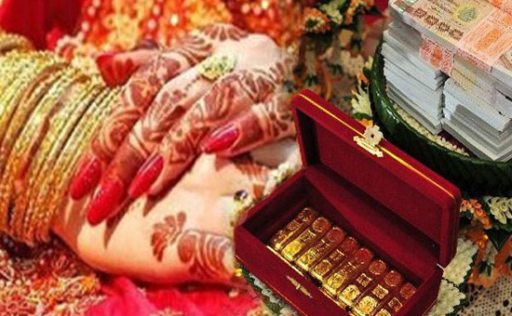
Sanjeev Nayyar,How the British created the Dowry System in Punjab. https://www.esamskriti.com/e/History/Indian-History/How-The-British-Created-The-Dowry-System-In-Punjab-1.aspx

Slide 14
On the Question of Power…
Do women need “protection” from religious regimes?
This was one reason given for US soldiers going into Afghanistan and Iraq.
Are these women any better off than before?
Plays into stereotypes. Can be used to justify “colonialism.”

Slide 15
Religion or response to the West?
The Western Question:
In strict regimes (Afghanistan, Iran) women’s movements seen as western and secular.
Fundamentalism in part a response to Western decadence?
Strict purity laws. More than argument about literacy, chaperones etc?

Slide 16
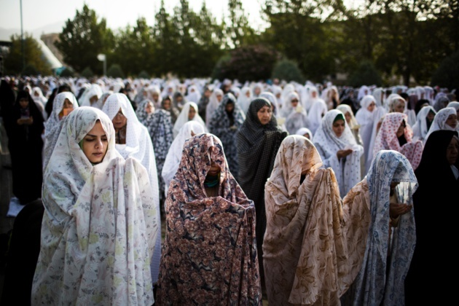
Vincent Tourret, “Does the Iranian Law Encourage Acid Attacks?” Le Journal International Archives (28 Nov 2014)

Slide 17
Religion or State Sanctioned Violence?
State Sanctioned Violence
Return of lashing and stoning, for calling out rape.
Are politics involved with lashing, stoning, and rape of political prisoners prior to execution?
Religion used to justify violence. A virgin cannot be killed, therefore she must be temporarily “married” (raped) before death.

Slide 18
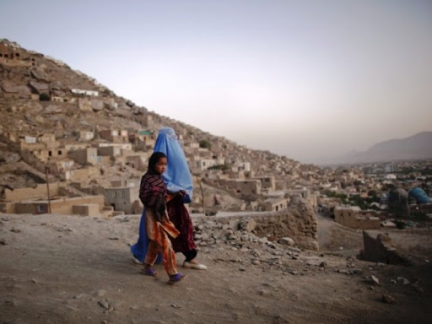
Gender Roles
Polarised gender roles, submissive, covered up women, alpha male, “heroic” image (at extreme levels, includes martyrdom).
Violence against boys and men too. In war times, execution of those who had gone through puberty.

Slide 19
Christianity, Violence, and Gender
Marie Fortune and Cindy Enger, “Violence against Women and the Role of Women,” 2005 (see reading list, or here)
Christian Church encouraged:
To stay in abusive marriages (Eph. 5:22-24).
Not to divorce (Eph. 5:20).
In more recent times, church more willing to see violence as sin used to gain power. But some Christian denominations still encourage women not to divorce or leave their abusive spouse.

Slide 20
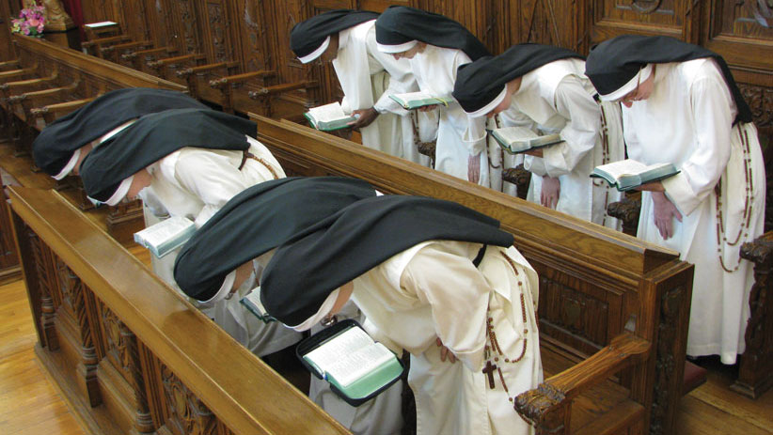
Podcast, “After Years of Abuse By Priests, #Nuns Too are Speaking Out.” March 18, 2019
Listen to podcast here

Slide 21
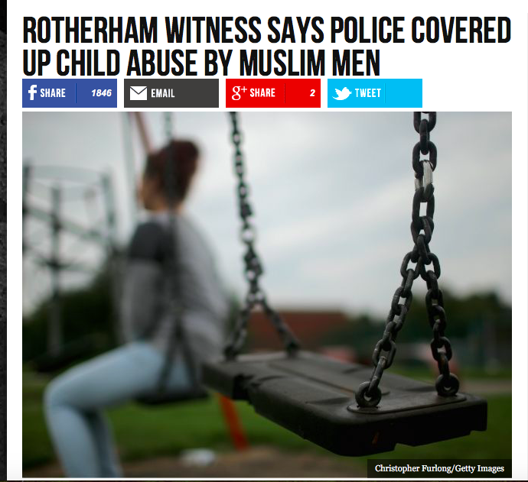
See articles by Slavoj Zizek and Waqas Tufail (listed under week 8 module).
From the outset, the Rotherham sex abuse case (which came to light in 2014) was interpreted through various intersecting lenses of race, class, religion, ethnicity, gender.
The treatment of victims and perpetrators by authorities and the media was coloured by their various intersecting identities. The grooming scandal was repeatedly framed as a religious and ethnic ‘issue’ impacting girls from a particular class background.
Other perpetrators and victims were overlooked by both the media and authorities.

Slide 22
Katie Edwards, “Silence of the Lamb”
In this BBC radio programme, Katie talks about her own experience of child exploitation in Rotherham, reflecting on it in light of biblical teachings and Christian traditions of silence in the face of suffering and abuse.
Listen to it here.

