Slide 1
Gender violence in the Bible

Slide 2
Talking about gender violence
This week’s topic can be emotionally challenging to discuss.
We will engage with it sensitively and encourage everyone to consider the tutorial on Friday as a safe space where we can learn about this difficult content empathetically and thoughtfully.
If you find the subject distressing, please feel free to absent yourself from the tutorials.

Slide 3
This week
Defining rape culture and rape myths
Identifying sexual violence in the Bible
Resistant readings of biblical ‘texts of terror’

Slide 4
What is rape culture?
A culture in which rape and other forms of gender violence are pervasive and normalized, legitimized, denied, or trivialized due to societal attitudes about gender and sexuality.
In rape cultures, we see many, everyday sociocultural practices that excuse or tolerate gender violence:
Rape is spoken about trivially (or even celebrated) in pop culture (e.g. film, TV, music)
How seriously does the judicial system take sexual violence? In New Zealand, only about 10 out of 100 sexual abuse crimes are reported and 3 of those get to court. Only one of those is likely to get a conviction.

Slide 5
Rape myths sustain and scaffold rape culture
(S)he was asking for it.
It is/was the victim’s responsibility not to be raped.
Men can’t help themselves.
‘Good’ men are not rapists.
Women play hard to get – but ‘no’ means ‘yes’.
Rape is ‘just sex’.
Rape victims are ‘defiled’ or ‘damaged goods’.
Rapes are committed by strangers.
Women lie about being raped.
A person cannot rape their spouse.
Sex workers cannot be raped.

Slide 6
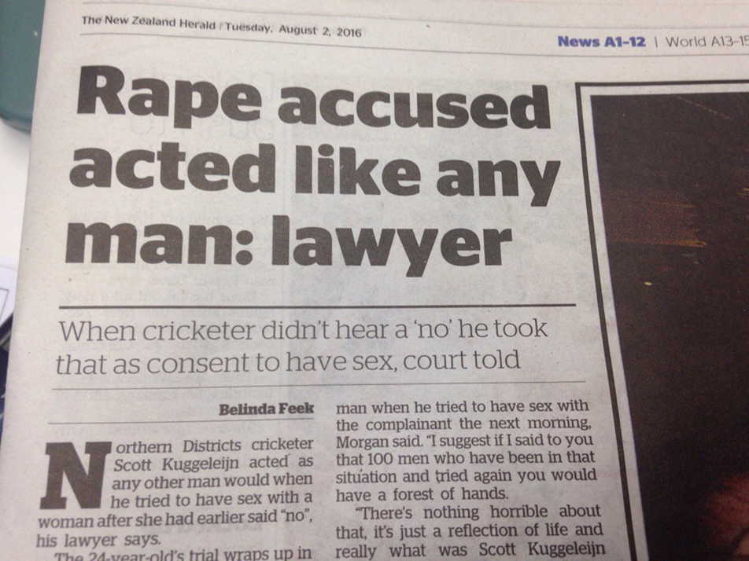

Slide 7
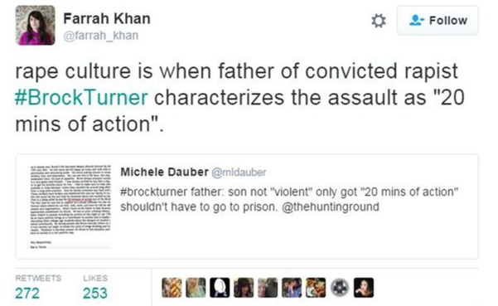
Are drunk girls to blame for sexual assault?
Notes:
Are drunk girls to blame for sexual assault?

Slide 8
Rape myths in biblical texts
Some of the same myths and misperceptions about sexual violence are also articulated in biblical texts.
Others are not mentioned explicitly in biblical texts, but may be imported onto texts by interpreters who are influenced by their own rape culture context (in other words, we see what we expect to see when we look at a text).
At times, biblical rape narratives are ignored, silenced, trivialized or excused both in biblical scholarship and religious contexts.

Slide 9
Silencing sexual violence is a part of rape culture
‘After rape, there is a terrible silence.’
– Deena Metzger
‘Rape has long been considered a crime so unspeakable, so shameful to its victims, that they are rendered mute and cloaked in anonymity.’
– Nancy Venable Raine
‘Silence and silencing are characteristic of approaches to sexual violence.’
– Ulrike Bail
‘To speak and be heard is to have power over one’s life. To be silenced is to have that power denied.’
– Courtney Ahrens

Slide 10
Sexual violence in the Bible
See reading by Johanna Stiebert (under week 9 module)
Stranger rape (e.g. Genesis 34)
Acquaintance rape/incest (e.g. Genesis 19; 2 Samuel 13)
Gang rape (e.g. Judges 19 – and threatened in Genesis 19)
Wartime rape (e.g. Deuteronomy 21:10-14; Numbers 25, Judges 21, etc.)
Coercive sex, or sex with a slave (which = rape; e.g. Genesis 12:10-20; Genesis 16; 2 Samuel 11; Luke 7:1-10)
Sex trafficking (e.g. Esther 2)
Metaphorical rape (e.g. Ezekiel 16, 23; Hosea 1-3)
Sexual violence as punishment (e.g. Matthew 27:28, 35)

Slide 11
How do we read texts of terror?
Redemptive readings – finding sympathy and compassion in the texts for victims of rape (e.g. Phyllis Trible, Texts of Terror)
Hermeneutic of suspicion – the texts are unredeemable and need to be critiqued (e.g. Esther Fuchs, Linda Day)
Silence – the texts are ancient stories whose socio-cultural context should be respected and left unchallenged (cf. cultural relativism; e.g. Phyllis Day, Meir Steinberg).

Slide 12
Breaking the silence – the responsibility of the biblical reader
‘Interpretation is never objective, never reliable, never free of biases and subjectivity’.
- Mieke Bal, Death and Dissymmetry, p. 238.
‘We cannot afford to ignore the activity of reading, for it is here that literature is realized in praxis. Literature acts on the world by acting on its readers.’
- Patrocinio Schweickart, ‘Reading Ourselves’, p. 615

Slide 13
The interpreter’s own silence
‘To accept the value statements of the text in utter passivity, without allowing oneself the freedom to reflect critically upon its claims and to question its assumptions is merely to foster a sense of complacency.’
- Eryl Davies, The Dissenting Reader, p. 8
‘By ignoring the ideological problem posed by stories of rape and adultery, by ignoring the patriarchal implications of the way in which the woman in the text is silenced, the modern androcentric critic reinscribes biblical sexual politics … The choral harmony of the authoritative narrators and the “objective” critics reencodes the silence about women’s oppression.’
- Esther Fuchs, “Contemporary Biblical Literary Criticism,” p. 138.

Slide 14
Our role as interpreters
‘In order to deconstruct the abuses of the present, we must dismantle the oppressive texts, interpretations, and practices of the past.’
Carole Fontaine, With Eyes of Flesh, p. 218.
‘We need to know the writing of the past, and know it differently than we have ever known it; not to pass on a tradition but to break its hold over us.’
Adrienne Rich, “When we dead awaken,” p. 35.
“Because the Bible continues to exert influence into the present, erasure of rape from the Bible can enable the easier perpetuation of rape myths … [which] have bearing and a damaging impact on real lives’.
Johanna Stiebert, p.7).

Slide 15
But what about anachronism?
What do ancient texts have to say to modern concepts of sexual violence?
Biblical understandings of sexual violence are very different from contemporary definitions.
Can we make comparisons between biblical and contemporary rape?
See Susanne Scholz (2005) in reading list

Slide 16
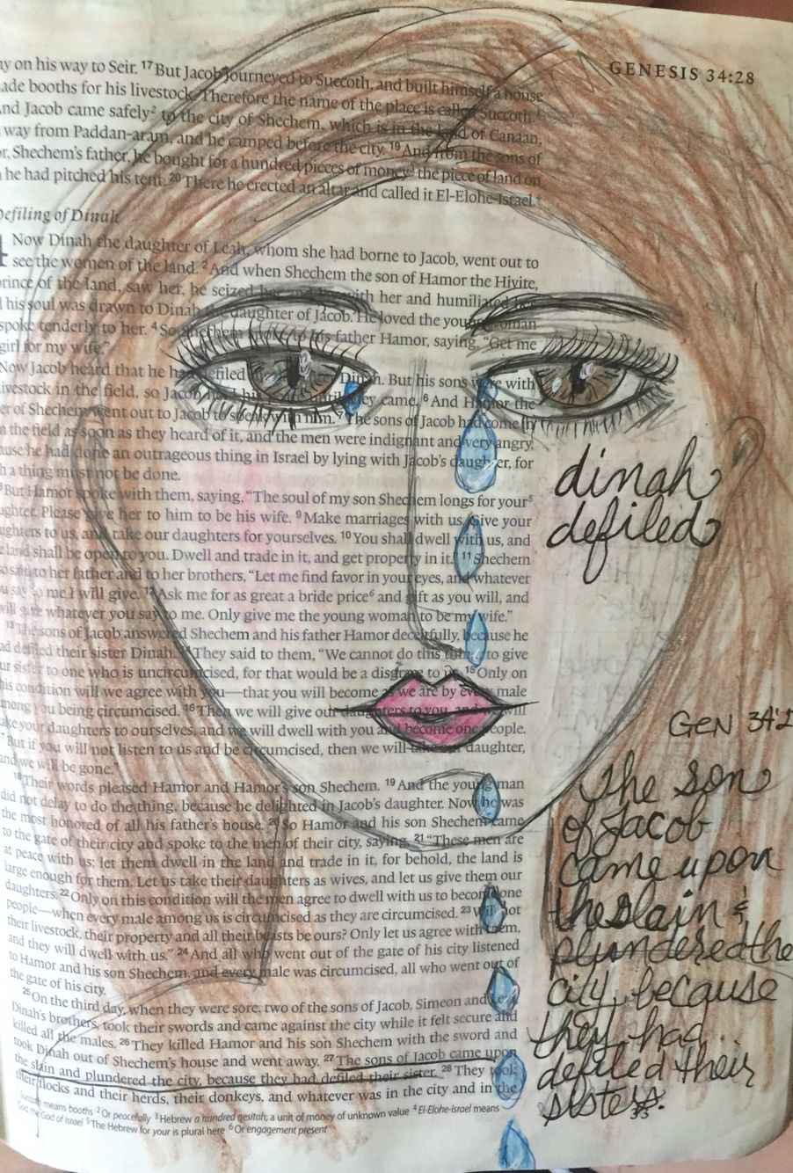
Genesis 34
Interpreters have identified various rape myths in this text:
She was asking for it
It is/was the victim’s responsibility not to be raped.
Rape is ‘just sex’
Men can’t help themselves.
‘Good’ men are not rapists.
Rape victims are ‘defiled’ or ‘damaged goods’.

Slide 17
‘Asking for it’
“Now Dinah the daughter of Leah, whom she had borne to Jacob, went out to visit the women of the region.”
Interpreters over the centuries have interpreted Dinah’s ‘going out’ as a sign that she had the ‘sexual intention of luring a man’ or was at least ‘at fault’ for letting herself be ‘seen’ by Shechem.
She is described as ‘sexually aggressive’, ‘unconventional’, ‘looking to be raped’, ‘asking for it’; she is accused of ‘imprudence’ and ‘transgression’ (going out by herself).

Slide 18
What does the Bible say about women who “go out”?
Not much, to be honest.
Women go out all the time – to work, to celebrate, to attend religious festivals, etc.
Deuteronomy 22:25-26 makes clear that a woman who is raped when out in the countryside is completely innocent.
The only biblical woman chastised for ‘going out’ is a married woman looking for a lover when her husband is away.
The threat of sexual harm to women who go out is mentioned from time to time, but is not associated with any sense of blame on the woman’s part.

Slide 19
Rape is ‘just sex’
The biblical text strongly suggests a coercive act of rape, followed by abduction:
“When Shechem son of Hamor the Hivite, prince of the region, saw her, he seized her and lay with her by force” (v.2; NRSV – NIV has ‘he raped her’).
“[Dinah’s brothers] killed Hamor and his son Shechem with the sword, and took Dinah out of Shechem’s house, and went away” (v.26).
Dinah’s rape is sometimes described in biblical scholarship as a ‘seduction’, a ‘liaison’, an ‘affair’, an ‘act of passion’, an ‘amorous folly’, and a source of Shechem’s ‘desire’ or ‘pleasure’.
Interpretations such as these completely elide the violence in this text and equates rape with ‘just sex’, diminishing its harmfulness.

Slide 20
Rape is an offence against the victim’s male kin
Issue of dishonour to male relatives, rather than the welfare of the victim.
‘[Dinah’s brothers] were shocked and furious, because Shechem had done an outrageous thing in Israel by sleeping with Jacob’s daughter—a thing that should not be done’ (v.7).
‘Then Jacob said to Simeon and Levi, “You have brought trouble on me by making me obnoxious to the Canaanites and Perizzites, the people living in this land. We are few in number, and if they join forces against me and attack me, I and my household will be destroyed.” But they replied, “Should he have treated our sister like a whore?”’ (vv.30-31)
Do Dinah’s brothers even recognize this event as rape, or are they more concerned that ‘their’ family’s sexual property (Dinah’s virginity) has been stolen (particularly by a non-Israelite man)?

Slide 21
‘Not your typical rapist’
Shechem wants to marry Dinah after he rapes her – he falls in love with her:
“[Shechem’s] heart was drawn to Dinah daughter of Jacob; he loved the young woman and spoke tenderly to her. And Shechem said to his father Hamor, ‘Get me this girl as my wife’.
Biblical interpreters take this as a sign of Shechem’s redemption – he’s an ‘affectionate young man’, who deserves our ‘sympathy’, and whose ‘commitment’ to Dinah is laudable.
The ‘good bloke’ trope – undermining the violence of the rape, diminishing blame, perpetuating myths that ‘good blokes’ don’t rape.

Slide 22
‘Damaged goods’
“When Jacob heard that his daughter Dinah had been defiled, his sons were in the fields with his livestock; so he did nothing about it until they came home” (v.5).
“Because their sister Dinah had been defiled, Jacob’s sons replied deceitfully as they spoke to Shechem and his father Hamor” (v.13).
“The sons of Jacob came upon the dead bodies and looted the city where their sister had been defiled” (v.27).
Victims may feel ‘defiled’ themselves after their rape. But this can be amplified by others’ responses to them (and this ties into purity culture).

Slide 23
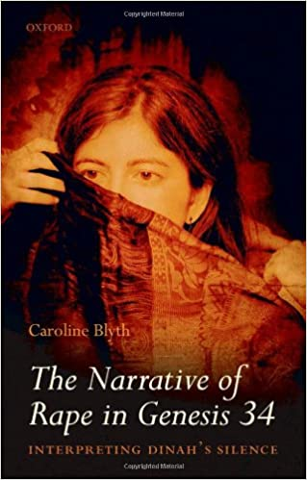
Where is Dinah in all of this?
Dinah is central to this story, yet her voice is the only voice that is never heard. All male characters are given a voice and point of view.
Reinforcing the silence that surrounds sexual violence.
How can we give Dinah her voice back?
Should we give Dinah her voice back?

Slide 24
‘Yes, but it’s complicated’
Genesis 34 ends with the annihilation of an entire Canaanite community by Dinah’s brothers.
Do their actions impact on our reading of this text?
Should the fact that Jacob and his descendants go onto colonize Canaan impact our interpretation of Shechem’s actions?
Should we be concerned about reinforcing colonial discourses about ‘foreign’ men posing a threat to colonizers’ women?
And if so, what happens to Dinah?

Slide 25
Where to take the text from here: Biblical interpretation as activism
Reading biblical rape texts critically, pointing out the rape myths present in both text and interpretation, can serve to highlight and challenge rape myths and rape culture in our own contemporary cultures.
E.g. see Jessica Keady’s chapter on Genesis 34.
Drawing connections between biblical rape texts and contemporary rape culture.
Highlighting the problematic nature of these biblical texts and their interpretations – their influence on readers.
Highlighting the current crisis of rape culture and all forms of gender violence.
Stopping the cycle of perpetuating rape myths through sacred texts.

Slide 26
Other examples for you to check out
The Shiloh Project: an interdisciplinary research network exploring the various connections between rape culture, religion and the Bible.
Breaking out of the echo chamber – speaking to audiences within and beyond the University, engaging with activists and practitioners as well as academics.
Bible and Critical Theory journal issue (2019) focuses on resistant readings of biblical texts depicting gender violence.
Rape Culture, Gender Violence, and Religion: Biblical Perspectives (2018) – this volume explores biblical ‘texts of terror’, reading them alongside contemporary popular culture.

Slide 27
Tutorial: Tamar Campaign
Tamar Campaign involves community-based, contextual biblical study to understand gender-based violence.
Start with the theme affecting community
Look behind the text (original context)
In the text (the message in its own right)
Beyond the text (how it speaks potentially to us today).
Read 2 Samuel 13:1-22 and also the notes and questions on this text (pp.26-28) in the Tamar Campaign booklet (linked to in the Reading List and under the week 9 module). Be prepared to discuss this in your tutorial this week.

