Slide 1
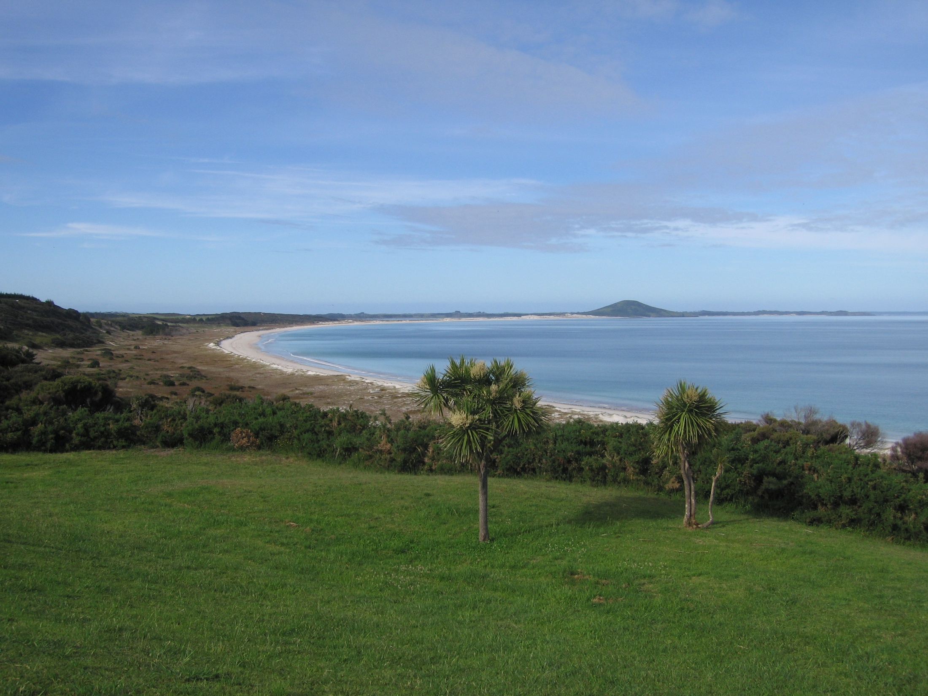
National Iwi Chairs’ Forum
MĀORI 230
Lecture 3 April 2017
Professor Margaret Mutu
Te Rūnanga-ā-Iwi o Ngāti Kahu
The University of Auckland

Slide 2
Readings
Mutu, M. 2016. Māori Issues in The Contemporary Pacific – A Journal of Island Affairs Vol.28 No.1 pp. 227-237.
Jackson, Moana, 2016. And Margaret Mutu, He Whakaaro Here Whakaumu Mō Aotearoa: The Report of Matike Mai Aotearoa – The Independent Working Group on Constitutional Transformation. Auckland, University of Auckland and National Iwi Chairs Forum. 125 pages. http://www.converge.org.nz/pma/MatikeMaiAotearoaReport.pdf
Provost, Lyn. 2015. Whānau Ora: The First Four Years. Wellington, Office of the Auditor-General. http://www.oag.govt.nz/2015/whanau-ora

Slide 3
Background
2005 Ngāi Tahu calls hapū and iwi leaders to hui to see how we can help each other take back control of our lives – mana Māori motuhake - National Iwi Chairs’ Forum (NICF) established
Since 2008 has been increasingly referred to on a range of issues affecting Māori
2010 – Annette Sykes strongly critical – allegations of lack of transparency, lack of mandate, underhanded dealing with government etc.
What is the NICF? What has it been doing?
Consider the work of three of its working parties – Freshwater, Whānau Ora and Matike Mai Aotearoa

Slide 4
National Iwi Chairs’ Forum
Informal group of chairs of mandated iwi/hapū representative bodies – 68 members registered
First hui 2005 Takahanga marae, Kaikōura.
Meets four times a year in different iwi rohe, according to the tikanga of that/those iwi.
February – Waitangi/Taitokerau; August – Tūrangawaewae/Hopuhopu/Waikato-Tainui; Others: Te Waipounamu (several); Porirua; Waitara; Pōneke; Heretaunga; Ōhākune; Tūranga (Gisborne); Te Kūiti; Tuahiwi (North Canterbury); Mt Maunganui; Whangaehu; Arahura (West Coast); Rotorua; Waiharakeke (Blenheim).
Purpose: To bring hapū and iwi together to share information and expertise, to tautoko each other and work together on issues of importance to all our whānau, hapū and iwi.

Slide 5
National Iwi Chairs’ Forum (cont)
Upholds te mana motuhake of all whānau, hapū and iwi and works towards realising that
Works in background, is supposed to keep a low media profile – some coverage on Māori media
Does not represent iwi or Māori – only iwi/hapū representatives can repesent iwi/hapū – government frequently chooses to misrepresent this aspect to provide false perception
Iwi/hapū chairs responsible for keeping own iwi informed – variable in practice
http://www.iwichairs.maori.nz/

Slide 6
NICF Working Groups – Iwi leaders’ Groups
Constitutional Transformation – Matike Mai Aotearoa
Freshwater
Climate Change and Emissions Trading Scheme
Whānau Ora
Resource Management Act reform
Mining and Oil Drilling
Education
Housing
Te Ture Whenua Māori Act reform
Te Reo/UN Taonga/treaty claims/covenant for children – current issues

Slide 7
Some Iwi Leader Groups adhere to the Forum kaupapa
Others, most often chaired by current or ex-government servants, risk becoming pawns of Ministers and government departments
Almost all chairs are men – although a number of women are deputy chairs. Many women attend the Forum hui.
Disputes over membership highlight inconsistencies in application of kaupapa

Slide 8
E.g.1: Freshwater Iwi Leaders’ Group
One of the first Iwi Leaders’ groups to be formed
Chairs: Sir Tumu Te Heuheu, (Sir Mark Solomon), Dr Toby Curtis and Tom Roa/Rahui Papa
Purpose: to advance the rights and interests of iwi in the Crown’s freshwater management policy following principles set down by NICF
  Te Tiriti o Waitangi te tāhuhu o te kaupapa o te wai;
  te mana o te wai;
  te mana motuhake o ia iwi;
  te kaitiakitanga o ngā hapū me ngā iwi i te wai;
  mana whakahaere o ngā hapū me ngā iwi ki te wai

Slide 9
Freshwater (cont)
Discussion with PM starting in 2007
Continued discussions with Ministers while an Iwi Advisors Group worked with the Land And Water Forum on setting policy for management and allocation of freshwater.
Conducted a number of regional hui with iwi around the country and several national summits – instructions clear and simple
Very clear that they are not negotiating a national settlement for water – direct negotiations can only take place between iwi and Crown

Slide 10
Freshwater (cont)
While the government has acknowledged that recognising Māori rights and interests in freshwater is a fundamental issue, progressing that recognition has been extremely challenging - although meaningful and substantive engagement is happening.
The New Zealand Māori Council case seeks to clarify the nature and extent of those rights and interests. The Tribunal has said they were equivalent to legal ownership in 1840 and that the sale of 49% of the shares of three SoEs without recognising the Māori rights will create a new Treaty breach.
Supreme Court 2013 ruled that sale would not undermine Māori interests and rights in fresh water provided promises made to court by government to provide recognition of those rights and interests are realised.

Slide 11
Freshwater (cont)
2015 Government promises to deliver a policy that recognises Māori rights and interests, including decision-making in water management and water quality – by February 2016
Hectic work plan put in place to achieve policy statement
February 2016 – government decides it can’t accomodate Māori rights and interests – business including farming interests much more powerful – water pollution will remain - wadeable rather than drinkable water quality and Māori not included in decision-making on allocation or water quality

Slide 12
E.g. 2 Matike Mai Aotearoa:
Constitutional Transformation &
Monitoring Mechanism
NICF identified common thread through all issues - the current constitutional arrangements prevent us from successfully addressing the injustices, inequities, denial of rights, land confiscations, racism etc.
The need for constitutional transformation to remove and remedy these has been debated by Māori for over a century.
Feb 2010 NICF formalised Constitutional Transformation Working Group – Matike Mai Aotearoa convened and facilitated by Moana Jackson (Ngāti Kahungunu), chaired by Margaret Mutu (Ngāti Kahu)

Slide 13
Working Group Purpose
Develop a model based on
Our tikanga and fundamental values
He Whakaputanga o te Rangatiratanga o Nu Tireni (Declaration of Independence 1835)
Te Tiriti o Waitangi (Treaty of Waitangi 1840)
and having consideration for
The United Nations Declaration of the Rights of Indigenous People
The Bolivian constitution
The international or globalisation context

Slide 14
Work to date
252 hui around the country + 70 rangatahi hui
Report issued February 2016 (Jackson and Mutu)
A further 28 hui and conferences to deliver report, encourage a national conversation and receive feedback
Report provides six indicative constitutional models

Slide 15
1. First of Three Possible Tricameral Models
Tino Rangatiratanga sphere
Iwi/Hapū Assembly
The Kāwanatanga sphere
The Crown
The Relational sphere
Joint Deliberative Body

Slide 16
2. 2nd Possible Tricameral Model
Rangatiratanga
Iwi/Hapū Assembly (including Urban Representation)
Kāwanatanga
The Crown
Relational
Joint Deliberative Body
16

Slide 17
3. 3rd Possible Tricameral Model
Rangatiratanga
Iwi/Hapū Assembly
Kāwanatanga
The Crown
Relational
Regional Assemblies

Slide 18
4. Multi-sphere Model
Rangatiratanga
Iwi/Hapū Assembly
Mana Motuhake
Iwi, Hapū, Crown
Kāwanatanga
The Crown
Relational
Hapū, other Māori repesentation, The Crown

Slide 19
5. Unicameral model
The Relational sphere
Iwi/Hapū, The Crown
(One body making decisions together)

Slide 20
6. A Possible Bicameral model
The Rangatiratanga sphere
The Kāwanatanga sphere

Slide 21
Recommendations – p.113
Next five years – discussion amongst Māori
Annual agenda item at national hui of lead Māori organisations
Māori Constitutional Convention 2021
Establish Working Group to work out structural and procedural issues for Māori
Māori initiate dialogue with other communities
Iwi, Hapū and lead Māori organisations initiate dialogue with the Crown
2021 – start organising a Tiriti Convention for country about constitutional transformation
2040 – goal for constitutional transformation

Slide 22
Monitoring Mechanism
Established 2014 to monitor NZ government’s compliance with the UN Declaration on the Rights of Indigenous Peoples
Reports to NICF and to UN Expert Mechanism on the Rights of Indigenous Peoples (in Geneva)
2015 – notifies its establishment and intention to report – invites government to contribute
2016 – reports on NZ non-compliance in respect of treaty claims settlements, TPPA and local government; recommends a national plan for implementation of UNDRIP & sets out principles
2017 – Government asks for talks to avoid further international embarrassment

Slide 23
Conclusion on National Iwi Chairs Forum
NICF is tikanga driven and accountable, avoids all and any attempts to impose non-Māori structures or laws
Is careful to respect mana motuhake of all hapū and iwi – especially those hosting hui – is becoming increasingly problematic with government infiltration
Past national Māori bodies have always been either assimilated into or destroyed by governments
Provides important information sharing for hapū and iwi and a regularly convened forum to fully debate issues affecting whānau, hapū and iwi nationally
Repeated attempts by National party since 2008 to influence agenda of hui and to bring NICF working parties under the control of Ministers and government departments

